Slide 1

CHINA AGING AND ALZHEIMER’S DISEASE INITIATIVE (CAADI)
YONG SHEN
Institute on Aging and Brain Disorders
Neurodegenerative Disease Research Center
University of Science and Technology of China
Hefei，China

Slide 2
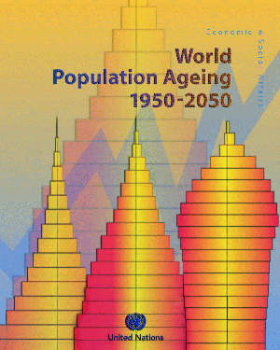

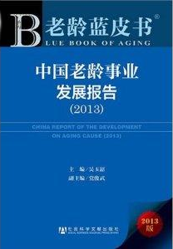
Population explosively increase in China
1960-2030: Population of 65 yr above in China
(40M)
2010-40 aging rate and # elderly
in China increases double！
(13M)
% of 65 yr people in whole populations
1964
1982
1990
2000
2010
2013
2020
2030
Aging becomes social and economic problems in China！
www.stats.gov.cn/tjsj/ndsj/2013/html

Slide 3


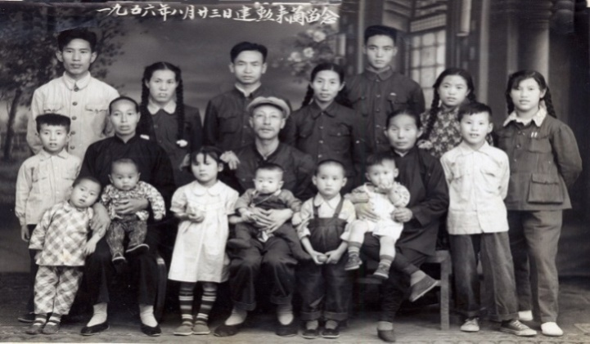
Healthy aging is significant in society and of China
Frequency of chronic disease(%)
2013 annual report of China
70
Life quality in elderly decrease
Family burden increase
Social need increases
Medical cost increases
Medical cost of
each person
2
50
3~4 times
1.5
2.5 times
30
1
10
0.5
Old
Mid/young
Old
Mid/young
Healthy aging
Notes:
由于计划生育政策和中国社会的进步，中国人均寿命已达76岁。中国在2002年就进入了少子化社会（14.03%），14岁以下人口占总人口的比例在15%以下。2002进入严重少子化12.86%（13%以下）
近80%的老年人患有慢性病，老年人医疗费用的开支是中青年人的2.5倍以上。给老人及其家庭和社会带来极大负担。因此，实现健康老龄化具有重大社会意义。
世界卫生组织2014年9月15日在日内瓦发布《2013世界卫生统计报告》提供的数字，日本、瑞士、圣马力诺三国人均寿命最高,为83岁，其次为澳大利亚、冰岛、芬兰、以色列、新加坡等国，为82岁。非洲的布隆迪、喀麦隆、中非、莱索托等国，人均寿命则只有50岁左右。中国人的人均寿命为76岁,高于同等发展水平的国家。报告显示,高收入国家的平均寿命为80岁,中高收入国家为74岁。所以,中国的人均寿命应排在中高收入国家之上。如果按性别划分,中国女性平均寿命是77岁,男性是74岁。
世界卫生组织(WHO)2015年5月13日发布了2015年版《世界卫生统计》报告。报告指出，从总体上看，截至2013年，全世界人口的寿命都较以往有所增加，其中日本为最长寿国家。中国在此次报告中的人口平均寿命为：男性74岁，女性77岁。
报告指出，到2013年为止，全球人口平均寿命为71岁，其中女性73岁、男性68岁。而这一数据与1990年出生婴儿的预期寿命相比，都各增长了6岁。而平均寿命最高的国家和性别分别为日本女性(87岁)和冰岛男性(81.2岁)。此外，2013年日本人平均寿命为84岁，蝉联全球第一。
实现“健康老龄化”，减少医疗费用支出，延长老年人劳动寿命，开发利用老年人才资源。

Slide 4
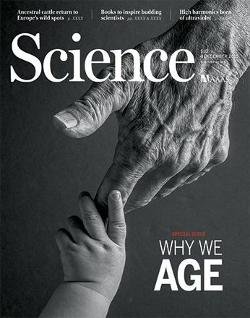

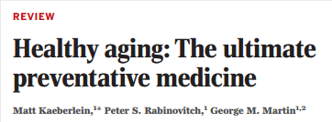
Healthy aging causes attention in international society
The Age Special Issue in Science thinks
“Prevention of diseases is the best way to maintain healthy aging

Slide 5






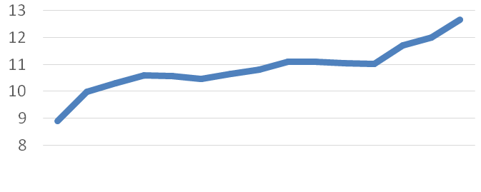
Investment on healthy aging in the world
1.267billions dollars
2002
890 millions of dollars
HORIZON 2020
2013
2016
J. Craig Venter. 公认的21世纪世界顶尖科学家，在基因组方面做出大量卓越的工作
Population
7.5 billions of Euro
September, 2014 announces to invest
1.5 billions of US dollars
Studying aging and related disorders
April, 2014 announced 220 millions of US dollars
Notes:
美国、欧盟等国家也在积极部署。美国于40多年前（1974年）成立了国家衰老研究所，40多年来每年资助约10亿美元用于衰老研究。欧美于2014年注入74.72欧元用于6年的相关研究。谷歌公司2014年宣布投入15亿美元用于开发相关项目。美国的长寿公司募捐了3个亿美元用于衰老与长寿研发。Aging is the single biggest risk factor for virtually every significant human disease... To solve the diseases of aging by changing the way medicine is practiced.
国际社会高度重视“健康老龄化”研究
美国和欧盟相继投入大量资金支持衰老和老年医学研究。美国国立卫生研究院1974年成立衰老研究所，每年都有10多亿美元支持。欧盟地平线2020也拨出75亿欧元开展相关研究。去年谷歌投资15亿成立独立公司，专注研发与衰老及其疾病相关的产品和服务。

Slide 6
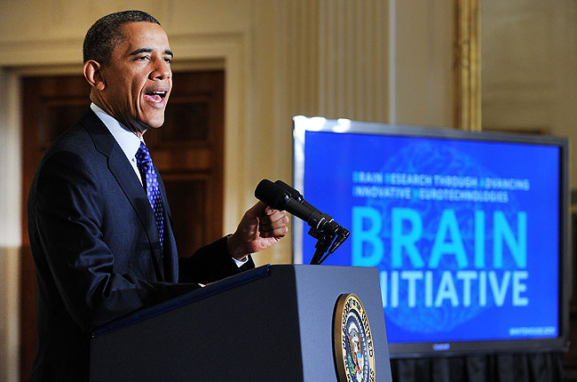



“Brain Initiative” in the world
US: The brain connectom，tools for neural circuits
Europe: Draw maps of brain functions, structure and networks, understanding and protection of the brain
Japan: neural circuit
in the monkey brain

Slide 7

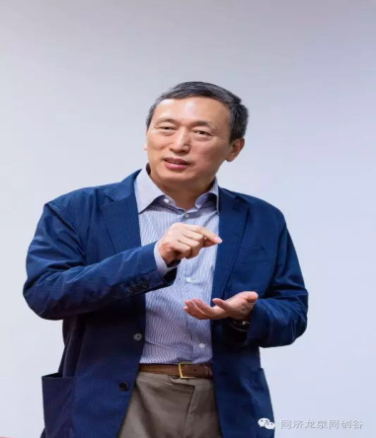
China Brain Initiative
Understand neural basis of cognitive functions
Develop brain-machine intelligence technologies
Develop effective approaches in early diagnosis/interventi
on of brain disorders
Develop brain research technolody platforms
Professor Gang Pei
“One body two wings”
Building the core and developing the applications
Frontiers of science and cutting edge of technology
Budget: 10 Billion US dollars before 2030

Slide 8
China Aging and Alzheimer’s Disease Initiative (CAADI)
AI and brain science
Brain disorders
  Alzheimers disease, depression and autism
  Molecular, synapse, elctrophysiology
New technology
AI big data and
Neuronscience
Using multi-mode big
data provide prediction
and Interfere techniques
for brain disorders
Material science and neuroscience
  USTC and material science institution
  Brain circuit imaging
  Single cell proteomics
  Brain chemical maps
Material science national
Laboratory at micro-scale levels
30 Billions of RMB

Slide 9
The organization structure of CAADI
Steering Committee
Policy Advisory Board
Scientific Director(PI)
Scientific Advisory Board
Clinical Core
Genetics Core
Senior Community
Imaging Core
Biomarker Core/data
Neuropath Core
PI laboratories
Translational Core

Slide 10
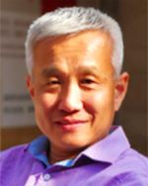
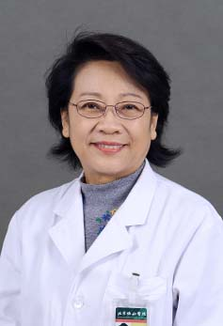
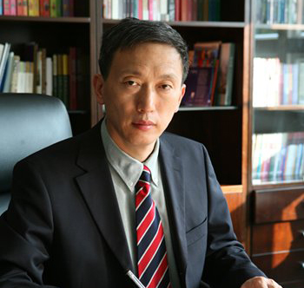
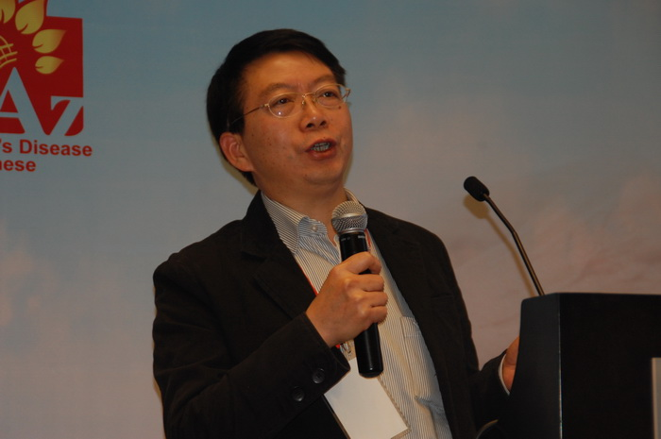
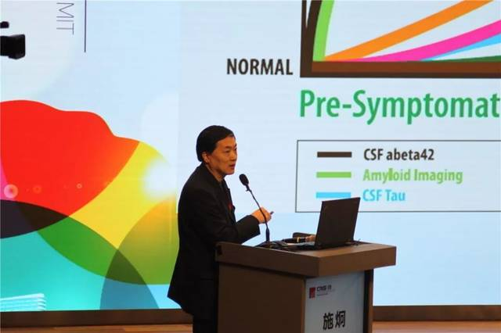
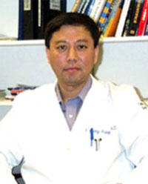
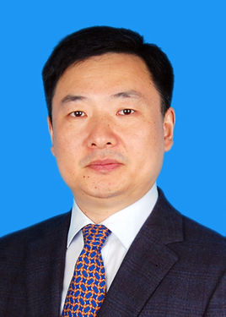
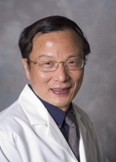
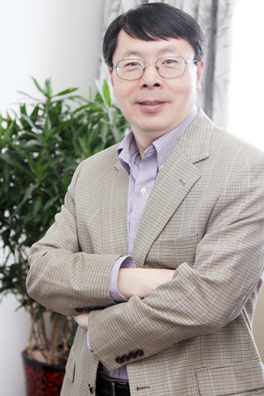
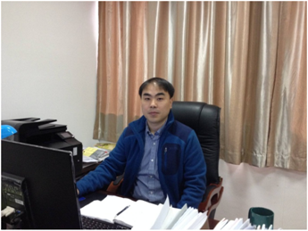
Council members of CAADI
Yong Shen,
NDRC, USTC
Liying Cui,
Pek Union
Hospital
Gang Pei,
Shanghai Insti LifeSci
Shifu Xiao,
Shanghai MentalHealt Ct
Jiong Shi,
Neurology
Tiantan Hospital
Yizheng Wang,
Natl Key Lab of Neuroscience
YanjiangWan
3rd Chongqing Hospital
Jing Zhang,
Peking University Sch Medicine
Jiahong Gao
PekUniversity
Qiang Liu,
NDRC, USTC

Slide 11
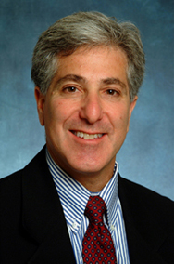


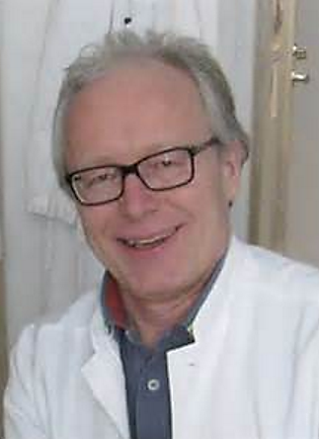

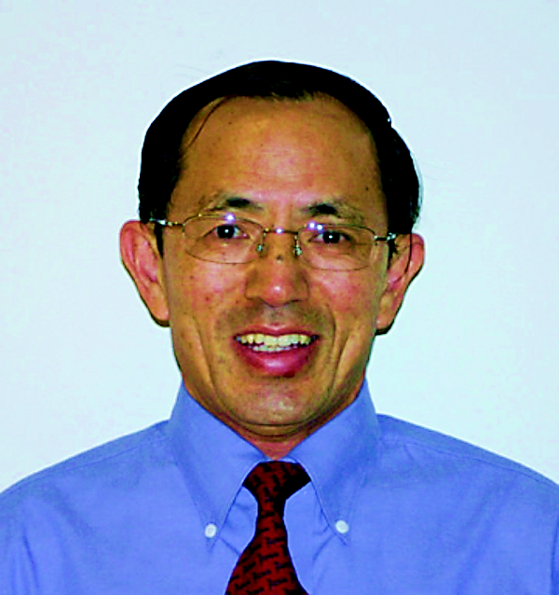
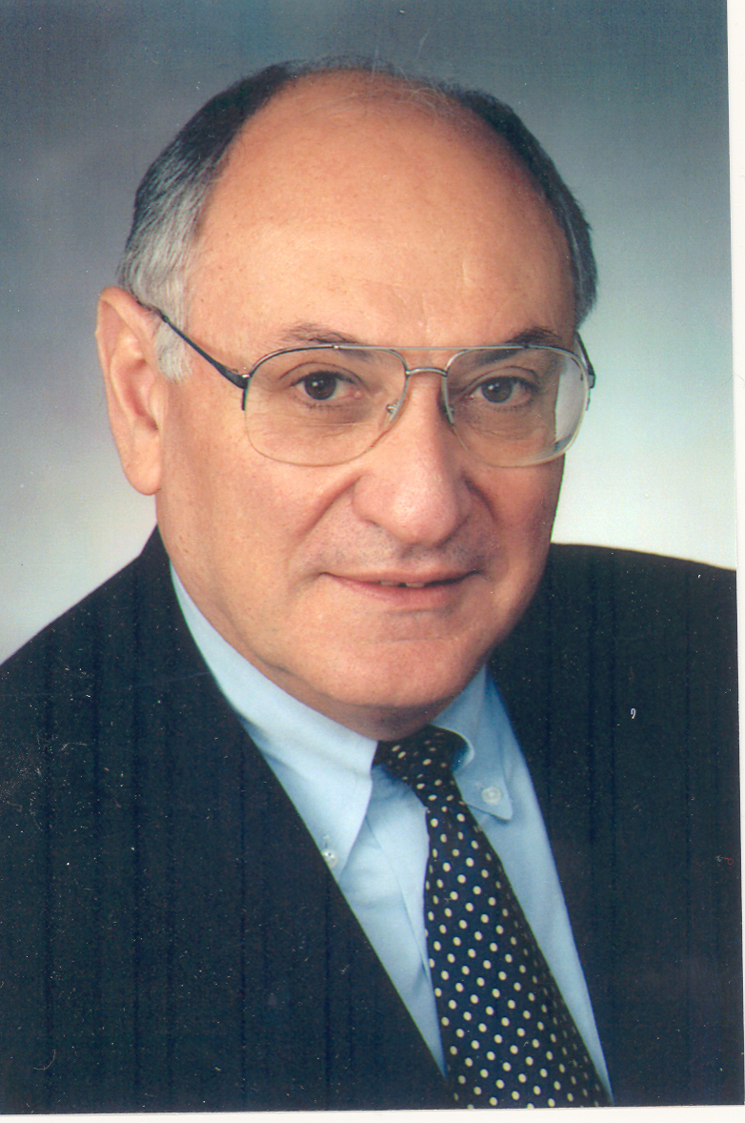
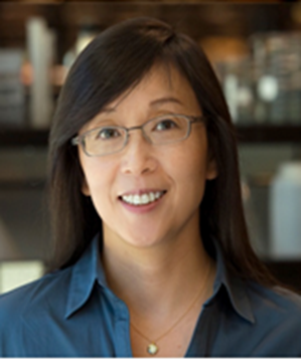
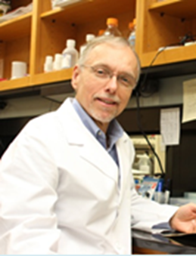
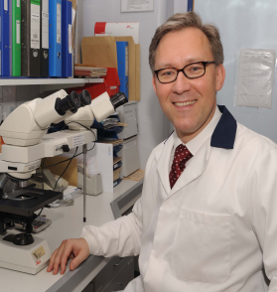
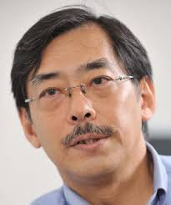
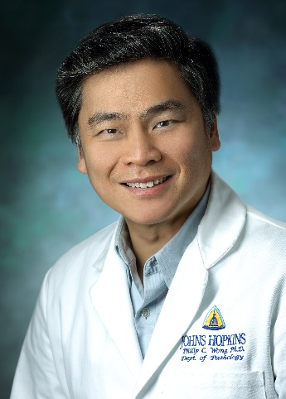
衰老的生物学基础与干预策略—保障措施
Scientific consultant members of CAADI
Allan I Levey
Neurology
Emory Univ.
Virginia Lee
Biochemistry
Univ PennMe
John Trojanowski
Pathology
UPennMedSch
Seppo Meri
Immunology
U Helsinki
Tony Wyss-Coray
Geriatrics
Stanford Univ
Hank Kong
Radiochemistry
Univ. Penn
Zaven S. Khachaturian
Alzheimer’s & Dementia
Li Gan
Neuroscience
UCSD
Robert Vassar
Mol Biology
Northwest Univ
Harald Hampel
Psychistry
Paris Univ
Takeshi Iwatsubo
Neurology
Tokyo Univ.
Philip Wong
Neuroscience
John Hopkins

Slide 12
Basic principles
Limited goals
Identify what the critical scientific questions in aging and related degenerative disorders are and select a few of them to tackle.
Stable support
Stably support research teams with focused directions
Collaborations
Collaborate different disciplines of medicine, chemistry, physics, engineering, computation on ideas and technologies.
Integration
Integrate all efforts and focus on molecular or cellular mechanisms of aging and degeneration.
Frontier breakthrough
Integrate the strenth of research teams to tackle couple the most difficult issues or hot-sports and make breakthrough.
Sharing and development
Create sharing and collaborative atmosphere: sharing ideas, resources, platforms, integrated technologies for successful conversion of frontier medicine to clinical practice.

Slide 13
General mission and goals of CAADI
General scientific mission：
Clarify cellular and molecular characteristics of organ aging and degeneration.
Elicidate regulative mechanisms of conversion of aging to degeneration.
Establish understanding and strategic plan for pathogenesis and progress age-related disorders.
Milestone goals:
Discover molecular switch of aging and degeneration
Determine the imitative factors of conversion of organ aging to degeneration.
Elucidate regulative mechanisms of aging and degeneration in age-related degenerative disorders and develop a strategic plan.
Notes:
13

Slide 14
Critical issues on aging and degeneration
Basic characteristics
Specific molecular markers for aging and degeneration
Environment factors
Internal and external environment factors that drive healthy aging to degeneration
Regulate modes
Regulative models of conversion of aging to degeneration and related disorders.
Notes:
具体地讲， 在“基本属性”方面，我们将集中研究“器官衰老与变性的特异性分子标志物”； 在“环境因素”方面， 我们将研究“驱动 xx”; 在调控模式方面，我们将研究“器官衰老向xx”

Slide 15
Steps towards to success
01
The program will support for 6-8 years
The first half of the program will support small/pilot studies, later will support major grants
02
The major part of the program will be major grants with integrated major grants, like PPG.
03
The program is composed of:
pilot grant, major project, integrated projects.
04

Slide 16
National Science Foundation of China
Major Project:
“Mechanisms of Organ Aging and Degeneration”
(2016-2024)
250 millions of RMB
(approximately 45 millions of US dollars)
Yong Shen: Chief Scientist (PI) and Chair
Scientist Advisory Committee

Slide 17
Ministry of Science and Technology of China
Major projects on chronic disease prevention
Mechanisms of cerebral small vessel diseases and clinical evaluation technologies
(12.5 Millions of RMB)
Chief Scientist (PI)： Yong Shen
University of Science and Technology of China
Basic research (5 institution): USTC, Fudan Univ. Institute of Genetics,
Hefei Martial Science Institution
Clinical research (9 Institutions): Beijing Union Hospital,、Beijing Tiantan Hospital, Shanghai Huashan Hospital, Huaxi Hospital, Wuhan Tongji Hospital, Nanjing Gulou Hospital, Changchun Hospital, Chongqing 3rd Hospital, Zhejiang 2nd Hospital
Notes:
各位专家，下午好，我是申勇，来自中科大。汇报的题目为：脑小血管病发病机制及临床评估关键技术研究

Slide 18
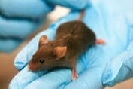
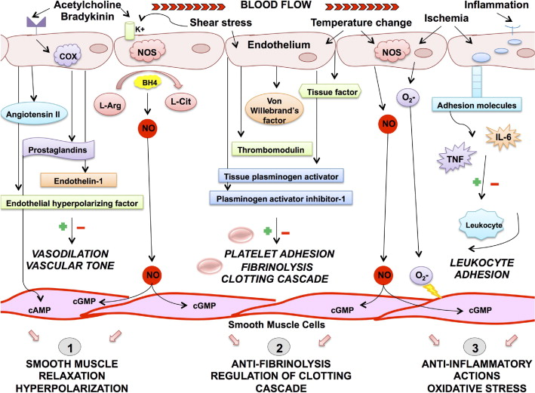


General goals and aims
Goals
Project aims
Aim1-Animal models：Models of endothelial and hypertension injuries and Aβ
Aim2-Pathogenesis：Elucidate roles of Aβ and molecular pathways in endothelial cells and injuries in CSVD
Elucidate mechanisms of CSVD
Identify biomarkers of CSVD
Establish evaluation system of CSVD
Aim3-Translation：search biochemical and imaging biomarkers
Aim4-Sectional:
Aim5-Community longitudinal research：
Validate the correction, sensitivity and specification from above examinations: search for early diagnostic biomarkers and set up community platforms.
Notes:
我们的总体目标是阐明脑小血管病的发病机制，获得生物标志物，建立定量化诊断和评估体系。通过五个课题来完成这一目标，从新动物模型的建立，发病机制的研究，转化研究到临床横断面和纵向研究。

Slide 19




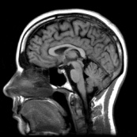

General technical flow
Clinic issues
National 9 A-hospitals
Animal models
pathogenesis
vessel BACE1
endothelial ADAMTS13-VWF
other vessel molecule passthways
collection
Imaging techniques
sectional hospital
patients
longitudinal：community elderly or high-risk populations
Clinical diagnosis and evaluation system
biochemical markers
imaging
markers
validation
Sample bank
collection
Notes:
这是我们的总体技术路线，从临床发现问题，到动物模型建立，再进行发病机制的研究，从而产生了生物标志物，走向临床进行验证，最终建立临床诊断及预警预后评估体系。

Slide 20
Chines Academy of Sciences (CAS):
Advanced medial research program in aging
Major steps of “Advanced Medical Research in Aging
Establish
the program
Formal
acceptance
Application
Pilot grant
Review
Done
Done
12millions
In 1 year
Strong
competition
250millions
For 5 years
1:2 match from local government to reach 500millions；
If we receive this support from CAS, we will fully support outstanding scientist in aging in CAS and China.

Slide 21
总体目标-“衰老的生物学基础与干预策略”
Advanced medial research program in aging
Supported by CAS
5 outstanding directions of Advanced medial research program in aging
Develop new technologies that can apply in aging
Dissect mechanisms of conversion of aging to degeneration
Elucidate molecular basis regulation of healthy aging
Make early diagnosis and prevention of degenerative diseases
Identify therapeutic targets to neurodegenerative diseases.

Slide 22

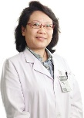
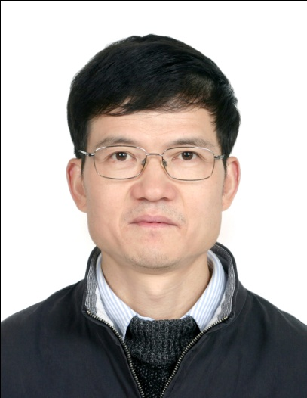
五个研究方向的相互关系
Chines Academy of Sciences (CAS):
Advanced medial research program in aging
Project 1
Genetics and epigenetics in aging
Project 4
Project 3
Project 5
Neuroimmune basis
of brain aging and degenerative diseases
Early diagnosis and prevention of age-related degenerative diseases
New tech and methods applying for aging
Project 2
Cell metabolism in aging and environment

Slide 23
顺义研究
社区人群队列
2013-2017年：失访5例，死亡54例
新发疾病：脑卒中49例；心肌梗死15例；糖尿病80例；高血压病 137例；高脂血症41 例
新发痴呆：已完成认知功能随访复查，目前正在进行新发痴呆诊断
1844例
遗传与环境因素与认知功能和运动功能减退、新发痴呆和其他神经系统疾病、新发卒中和其他心脑血管病及死亡的相关性和预测价值
脑血管、脑结构改变对认知功能和运动功能减退、新发痴呆和其他神经系统疾病、新发卒中和其他心脑血管病及死亡的相关性和预测价值
随访研究
2017年
持续随访研究
问卷病历记录
体格
检查
生物
标本
辅助
检查
死亡及死亡原因
新发痴呆和其他疾病
日常生活能力
用药
血、尿、粪便
生化、激素、维生素
新的生物标记物测定
cDNA
头颅MRI复查
应用新的非干扰、定量化神经功能评价工具检查
人体测量
血压
骨关节
神经系统
认知测试（1次/3年）

Slide 24
二、痴呆疾病队列2018年度
依托已建立的多种类型痴呆疾病队列，重点研究以下问题：
不同类型痴呆患者（AD、LBD、FTD、脑白质病伴发痴呆）脑脊液A ß 42、Ttau、Ptau以及比值的差异；
MMSE正常的痴呆患者认知功能障碍特点
APOE4基因携带者的认知功能障碍特点以及影像变化特点
血流灌注与FDG-PET 在不同类型痴呆患者中的差异

Slide 25
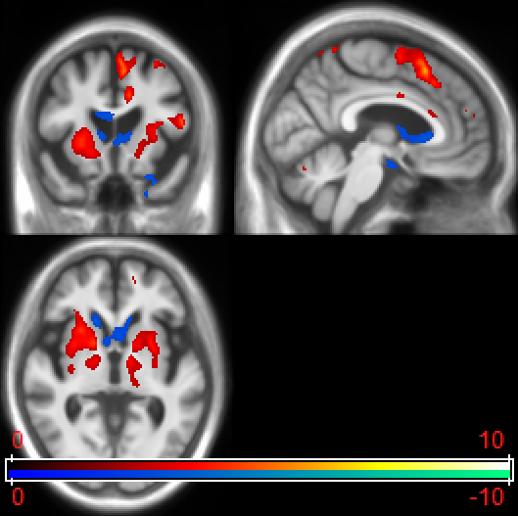
不同类型痴呆的生物标记差别
Dr. Jing Gao from Peking Union Hospital
LBD
AD
痴呆伴脑白质病
FTD
ALS
已有 痴呆患者数据库 2000例+
已有 痴呆患者认知评价数据库3000人次+
已有 认知障碍人群功能磁共振700人次
已有 痴呆人群FDG-PET数据300份 +
已有 认知障碍人群基因研究用血2000份+
已有 痴呆以及对照人群脑脊液生物标记数据100+

Slide 26
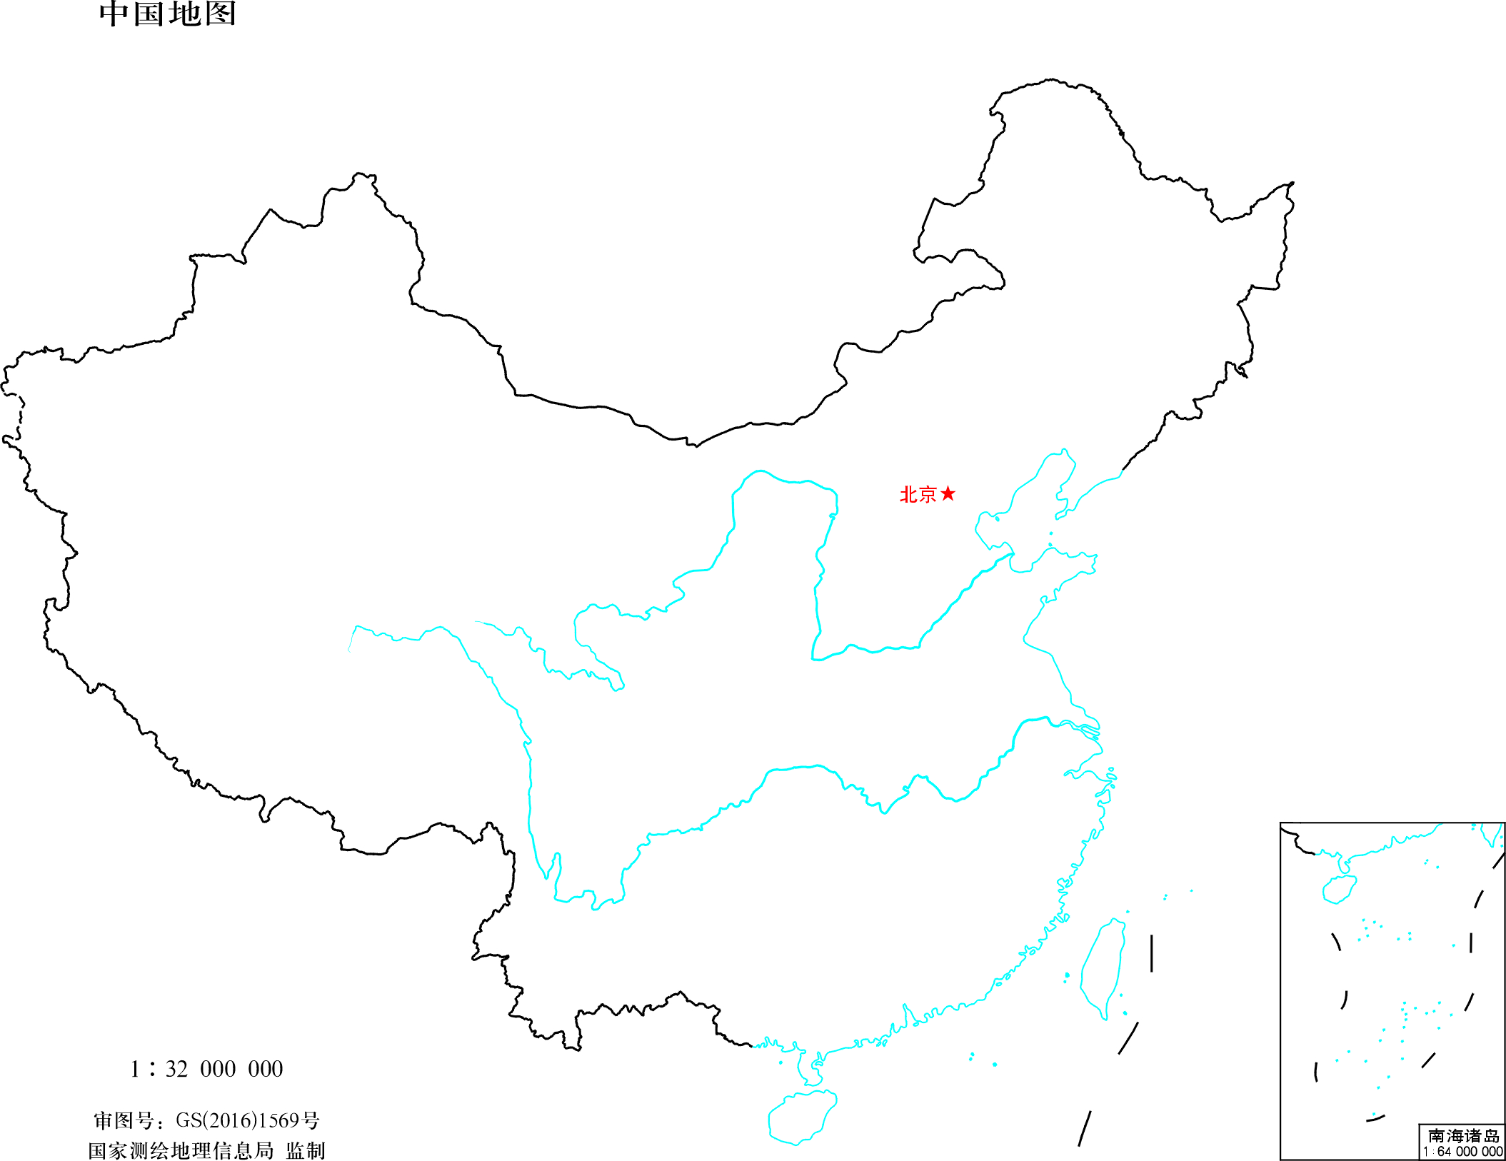
Why is CAADI in Hefei?

Slide 27
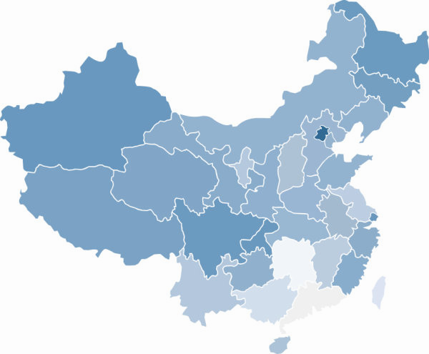
China Aging and Alzheimer’s Disease Initiative (CAADI)
Changchun
Beijing
Xi’an
Nanjing
Chengdu
Hefei
Shanghai
Hangzhou
Kunming
Guangzhou

Slide 28

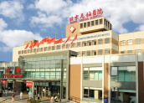

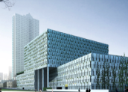

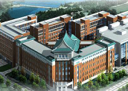

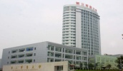

CAADI Resource：multi-centers hospitals
Beijing Union Hospital
Beijing Tiantan Hospital
Shanghai Huashan Hospital
Nanjing Gulou Hospital
Chengdu Huaxi Hospital
Jilin Bethiun Hospital
Wuhan Tongji Hospital
Chongqing 3rd Hospital
Hangzhou1 2nd Hospital 院
Notes:
参与本项目主要的这9家医院都是全国一流的三甲医院。

Slide 29
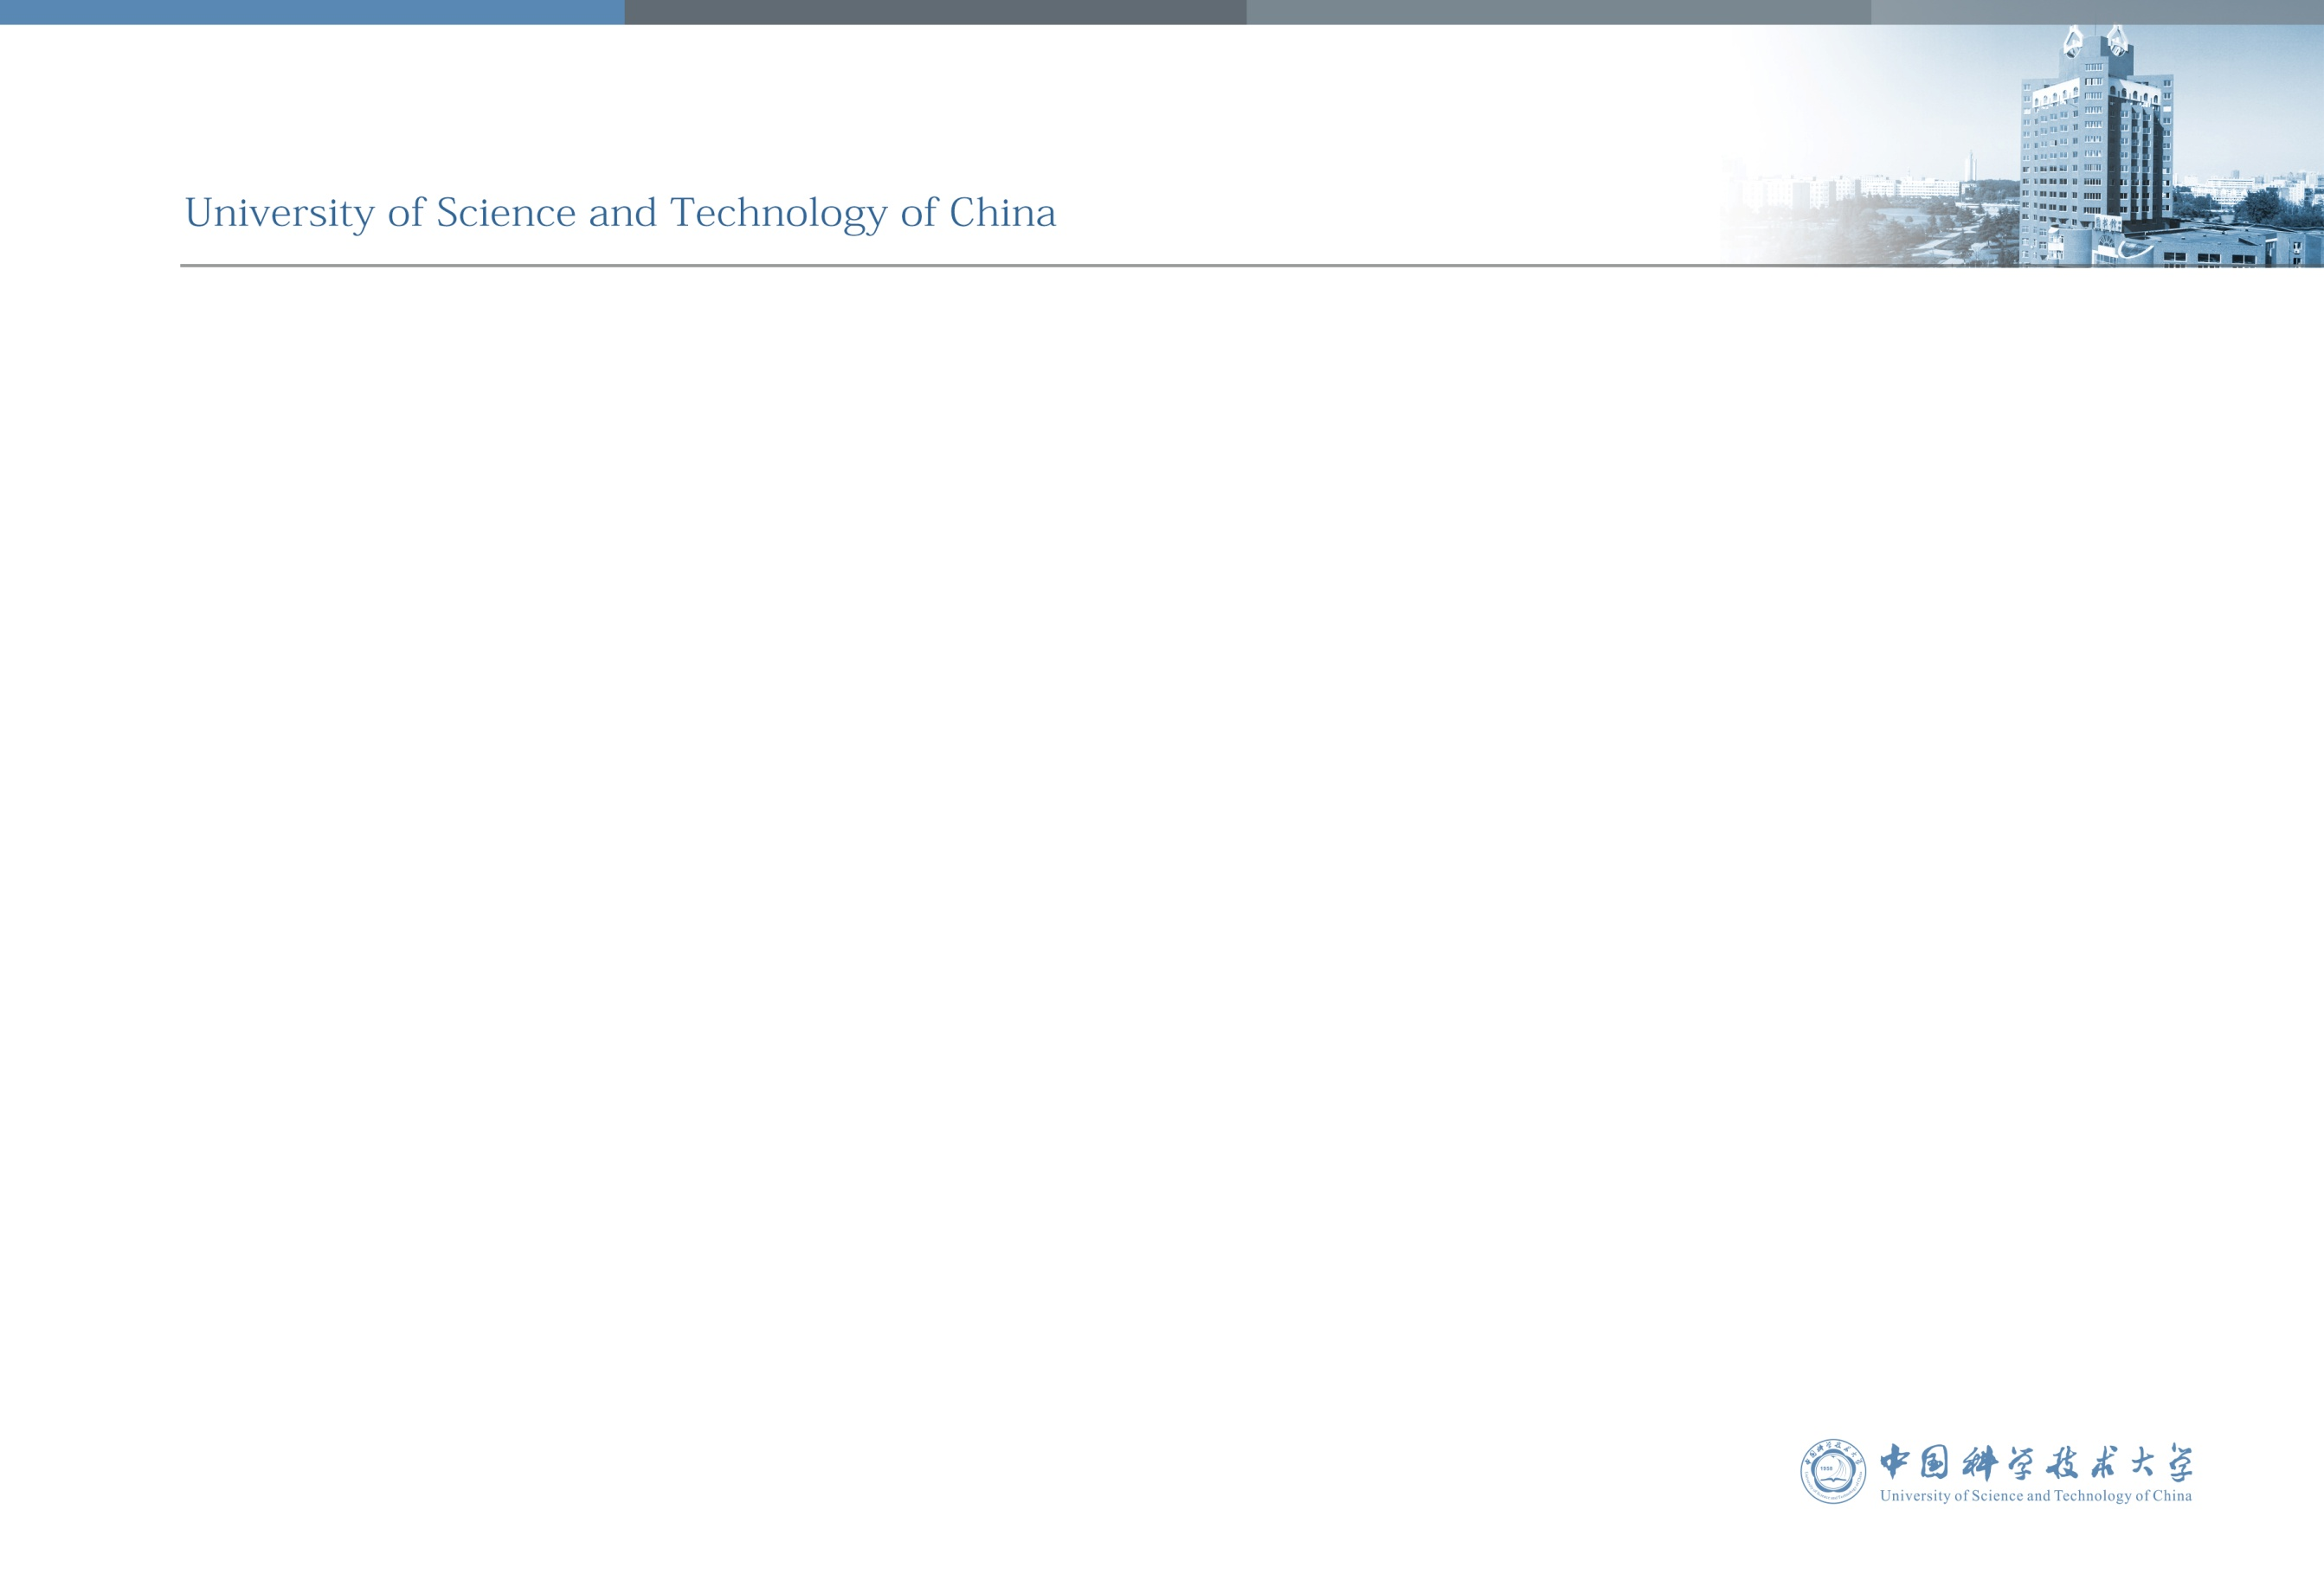
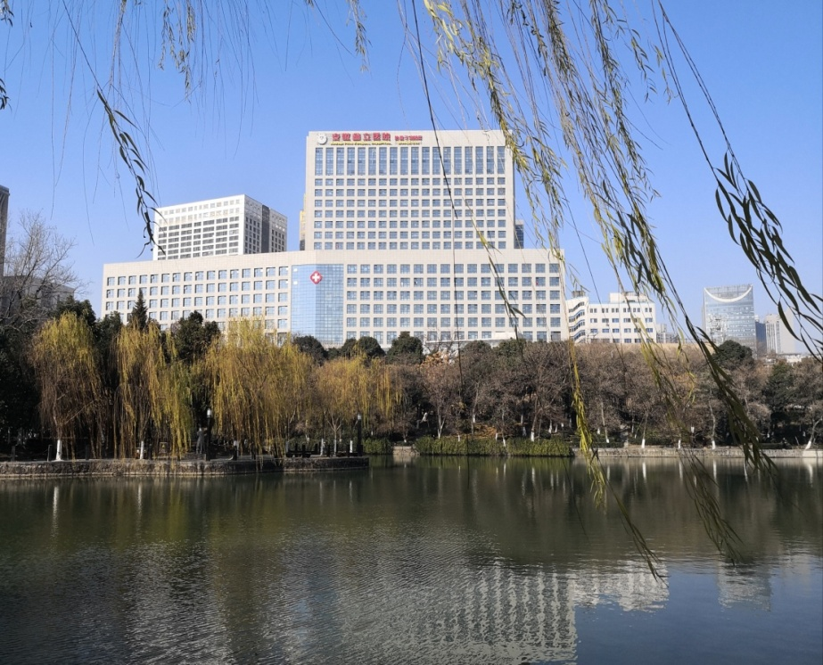

The hospital in Hefei with USTC
6 districts, 5,450 beds
maximum of 17,000 outpatient visits a day
discharges 176,000 patients on yearly average
Advanced medical equipment: PET-CT、TOMO
The first Smart Hospital in China
Planning to construct a Pre-Hospital for clinical research

Slide 30
Top 10 largest hospital in China
Full-scale services
Headquarter：2445 beds，33 clinical disciplines, 17 medical technical disciplines. General hospital.
South district (Anhui Provincial Cardio-Cerebral-Vascular Hospital): 2000 beds. Cardio-cerebral-vascular treatment and clinical college center.
The First Affiliated
Hospital of USTC
West district (Anhui Provincial Tumor Hospital)：1100 beds.Tumor prevention and treatment center.
North District(under construction): 1800 beds. Research centre and international medical transformation center.
USTC-FAH has 7.72 million square meters construction area, 5545 beds, the scale ranks top 10 in China, and has advantageous technologies in aspects of cardiovascular, cancer, geriatric medicine,neurosurgery etc.
Geriatric Medicine and RehabilitationCenter(under construction)：6000 beds, Geriatric rehabilitation center.
Infectious Diseases Hospital: Health emergencies center and infectious diseases center in Anhui province.

Slide 31


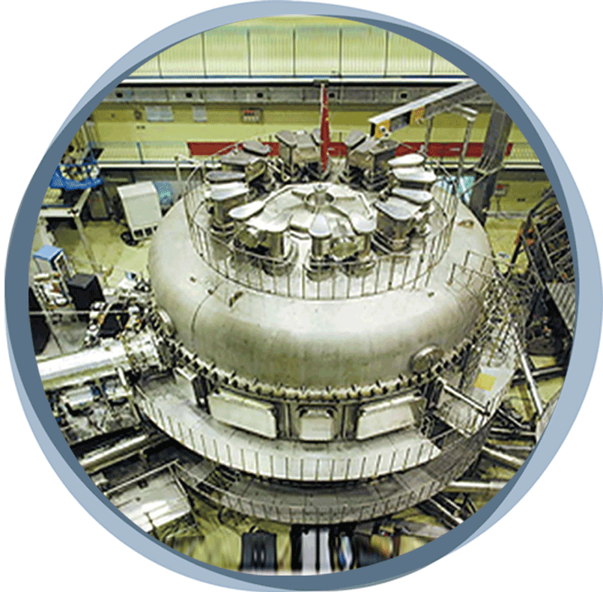
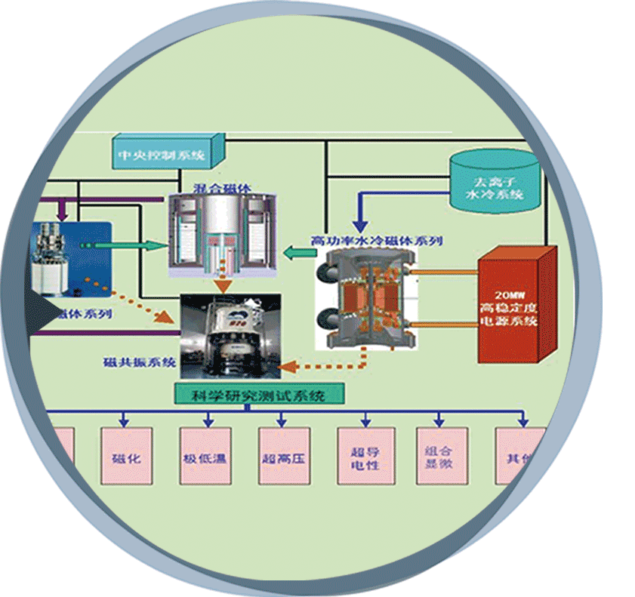
FACILITY EXCELLENCE
Hefei City is one of the only three Comprehensive National Science Centers in China, other than Beijing and Shanghai.
USTC is one of the most important innovation center in China operating national level labs and national scientific large facilities.
The National Laboratory for Quantum Information Science has been kicked off last year.
Experimental Advanced Superconducting Tokamak
National Synchrotron Radiation Laboratory
(NSRL)
Experimental Facility of Stable High Magnetic Facilities
Hefei National Center for Physical Sciences
at Microscale (HFNL)
Notes:
In 2017, China central government launched a major project to build a comprehensive “Hefei National Science Center” (to be completed in year 2020).
This National Laboratory will be built as the style of United States Department of Energy, and will focus in the area of study based on the idea that information science depends on quantum effects in physics.

Slide 32







衰老的生物学基础与干预策略—保障措施
China Aging and Alzheimer’s Disease Initiative
中国科学院天然免疫与慢性疾病重点实验室
神经科学国家重点实验室
分子发育生物学重点实验室
膜生物学国家重点实验室
新药研究国家重点实验室
中科院干细胞生物学重点实验室
中科院脑疾病与脑功能重点实验室
Supports from 4 State-Key Laboratories and CAS-Key Laboratories

Slide 33
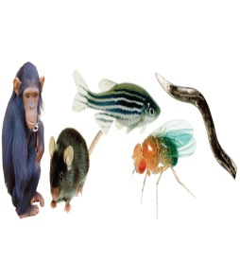
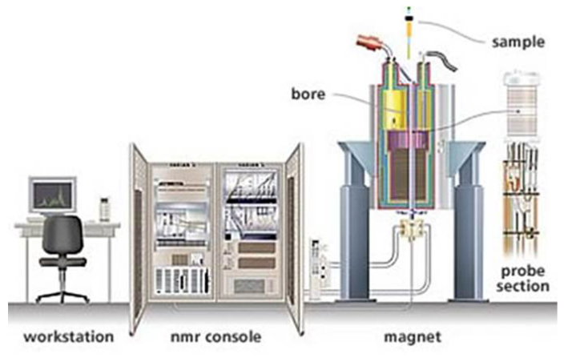
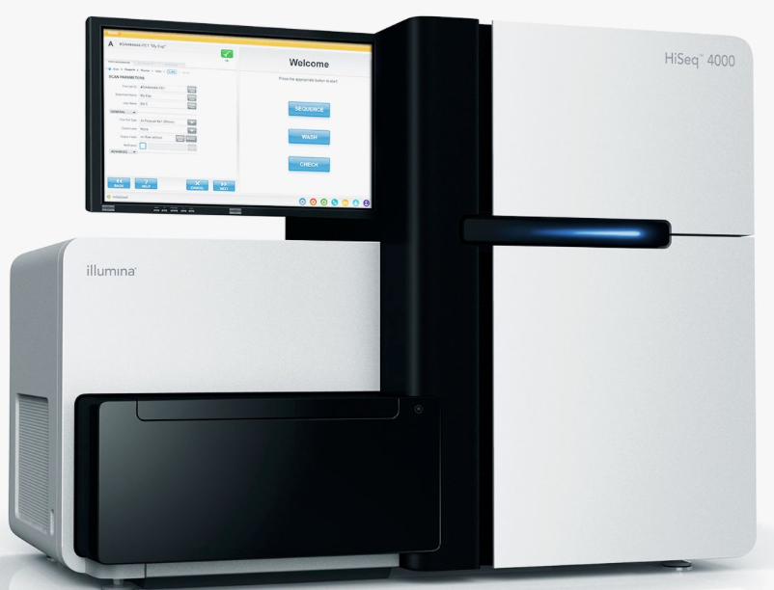
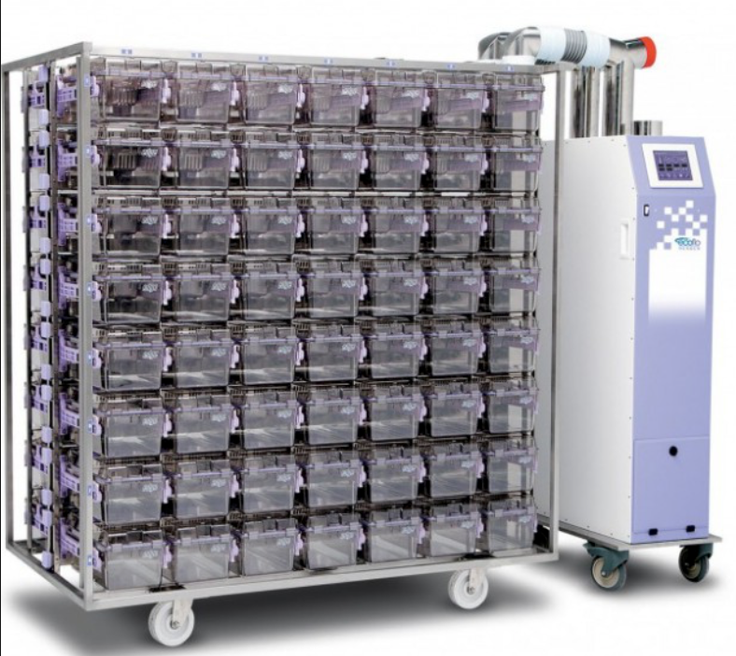
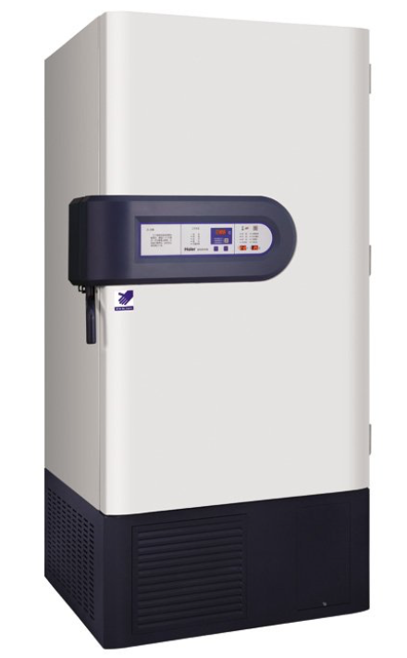
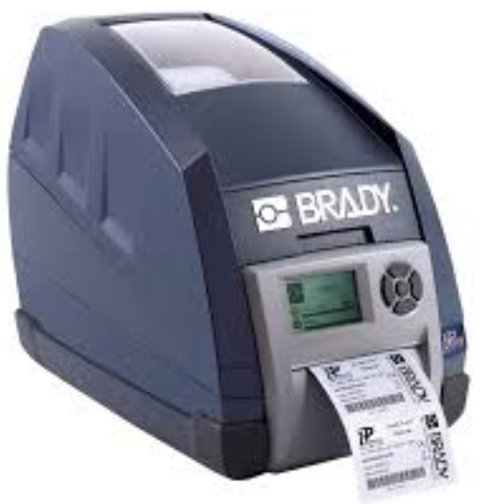


衰老的生物学基础与干预策略—保障措施
CAADI is supported by three national science centers in China
Epigenomic
platform
Single cell
Sequencing
platform
Animal model platform
Drug screening
platform
Brain bank
platform
Supports are also from Beijing Comprehensive National Science Center, Shanghai Comprehensive National Science Center and Hefei Comprehensive National Science Center.

Slide 34
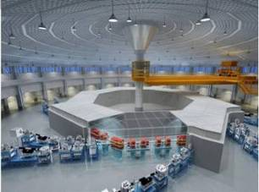


地缘优势：合肥大科学综合区
HEFEI COMPREHENSIVE NATIONAL SCIENCE CENTER
National Synchrotron Radiation Laboratory
Material Science at micro-scale National Science Center
Hefei Comprehensive National Science Center
Chinese Academy Of Sciences

Slide 35



    CAADI is supported by national platforms
National or CAS Key labs
Aging Research Center
National Synchrotron Radiation Laboratory
National research center for microscale material science
National key laboratory of brain and cognitive science
National key laboratory for biological macromolecules
CAS institute of genetics and developmental biology
Institute of Biophysics Research Center for Aging
Key laboratory of behavioral sciences
CAS Key Laboratory of Brain Disease Hospital and brain function
National key laboratory of neuroscience
National key laboratory for new drug research
National key laboratory of cell biology
Key laboratory of brain function and disease
Key laboratory of the primate neurobiology
USTC affiliated hospital geriatrics
USTC aging neurological disease research center & brain bank
USTC affiliated hospital geriatrics rehabilitation center
Animal models and human diseases
Key laboratory of mechanism
USTC affiliated hospital Institute of geriatrics
Notes:
这些国家级重点实验室分布在全国各地，另外还有各地的专业从事衰老研究的中心及院所、如

Slide 36




RESEARCH EXCELLENCE
Iron-Based High Temperature Superconductor
Superconductivity at 43 K in SmFeAsO_{1-x}F_{x}first time broke Mcmillan Limit
Winner of China’s first prize for natural science in 2013
Nano-Materials
Synthesis & Self-assembly
Biomimetic Nano-materials & Energy conversion
Fire Safety Science
Building & Industrial Fire, Wildland & Urban Fire
Fire Risk Assessment, etc.
Speech Synthesis and Language Information Processing
Big Data
Artificial Intelligence

Slide 37
University Reputation
TOP 100
QS World University Rankings 2017/18
TOP 3
Best global universities in China
U.S. News Rankings 2018
TOP 3
in Mainland China
THE Asia University rankings 2018
4
Disciplines in ESI’ s
world top 0.1% (March, 2018)
Physics, Material Science, Chemistry, Engineering
13
Disciplines in the world’s Top 50
ARWU Subject Rankings 2017
Physics, Chemistry, Mechanical ENG, Electrical ENG, telecom ENG, computer, Chemical ENG, Material ENG, Instruments ENG,
Nanoscience, Energy
Plant and & Animal Sciences
Molecular Biology & Genetics
AACSB
Accreditation
School of Management

Slide 38

TECHNICAL ADVANGTAGE: Single cell technology
Diagnostic analysis at single cell accuracy
High throughput (thousands of chemical molecules can be detected in a single neuron at the same time)
Synchronous electrophysiological function recording
Changes in the types and contents of chemical molecules under physiological activities and pathological conditions
Identify metabolic pathways within individual neurons
PNAS, 2017; Cell 2018

Slide 39


Single cell proteomic technology
Single cell proteomics
detect chemicals
PNAS, 2017
Single cell proteomics
detect glutamate involved neural circuits
CELL, 2018

Slide 40


发展单细胞器质谱
Recently we first in the world measure chemical components in single cell organ, i.e. lysosome

Slide 41





TECHNICAL ADVANGTAGE:
Synchrotron radiation photoionization spectroscopy
3D high resolution chemical pathology analysis of whole histological sample
Conventional approach： desorption,ionization carry out simultaneously
Synchrotron radiation ： desorption,ionization carry out step by step
Synchronous radiation photoionization
energy range 6～20 eV
Synchronous radiation national laboratory

Slide 42















TECHNICAL ADVANGTAGE:
Single cell sequecing+Deep learning：Precision medicine for brain diseases
Disease specificity regulatory networks
Normal vs patients
Chromatin blank site/
Active DNA transcription sites/
Chromatin adhesion non-coding RNA
Patients specificity regulatory networks
Big data
analysis platform
patients vs patients
High performance computing
ATAC-seq
Single cell-seq
PIRCh-seq
Cell specificity regulatory networks
Cells vs cells
Deep learning algorithms
High throughput
sequencing platform
ATAC-seq
Single cell ATAC-seq
Single cell RNA-seq
RIRCh-seq
Whole genome DNA
active transcription site
Whole genome DNA of single
Cell active transcription site
Single-cell transcriptome
RNA expression quantity
non-coding RNA
Occurred in a specific area of chromatin non-coding RNA
High throughput sequencing
Healthy population
Patient population
Patient population
Tissue
sample
Flow
separation
Disease samples and electronic
medical record system
Cloud computing platform
Flow separation lymphocytes
in fresh blood
Healthy tissues
Diseased tissues
T cells
B cells
T cells
B cells
Qu et al, Cancer Cell 2017, Nature Methods 2016, Cell Systems 2015, Wan and Qu et al Nature 2014
Electronic medical record system

Slide 43








TECHNICAL ADVANGTAGE:
Synchrotron radiation energy in subcellular level imaging and other spectroscopy system
Synchrotron radiation energy in subcellular level imaging
Combined synchrotron radiation energy in imaging with super resolution imaging, can accurate positioning protein, protein distribution, the cell fine structure, the relationship between organelles and cell function and neurodegenerative diseases.
Biotechnol. Adv.
31:387(2013)

Slide 44





INNOVATION OF BRAIN DISORDER RESEARCH
Brain Bank and Neurodegenerative disease Research Center
RESEARCH
Synapse and plasticity
Neural circuits and structures
Molecular mechanisms of diseases
Brain maps at the large scales
PLATFORM
  Brain bank
  Behavioral platforms
  Biomarker assay platforms
Neuroimaging and brain PET

Slide 45

Aging and AD Research Platforms in Hefei
Comprehensive National Science Center
1,000,000 square feet

Slide 46

Institute on Aging and Brain Disorders is part of CAADI
Cold room/sample prep molecular biology/biochemistry
手术样品
Cell culture
Imaging
Proteomic room
Office conference room
Part of CAADI laboratories are finished
Have collected clinical and pathological samples
Generate some preliminary results

Slide 47






Unique resource: Samples from degenerative diseases
DISEASES：AD，CAA，MCI，
PD，CT
TISSUES: 350；
CSF： 3000；
BLOOD: 5500
IMAGING MICROSCOPY:
full imaging and analyses
Neurodegenerstive Disease Research Center, University of Science and Technology of China
Notes:
2个社区，长期采样，按项目批量，专属样本管理。同时：仪器统筹，设备对接，耗材管理，财务管理

Slide 48


Unique resouse: You see what you get
Notes:
炫

Slide 49
Cross with NMR：PET/CT FDG Imaging
Combination the structure with function
GE Discovery PET/CT

Slide 50
China Aging and Alzheimer’s Disease Initiative (CAADI)
Changchun
Beijing
Xi’an
Nanjing
Chengdu
Hefei
Shanghai
Hangzhou
Kunming
Guangzhou

Slide 51




Smart Medicine in USTC-FAH
AI Assisted Diagnosis and Therapy Center
1.Artificial intelligence medical imaging aided diagnostic platform
2.Medical data integration platform
3.Cloud doctor mobile platform
4.Ultrasound intelligent voice assistant
5.Automatic dispensing system

Slide 52






Comprehensive National Science Center
National Synchrotron
Radiation Laboratory
Guest-Greeting Pine in
HuangShan
Hongzhang Li 's
former residence
National research center for
microscale material science
Hong Cun in the
south of Anhui
San He ancient town
in Hefei

Slide 53


Welcome to Hefei for scientific collaborations, enjoying Hui culture and tasting the Hui tea and Hui drinks

