Slide 1
Japanese AD Neuroimaging Initiative (J-ADNI)
2007-2018
July 20, 2018
Departments of Neuropathology,
Graduate School of Medicine
University of Tokyo
Principal Investigator of J-ADNI
Takeshi Iwatsubo
Notes:
1

Slide 2
Japanese ADNI
a longitudinal observational study for imaging/fluid biomarkers that predict/surrogate clinical progression
Using an identical protocol to US ADNI; focusing on MCI
Sapporo
7-year study (since 2007)
38 clinical sites
600 subjects
(537 enrolled)
subjects | N | follow up
early AD | 150 | 2 yr
MCI | 300 | 3 yr
NC | 150 | 3 yr
Hirosaki
Akita
Iwate
1.5T MRI
(3D MPRAGE, ADNI phantom)
PET
---FDG 63%
---amyloid PiB 35% (PiB 16 sites, BF227 2 sites)
Blood + apoE (100%)
CSF 37%
Clinical (Japanese translated Uniform Data Set)
Tohoku
Niigata
Gumma, Tsukuba, Mihara
Kanazawa
Shinshu NCNP Saitama
Kyorin
Tokyo Met Geriatric Hosp
Tottori
Tokyo Med col, Nippon Med, Juntendo, TMDU, Tokyo
Asahi/Chiba-higashi
Kyoto Kyoto Pref
Natl Longev., Hamamatsu, Kurihama, Yokohama
Okayama
Kobe,
Osaka City
Osaka, Nara
Japanese-pharma Industry Scientific Advisory Board (11)
Astellas, Eisai, Daiichi Sankyo
Dainippon-Sumitomo, Shionogi Takeda, Tanabe-Mitsubishi
Eli-Lilly, Merck-Banyu, BMS, Pfizer
Chugai, Novartis (J-ADNI2)
Kagawa
Fukuoka
Kumamoto
Public Funding from NEDO, MHLW & JST
~4M USD eq/year (2/3 public funding, 1/3 pharma)
Public-private partnership
in a precompetitive setting
Imaging company ISAB (7)
GE, Siemens, Hitachi, Toshiba
Shimadzu, Mediphysics, Micron

Slide 3
Cognitive Normal
Mild AD
Late amnestic MCI

Slide 5
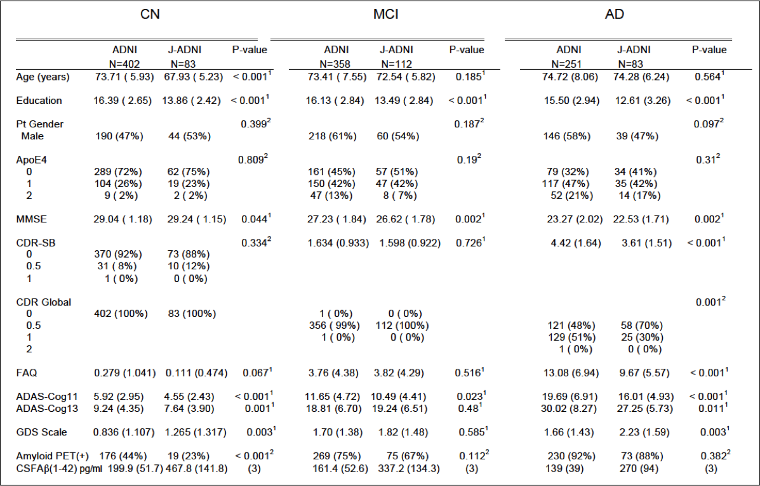
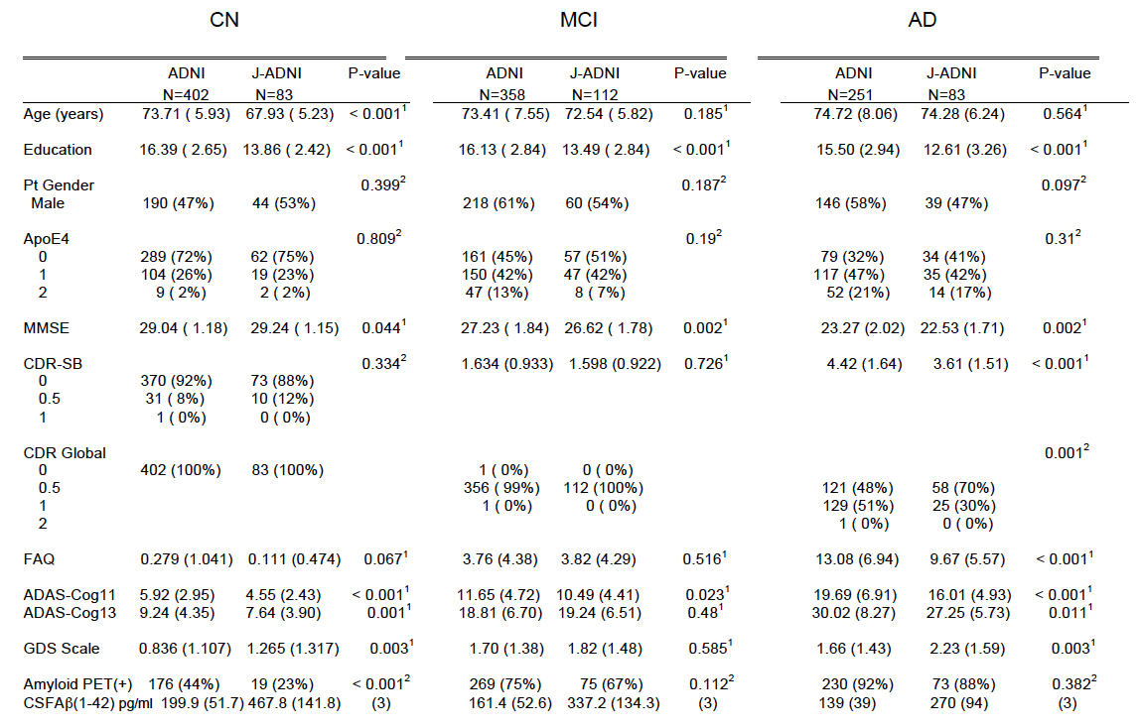
Comparison of baseline data of J-ADNI（278 cases） and US-ADNI(1011 cases） with amyloid info

Slide 6
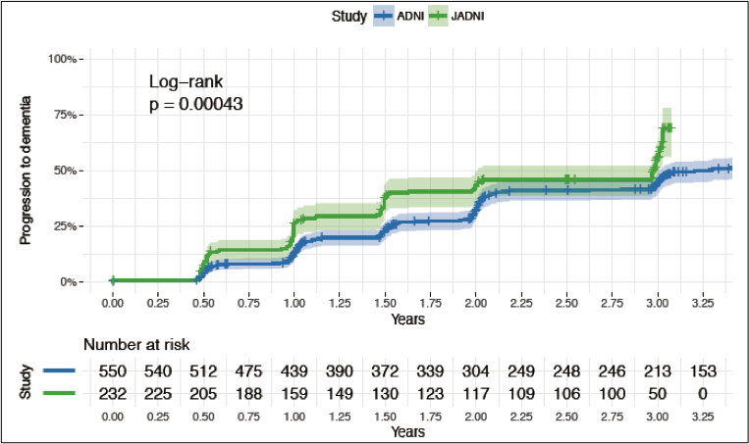
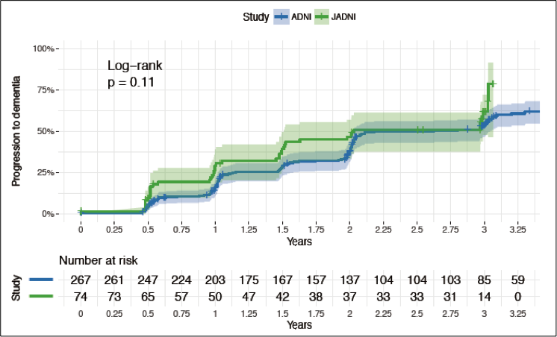
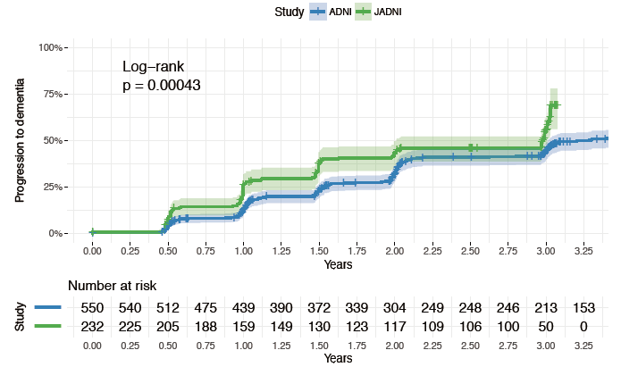
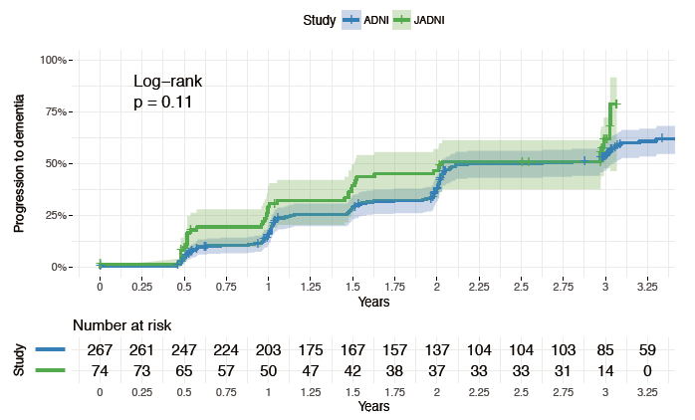
Comparison of clinical conversion from MCI to dementia in ADNI and J-ADNI
Total LMCI
Amyloid positive LMCI (prodromal AD)

Slide 7
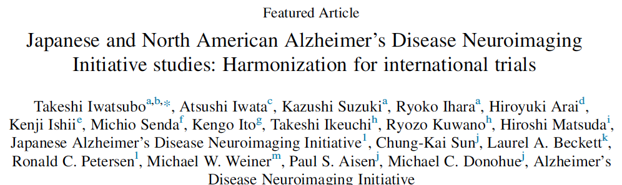

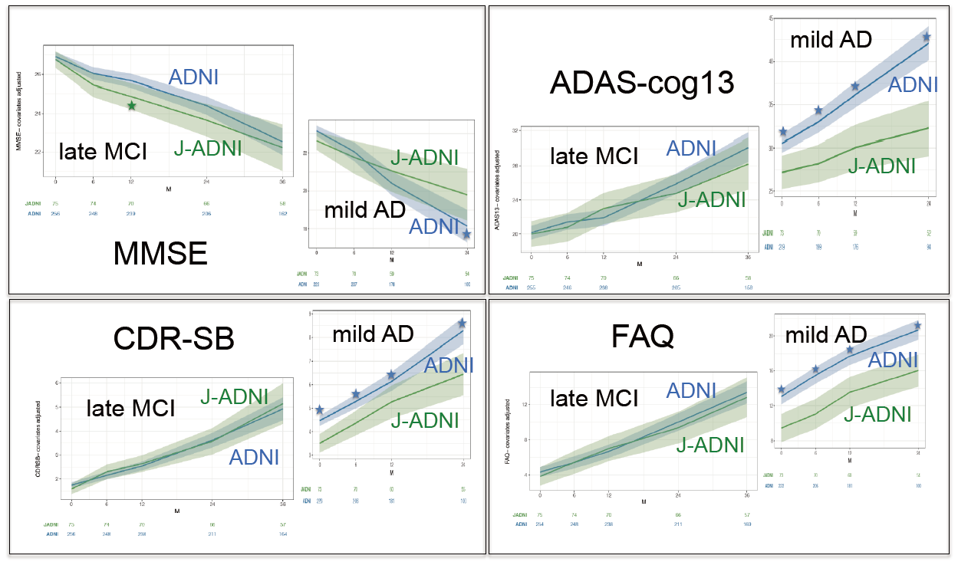
Highly comparable progression profiles in amyloid(+) late MCI
between J-ADNI and NA-ADNI (slightly milder in J-ADNI mild AD)

Slide 8
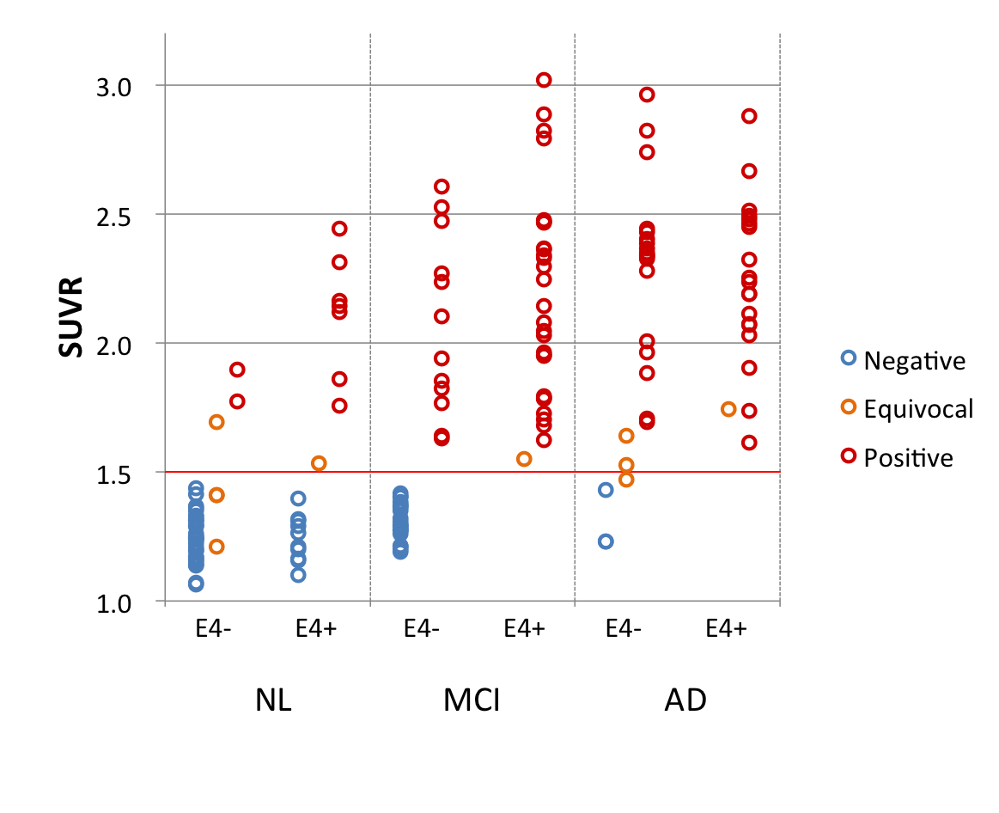
Amyloid PET and CSF biomarkers in J-ADNI
Kenji Ishii, amyloid PET core of J-ADNI
Takeshi Ikeuchi and Ryozo Kuwano biomarker core of J-ADNI
mcSUVR and PiB(+)vity by Group and ApoE4
Co-plot of mcSUVR of PiB and CSF Aβ(1-42)
ε4- ε4+
8% 55%
ε4- ε4+
41% 100%
ε4- ε4+
84% 100%
24%
66%
93%
by Visual Reads
24%
65%
90%
by mcSUVR cut off
Amyloid ＰＥＴ positivity
matches well with the low
Aβ(1-42) CSF levels）

Slide 10
J-ADNI database
Released for research use from the National Bioscience Database Center (NBDC) of JST, Japan, on Jan 29, 2016.
Available for world-wide researchers by just obtaining approval from local ethics committee and then apply to NBDC at http://humandbs.biosciencedbc.jp/en/data-use
Total number of datasets
3691 Case Report Forms
3078 Cognitive Test Worksheets
2550 Clinical Dementia Rating
2459 1.5T MRI images, 256 3T MRI images
1387 FDG PET images
594 amyloid PET images
3067 blood tests
339 CSF Aβ and tau
28 registered users (including 5 international); just connected to GAAIN!

Slide 12
Japanese Trial Ready Cohort of preclinical/prodromal AD
Preclinical AD
observational
J-DCS
Regional cohort
Care study
Outreach
enlightenment
Clinical trial/
Study infra
Screening registry function
Longitudinal cohort study
of MCI and preclinical AD
(Trial Ready Cohort）
POC trials
In PPP style
Preclinical AD
Trial e.g. A4
Collaboration
sharing
Orange Registry
IROOP (internet based
registry)
Industry initiated
Ph 3 trials
Approval
marketing
Healthy aging society
Japan Society for Dementia Research
International collaboration
Alzheimer Association, Global CEO initiative/GAP, EPAD/IMI,ACTC, ATRI, NIA…..)
AMED
MHLW, METI, MEXT
industry（ＰＰＰ）

