Slide 1

ADNI Genetics Core
Update
Andy Saykin
Indiana University School of Medicine
WW-ADNI Meeting
Chicago, IL
July 20, 2018
asaykin@iupui.edu

Slide 2
Overview
Progress and selected highlights
  Genetic biosample sets on new participants banked at NCRAD to date
  Publications of genetics studies using ADNI endophenotypes
New Mega-GWAS (including ADNI) – under review (Kunkle et al; Jansen et al)
Polygenic score approaches applied to AD and ADNI data
Metabolomics – bile acid analyses and the gut-liver-brain axis
Epigenetics – DNA methylation & telomere length project updates
Future plans
  Working with ADSP to obtain WGS on eligible participants not already sequenced
  Continued collaboration with ADMC, MODEL-AD, AMP-AD, ADGC/ADSP, ADCs.
  Systems biology and integrative analyses / machine learning

Slide 3
ADNI-3 Genetic Core Biosamples
VISIT | BUFFY COAT | CELL LINES | DNA | PBMC | RBC | RNA
Baseline | 203 | 193 | 193 | 189 | 204 | 203
Rollover | 318 | 18 | 298 | 308 | 315 | 320
Year 1 | 32 | 0 | 1 | 0 | 3 | 32
TOTAL | 553 | 211 | 492 | 497 | 522 | 555
New in ADNI-3
* Updated July 5, 2018

Slide 4

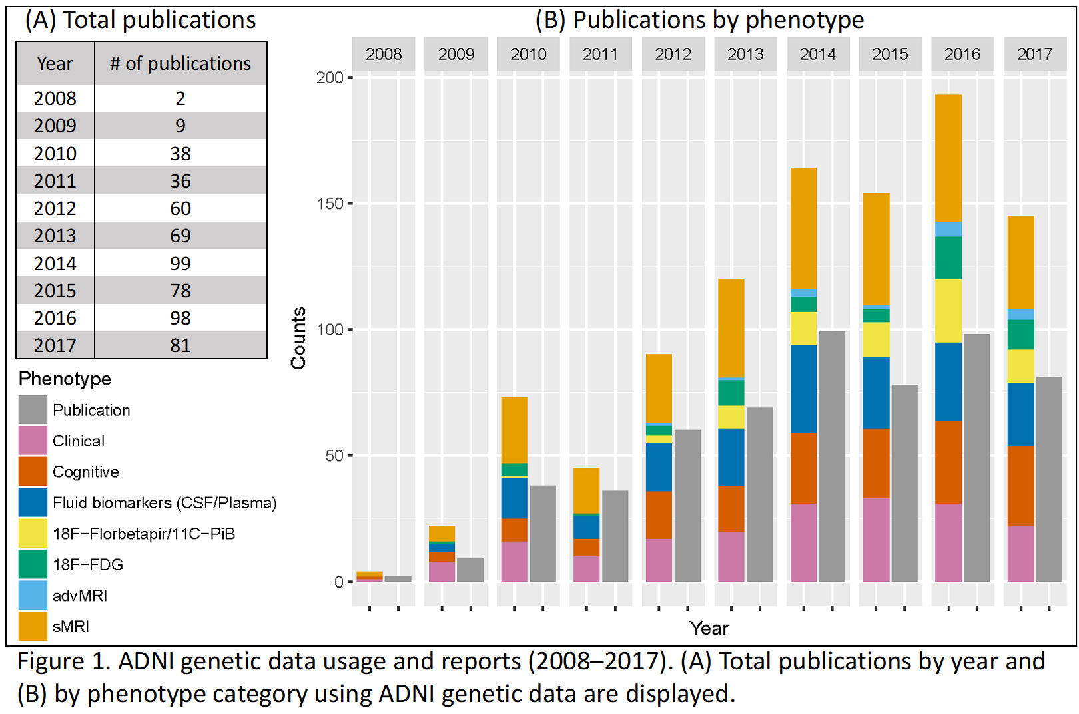
Genetics Studies Using ADNI Endophenotypes:
Publications Using ADNI Genetic Data (2008–2017)
Xiaohui Yao, Yan, Saykin & Shen: Monday 7/23/18, Poster Session: P2-07, Number: P2-235
Notes:
Yao, X et al. Genetic findings using ADNI multimodal quantitative phenotypes: a 2016 update. Alzheimer's & Dementia: The Journal of the Alzheimer's Association, 13(7): P694-69;
Genetic Findings Using ADNI Multimodal Quantitative Phenotypes: A 2017 Update, Xiaohui Yao, Jingwen Yan, Andrew J. Saykin, Li Shen*, and for the ADNI
Session: P2-07, Diagnosis and prognosis: biomarkers (non-neuroimaging)
Poster number: P2-235
Date: Monday, July 23, 2018: 9:30AM-4:15PM; McCormick Place, Hall-F1
As of 11/16/2016
Gray bar indicates the total number of publications.
Note that one paper can be counted multiple times in the color bar.
Data Source: We searched the PubMed database using the EndNote X7 online search tool with the following three criteria: (1) the “All Fields” contains
“Alzheimer’s Disease Neuroimaging Initiative”; (2) the “All Fields” contains “APOE,” “apolipoprotein,” “gene,” “genetic,” “genetics,” “genome,” “genomic,” or “genomics”;
and, (3) the “Year” field value is between 2015 and 2016. We manually reviewed all the abstracts and identified 159 relevant ADNI genetic publications through this extensive search.

Slide 5
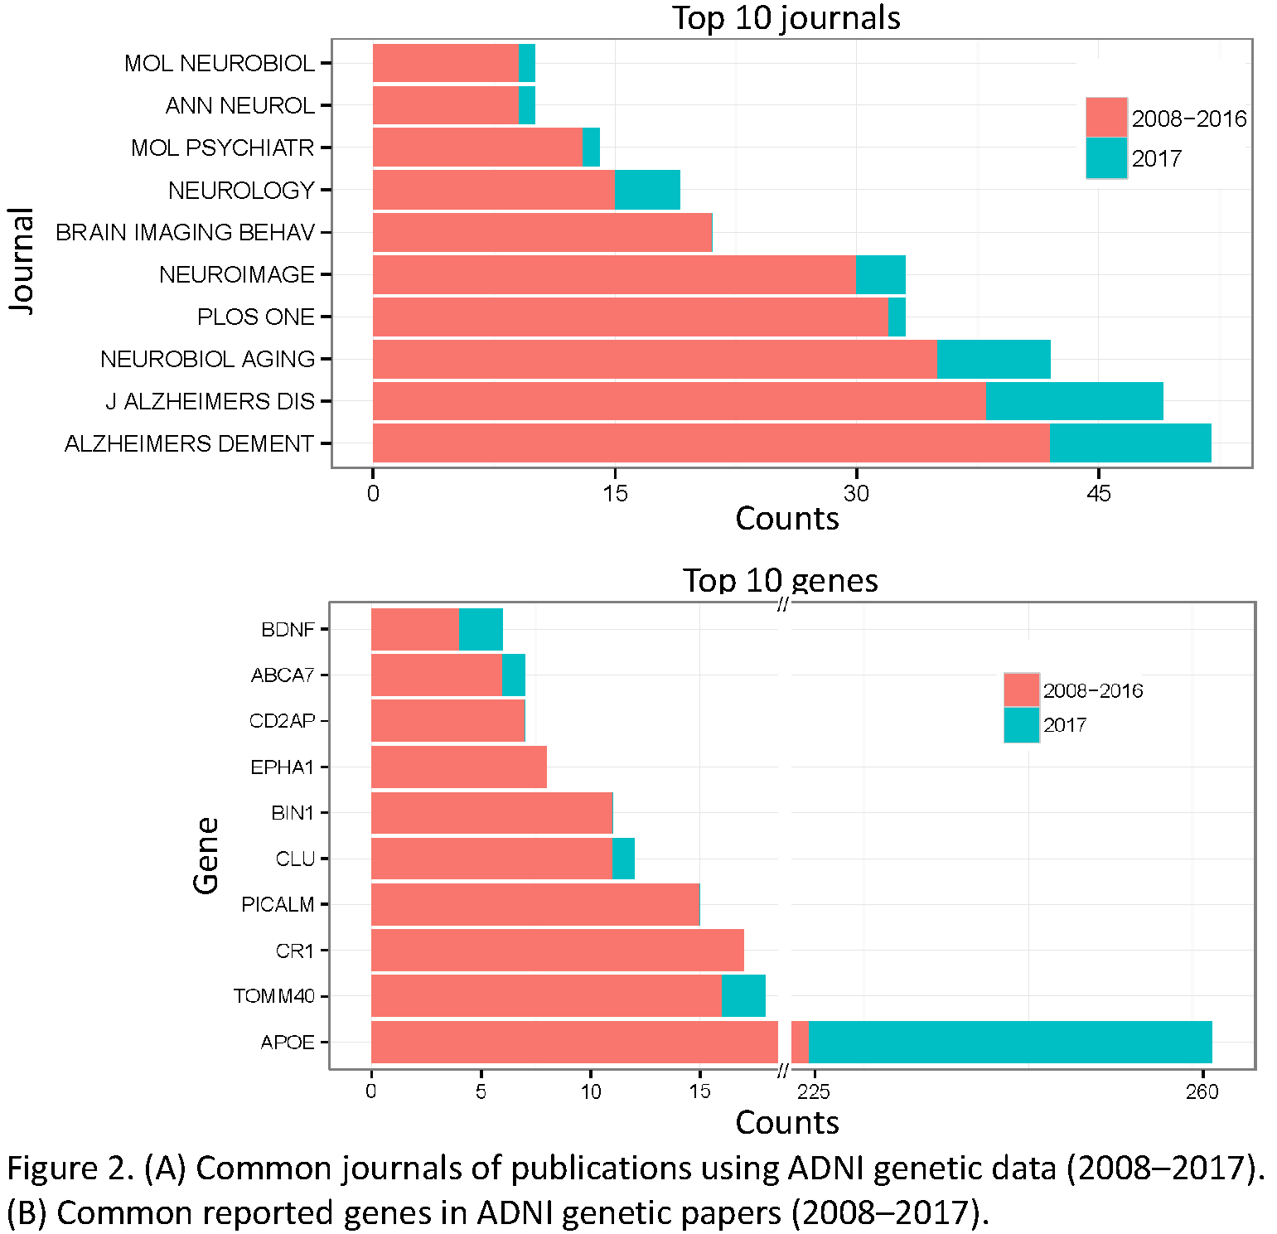
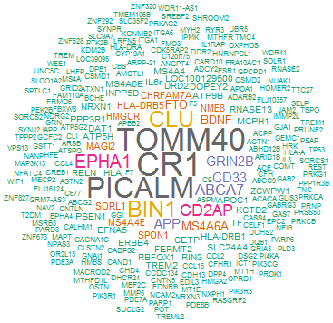
Snapshot of Publications Using ADNI Genetics Data
Top 10 Genes and Journals: (2008–2017)
See Poster for Top Biological Pathways:
Xiaohui Yao, Yan, Saykin & Shen: Monday 7/23/18, Poster Session: P2-07, Number: P2-235
Updated: 1/23/2018

Slide 6

Top IGAP AD Candidates: Imaging Associations (ADNI)
APOE effect: Multivariate analysis of 27 variants in the pooled ADNI sample
Disease stage specific effects in ADNI: ABCA7 association in AD group only
Lambert et al Nature Genetics (2013)
Stage et al (2016) Alz & Dem: DADM; (FDG & GMD)
Apostolova et al (2018) JAMA: Neurology: (Amyloid PET) doi:10.1001/jamaneurol.2017.4198
Gene effects - often stage-specific
Notes:
DESIGN, SETTING, AND PARTICIPANTS This study analyzed the genetic and florbetapir F 18
data from 322 cognitively normal control individuals, 496 individuals with mild cognitive
impairment, and 159 individuals with AD dementia who had genome-wide association studies
and 18F-florbetapir positron emission tomographic data from the Alzheimer’s Disease
Neuroimaging Initiative (ADNI), a prospective, observational, multisite tertiary center clinical
and biomarker study. This ongoing study began in 2005.
MAIN OUTCOMES AND MEASURES The study tested the association of AD risk allele carrier
status (exposure) with florbetapir mean standard uptake value ratio (outcome) using
stepwise multivariable linear regression while controlling for age, sex, and apolipoprotein E
ε4 genotype. The study also reports on an exploratory 3-dimensional stepwise regression
model using an unbiased voxelwise approach in Statistical Parametric Mapping 8 with cluster
and significance thresholds at 50 voxels and uncorrected P < .01.
RESULTS This study included 977 participants (mean [SD] age, 74 [7.5] years; 535 [54.8%]
male and 442 [45.2%] female) from the ADNI-1, ADNI-2, and ADNI–Grand Opportunity. The
adenosine triphosphate–binding cassette subfamily A member 7 (ABCA7) gene had the
strongest association with amyloid deposition (χ2 = 8.38, false discovery rate–corrected
P < .001), after apolioprotein E ε4. Significant associations were found between ABCA7 in the
asymptomatic and early symptomatic disease stages, suggesting an association with rapid
amyloid accumulation. The fermitin family homolog 2 (FERMT2) gene had a stage-dependent
association with brain amyloidosis (FERMT2 × diagnosis χ2 = 3.53, false discovery
rate–corrected P = .05), which was most pronounced in the mild cognitive impairment stage.
CONCLUSIONS AND RELEVANCE This study found an association of several AD risk variants
with brain amyloidosis. The data also suggest that AD genes might differentially regulate AD
pathologic findings across the disease stages.

Slide 7


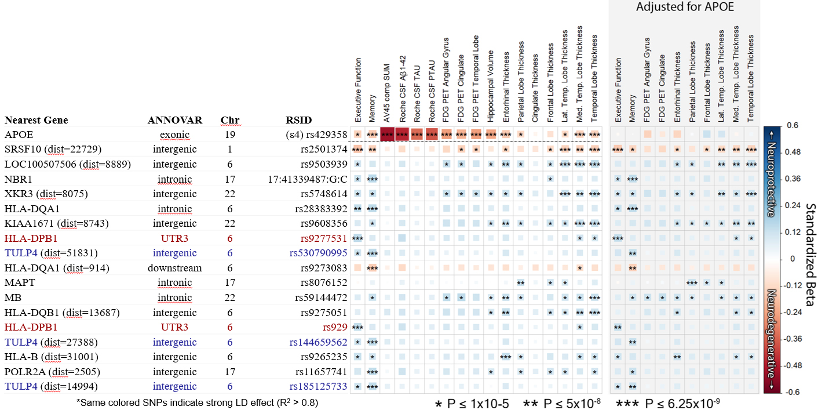

Updated GWAS of Key ADNI-2 Endophenotypes
SNPs shown below passed p=6.25x10⁻⁹ in > 1 endophenotype; ordered by min P values. APOE region SNPs trimmed for clarity.
Tanner Jacobson et al: Sat AIC #P-70 & Mon P2-04 #P2-103

Slide 8

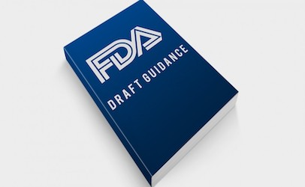
2012
Strategies to decrease heterogeneity − Selecting patients with baseline measurements in a narrow range (decreased inter-patient variability) and excluding patients whose disease or symptoms improve spontaneously or whose measurements are highly variable (less intra-patient variability).
Prognostic enrichment strategies − choosing patients with a greater likelihood of having a disease-related endpoint event (for event-driven studies) or a substantial worsening in condition (for continuous measurement endpoints); increase absolute effect between groups.
Predictive enrichment strategies − choosing patients more likely to respond to the drug treatment than other patients with the condition being treated. Such selection can lead to a larger effect size (both absolute and relative) and permit use of a smaller study population.
https://www.fda.gov/downloads/Drugs/GuidanceComplianceRegulatoryInformation/Guidances/UCM332181.pdf

Slide 9
Stratification by Polygenic Score
Re: FDA guidance on enrichment –
1) PHS appears to have potential for enrichment of clinical trials with those at high short term risk
(See Desikan et al example, left)
2) Pathway-based scores may help decrease heterogeneity (e.g., A/T/N/V risk enrichment) for better therapeutic targeting
Desikan, R.S. et al. Genetic assessment of age-associated Alzheimer disease risk: development and validation of a polygenic hazard score. PLoS Med. 14, e1002258 (2017)
Notes:
Figure. Kaplan-Meier estimates and Cox proportional hazard model fits from the ADGC Phase 1 case-control dataset.
The figure illustrates the relative risk for developing AD for each PRS-risk group. People in the lower quartile (1st quartile) have much higher survival (AD-free time) compared to people in the highest quartile (4th quartile).
Also notice how the survival and the corresponding age, differ between the different quartiles: The median survival(AD free) for the people in the 4th quartile is about 77 years. For the1st quartile the median survival is almost 95 years.
Dashed lines are the Kaplan Meier estimates.
Solid lines are the Cox proportional hazard estimates
(instead of time to AD, Desikan et al., use age as time unit in the Cox model, that is why the x-axis is age instead of time)

Slide 10
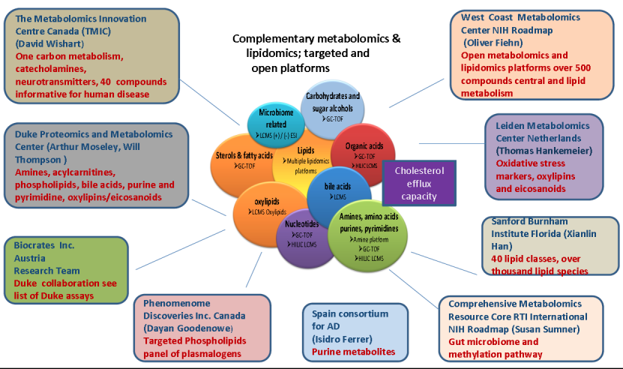
AD Metabolomics Consortium (ADMC)
Bile Acid Metabolism:
The Gut Liver Brain Axis
BA’s - end product of cholesterol metabolism by human and gut microbiomes
PI: Rima Kaddurah-Daouk, Duke University
https://sites.duke.edu/adnimetab/about-us/participating-centers/

Slide 11
Bile Acid Profiles & Clinical Outcomes (ADNI-1/2)
S. MahmoudianDehkordi et al submitted
A and B. Lower levels of CA and higher levels of two secondary to primary ratios were significantly associated with higher odds of converting from MCI to AD.
C and D. Cox hazards model of the association of conversion from MCI to AD.
https://www.biorxiv.org/content/early/2018/03/17/281956
Notes:
A and B. Lower levels of CA and higher levels of two secondary to primary ratios were significantly associated with
higher odds of converting from MCI to AD. EMCI and LMCI patients that converted to AD dementia in 4 years
after baseline were labeled as MCI-Converter; 9 bile acids and ratios that were significantly dysregulated between
CN to AD were assessed; P-values were estimated from logistic regression models and adjusted for age, sex, body
mass index, and APOE ε4 status; the significance level was adjusted for multiple testing according to Bonferroni
0.05/9 = 5.56 x 10-3. C and D. Cox hazards model of the association of conversion from MCI to AD. Red line: 1st
quantile, Red line: 3rd quantile. Analysis was conducted using quantitative values and stratification by quantiles was
used only for graphical representation.

Slide 12
Bile Acid Profiles in MCI & AD: Imaging, CSF & Genetics
Kwangsik Nho et al submitted
https://www.biorxiv.org/content/early/2018/03/18/284141
Notes:
Nho Fig: Heat map of q-values of association between bile acid profiles and the “A/T/N” biomarkers for
AD (a). P-values estimated from linear regression analyses were corrected for multiple testing
using FDR (q-value). Color code: white indicates q-value>0.05, reds indicate significant positive
associations, and greens indicate significant negative associations. Several ratios were calculated
to inform about possible enzymatic activity changes in AD (b). These ratios reflect: (1) Shift in
bile acid metabolism from primary to alternative pathway, (2) Changes in gut microbiome
correlated with production of secondary bile acids, and (3) Changes in glycine and taurine
conjugation of secondary bile acids. LCA was excluded in prepossessing checks.
Nho et al Abstract:
Introduction: Bile acids (BAs) are the end products of cholesterol metabolism produced by human and
gut microbiome co-metabolism. Recent evidence suggests gut microbiota influence pathological features
of Alzheimer’s disease (AD) including neuroinflammation and amyloid-β deposition.
Method: Serum levels of 20 primary and secondary BA metabolites from the AD Neuroimaging
Initiative (n=1562) were measured using targeted metabolomic profiling. We assessed the association of
BAs with the “A/T/N” (Amyloid, Tau and Neurodegeneration) biomarkers for AD: CSF biomarkers,
atrophy (MRI), and brain glucose metabolism ([18F]FDG-PET).
Results: Of 23 BA and relevant calculated ratios, three BA signatures were associated with CSF Aβ1-42
(“A”) and three with CSF p-tau181 (“T”) (corrected p<0.05). Furthermore, three, twelve, and fourteen BA
signatures were associated with CSF t-tau, glucose metabolism, and atrophy (“N”), respectively
(corrected p<0.05).
Conclusion: This is the first study to show serum-based BA metabolites are associated with “A/T/N” AD
biomarkers, providing further support for a role of BA pathways in AD pathophysiology. Prospective
clinical observations and validation in model systems are needed to assess causality and specific
Mechanisms underlying this association.

Slide 13
Bile Acid Ratios: Cortical Thickness & FDG PET
Text
Text
Kwangsik Nho et al submitted
https://www.biorxiv.org/content/early/2018/03/18/284141

Slide 14
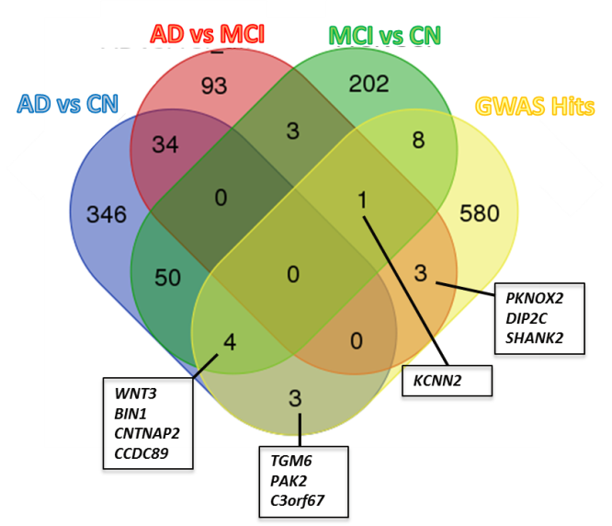
Epigenetics Project Updates
Illumina Epic Arrays & QC completed, data posted
Cross sectional analyses completed and will be submitted, longitudinal analyses are underway
Association with genetic variation (below), cognition & other endophenotypes
Telomere length
DNA Methylation
Project
DNA molecule methylated on both strands on the center cytosine
Influences gene expression without changing DNA sequence
Can be studies in blood, brain and other tissues
Evaluated using DNA from longitudinal ADNI blood samples along with technical replicates
Group contrasts overlap with AD gene variation
Vasanthakumar et al DNA Methylation poster (Tuesday, P3-120)
Notes:
DNA Methylation Changes Overlap with Genetic Variations Previously Associated with Alzheimer’s disease
Aparna Vasanthakumar

Slide 15
ADNI Longitudinal Telomere Study Update
Kelly Nudelman (IU)
Design and Methods:
N=653 unique individuals (ADNI-GO/2)
N=199 have technical replicates (same sample same visit - 399 total replicates)
V1 N=653
V2 N=569
V3 N=451
V4 N=38
V5 N=9
Telomere length was measured using quantitative PCR by Dr. Jue Lin at UCSF
T/S (telomere / single-copy gene) ratios were calculated for each sample, normalized to reference genomic DNA
All assays used same lots of reagents
Baseline and follow-up samples from the same participant were always measured in the same plate to eliminate batch effects
Visit (N)

Slide 16
Technical Issues and Solution
Experimental bias detected
  Machine calibration issue in core lab
  Subset of samples re-run
Additional bias suggested by lengthening telomeres over visits
  Sample type (blood, buffy coat) and length of time DNA stored prior to analysis identified as additional confounding variables
Mixed model accounting for multiple visits and replicates used to calculate standard residuals for T/S ratio
  Adjusted for sample type, DNA storage time, plate, and well position
Initial Evaluation: basic sex, age and time effects closer to expectation
Plan: repost raw data with caveats along new adjusted data set and a white paper explaining the issues and the adjustment approach

Slide 17
Preliminary results: 12 mo. change in T/S residuals
V1 to V2 change: T/S residual on average decreasing (mean=-0.007; SE=0.008)
CN
MCI
AD
K. Nudelman et al unpublished data

Slide 18

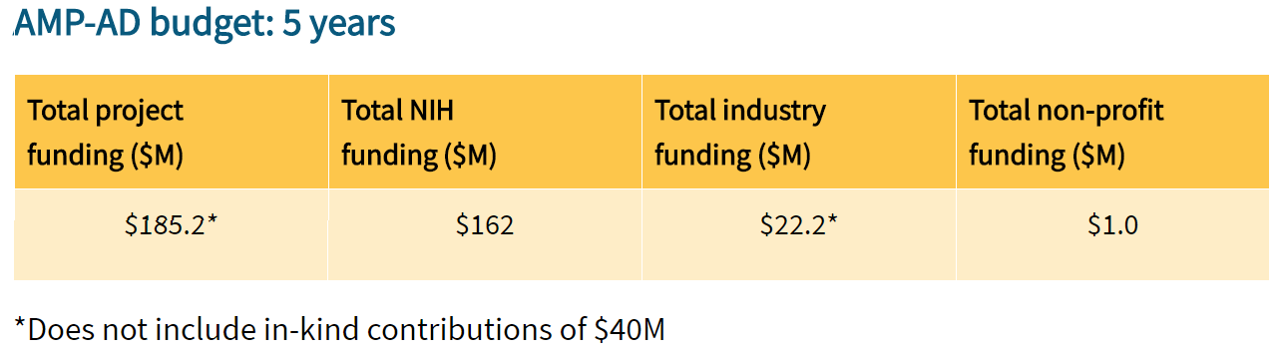
From Complexity toward a Precision Medicine of AD
NIA Consortia/Initiatives:
AD Centers Program
ADNI & DIAN -> LEADS
ADGC & ADSP, NIAGADS
(genetics & genomics)
AMP-AD (target ID)
MOVE2-AD (vascular)
Resilience
MODEL-AD (systems)
ADMC (metabolomics)
Synapse Hub (AMP-AD)
ACTC/ATRI (trials)
https://www.nia.nih.gov/research/amp-ad

Slide 19
Plans and Future Directions
Find resources for WGS, transcriptome and epigenetic profiling of ADNI’s longitudinal DNA and RNA samples
  ADSP for WGS, other groups and/or companies for RNA-seq and other –omics
Continue AD systems biology research with AMP-AD/MOVE-AD, ADMC, ADSP/IBM Watson, and other partners
  Test ADNI data for emergent findings from increasing human and model systems studies
  Validate ADNI findings in –omics data from independent brain tissue and blood samples
  Polygenic approaches: Target specific pathways and endophenotypes (A/T/N/V etc)
  Machine learning approaches to multilayer -omics data (genomics & predictive analytics)
Facilitate replication studies with other cohorts – WW-ADNI, ADCs, others
Collaborate with partners on molecular and functional validation follow-up studies including the IU/JAX/Sage MODEL-AD U54
Continue discussions with interested PPSB member teams on joint multi-omics analyses to reduce duplicative efforts across companies and academic labs
Collaborate w/NPath core on relating pathological features to genetic variation

Slide 20

Genetics Core/Working Groups
Indiana University
Imaging Genomics Lab
  Andrew Saykin (Leader)
  Liana Apostolova
  Kwangsik Nho
  Shannon Risacher
  Jingwen Yan
  Taeho Jo (new)
  Students: Danai Chasioti, Tanner Jacobson, Megan Bernath, Cecily Swinford
National Cell Repository for AD
  Tatiana Foroud (co-Leader)
  Kelley Faber
  Kelly Nudelman
PPSB Working Groups
  Aparna Vasanthakumar (AbbVie)*
  Raj Hooli (Eli Lilly)*
  PPSB Chairs
  FNIH Team
  * Genetics Core Liaisons*
Core Collaborators/Consultants
  Li Shen (U Penn)
  Steven Potkin (UCI)
  Robert Green (BWH)
  Paul Thompson (USC)
  Rima Kaddurah-Daouk (Duke)**
  ** AD Metabolomics Consortium
Mitochondrial DNA project
  Keoni Kauwe (BYU)
Epigenetics Working Group (PPSB):
  Wade Davis (AbbVie)
  Jeffrey Waring (AbbVie)
  Qingqin Li (J&J)
Systems Biology Working Group
AMP-AD Collaborators (many!)
2018

