Slide 1
Integration of CRM by Companies
GBSC F2F meeting; July 21st 2018 Chicago

Slide 2
Aim
Investigate consistency between the CRM-adjusted concentrations, measured in CSF samples using different Beta-Amyloid 1-42 assays

Slide 3
Aim
Investigate consistency between the CRM-adjusted concentrations, measured in CSF samples using different Beta-Amyloid 1-42 assays
Participants
Fujirebio Lumipulse G β-Amyloid 1-42
EUROIMMUN Beta-Amyloid 1-42 ChLIA
Roche Elecsys® β-Amyloid (1-42) CSF

Slide 4
Study design
Sample sets:
CRM samples (N = 3), provided by Ingrid Zegers
Frozen CSF pools (N =15 ), provided by EUROIMMUN
Pre-analytical handling
CRM & CSF pools: thawed 30 min at RT while rollermixing, short spin down
Problem: the tubes with frozen CSF were very small. Roche and Fujirebio needed to use a kind of adapter to be able to measure them -> limitation of study
Measurement:
CRM samples: 2 aliquots were measured at the begin and end of the run, 2 runs were performed
Other samples: 1 aliquot was measured in each run in randomized order, 2 runs were performed
2 determinations from each aliquot
Measurement results
Original concentrations and re-calibrated using CRM samples (CRM-adjusted) concentrations

Slide 5
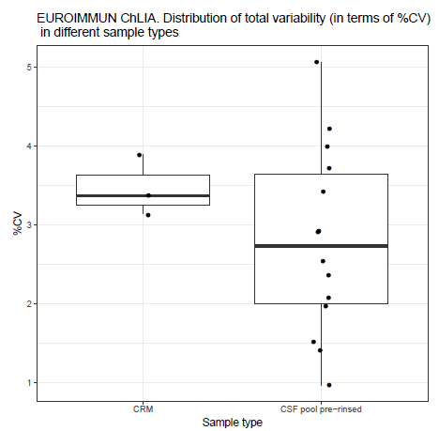
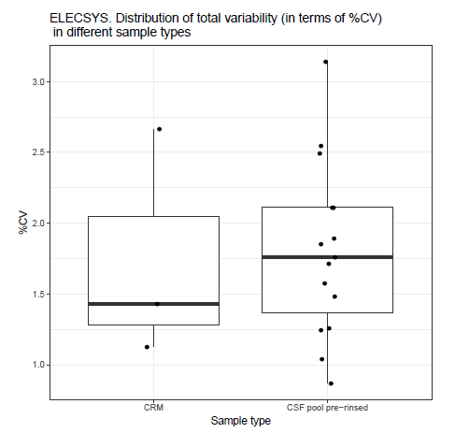
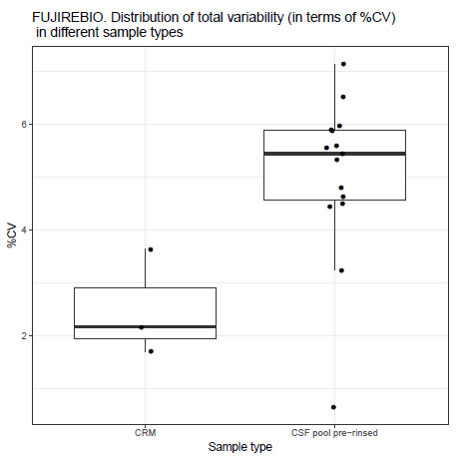
Precision of the original concentrations
For each sample and each system several measurement replicates are available: N = 8 for CRM, N = 4 for CSF pools.
Variability of replicates is low. No outliers are observed.
For the further analysis all replicates are averaged.
→ good overall precision across all sample types and different systems

Slide 6
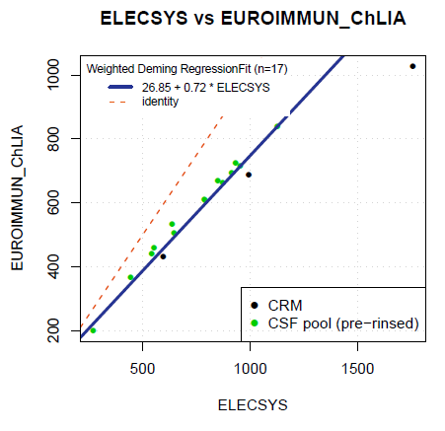
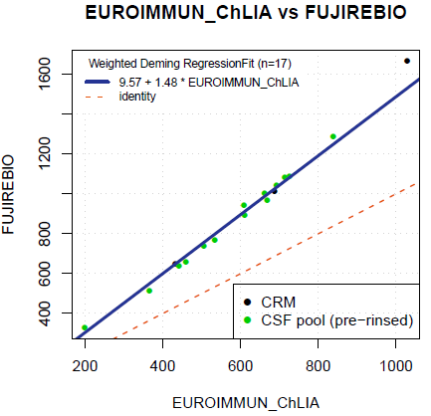
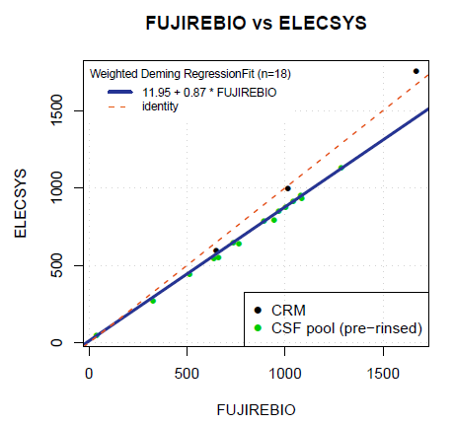
Correlation and bias between the original concentrations
X | Y | Pearson’s r | Slope | Bias at median concentration
Roche | EUROIMMUN | 0.97 | 0.72 (0.50, 0.94) | -25% (-28%, -21%)
EUROIMMUN | Fujirebio | 0.99 | 1.48 (1.15, 1.81) | 49% (46%, 52%)
Fujirebio | Roche | 0.98 | 0.87 (0.71, 1.02) | -12% (-16%, -8%)
High correlation between the systems;
Large bias (Bias estimate may be partly influenced by the pre-analytic problems)
Red dashed line - identity
Notes:
red dashed line - identity
Discrepany due to small sample volume?

Slide 7
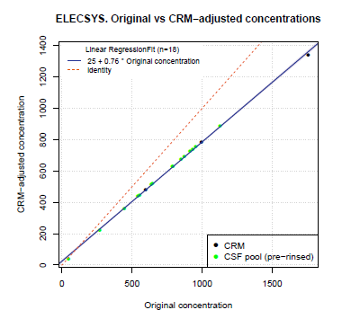
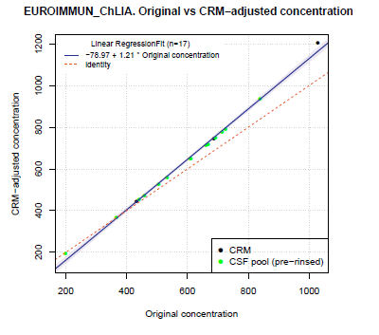
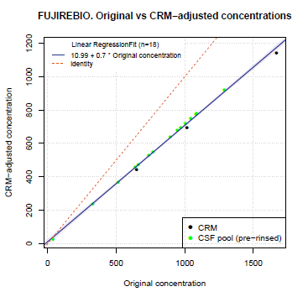
Original vs re-calibrated (CRM-adjusted) concentrations
Correlation between original and re-calibrated concentrations is given in all systems
Red dashed line - identity

Slide 8
Improvement of bias between the systems by re-standardization
Original concentrations
X | Y | Pearson’s r | Slope | Bias at median concentration
Roche | EUROIMMUN | 0.97 | 0.72 (0.50, 0.94) | -25% (-28%, -21%)
EUROIMMUN | Fujirebio | 0.99 | 1.48 (1.15, 1.81) | 49% (46%, 52%)
Fujirebio | Roche | 0.98 | 0.87 (0.71, 1.02) | -12% (-16%, -8%)
Re-standardized concentrations
X | Y | Pearson’s r | Slope | Bias at median concentration 700 pg/ml
Roche | EUROIMMUN | 0.98 | 1.07 (0.89, 1.24) | 2.2% (-2.2%, 6.7%)
EUROIMMUN | Fujirebio | 1.00 | 0.91 (0.81, 1.00) | -1.6% (-3.3%, -0.02%)
Fujirebio | Roche | 0.98 | 0.91 (0.81, 0.98) | -0.2% (-7.3%, 1.4%)
No significant/relevant bias between the re-standardized concentrations

Slide 9
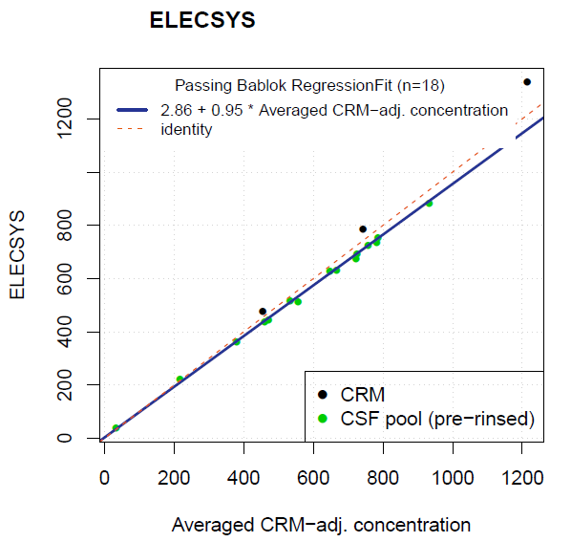
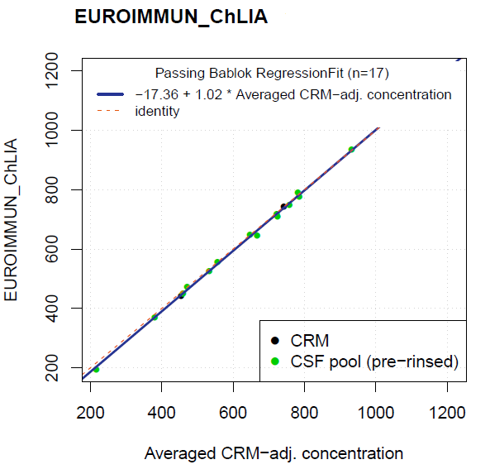
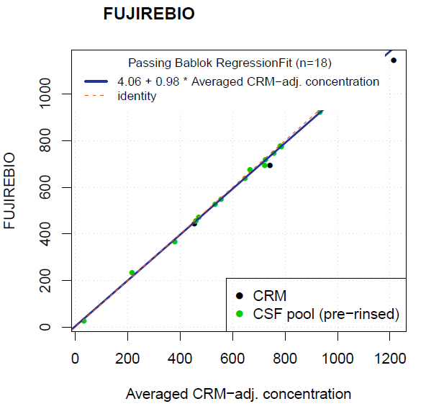
Re-standardized concentrations vs the average over all systems
X | Y | Pearson’s r | Slope | Bias at median concentration 700 pg/ml
Average | EUROIMMUN | 1.00 | 1.02 (0.95, 1.03) | -1.5% (-3.3%, -0.5%)
Average | Fujirebio | 1.00 | 0.98 (0.93, 1.00) | -1.2% (-3.0%, -0.7%)
Average | Roche | 0.99 | 0.95 (0.93, 1.07) | -4.3% (-5.4%, -0.01%)
High consistency between the re-standardized concentrations
No significant/relevant bias between the re-standardized concentrations

Slide 10
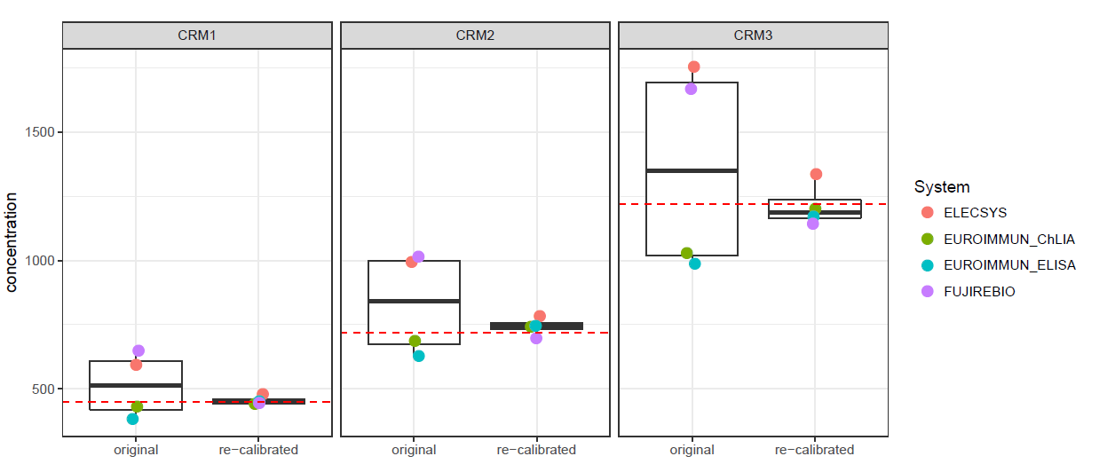
Original and re-standardized measurements in CRM measurements
Averaged re-standardized measurements
CV = 24%
CV = 4%
CV = 24%
CV = 5%
CV = 30%
CV = 7%
Red dashed lines – CRM target values
%CV between averaged measurements is shown below the graph.
Deviations to the target values are within ±9%

Slide 11
Overview of results
Results of the analysis
No outliers and low variability of measurement replicates
High correlation between systems on the original and re-standardized scale
Linearity
Large bias between the systems on the original scale (up to 49%)
High consistency between the re-standardized concentrations (bias to averaged re-standardized concentrations below 5%)
Re-standardized measurements of CRM samples are close to their target values (deviations are within ±9%)
Limitations:
The bias estimates between the methods may be influenced by pre-analytical problems (small volume, small tube)

Slide 12
Conclusion
Re-calibration of Beta-Amyloid 1-42 assays using the CRMs is feasible
Bias between Beta-Aymloid 1-42 assays of different vendors is minimized
All 3 participating vendors are now committed to commercialize re-calibrated Beta-Amyloid 1-42 assays
Outlook
Group will continue working together
Round Robin study to be planned
Reach-out again to start discussion with other vendors

Slide 14
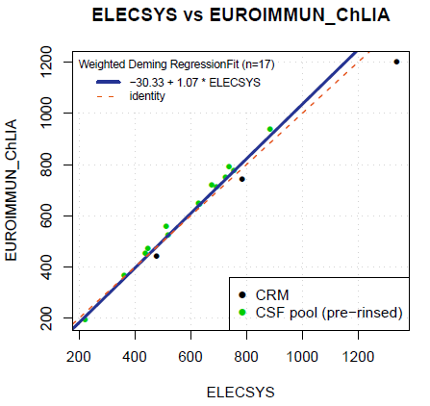
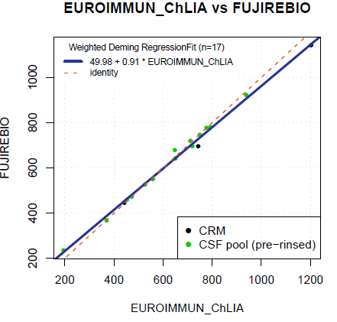
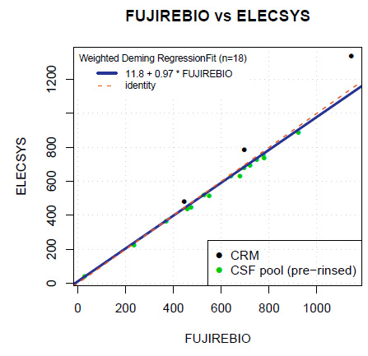
Improvement of bias between the systems by re-standardization
Original concentrations
Re-standardized concentrations
Red dashed line - identity
Notes:
Correlation is still good after re-calibration

Slide 15
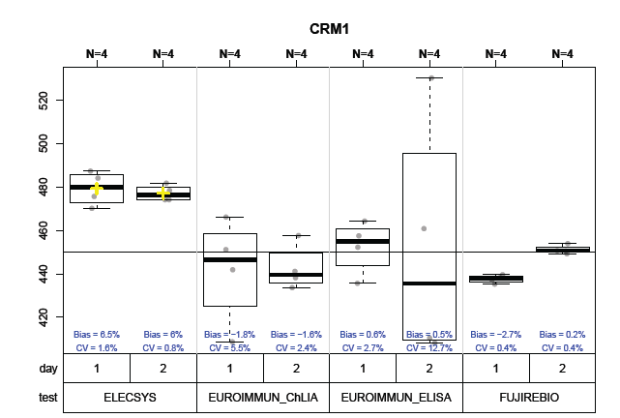
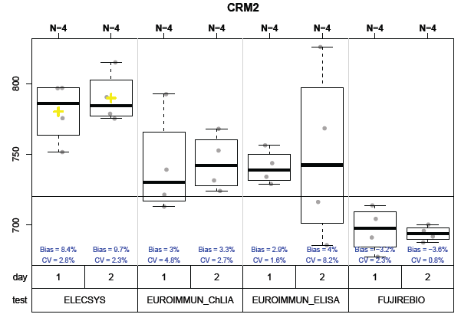
CRM-adjusted measurements in CRMs
Suggest to delete
Measurement of the CRMs on the restandardized assay confirms succesfull restandardization.
→ Concentrations are close to the assigned values by LC-MS/MS (JCTLM ID: C11RMP9)
CRM measurements of Fujirebio & Euroimmun are close to the target values
Roche – positive bias 6-9% to the target value (to be assessed).

Slide 16
Bias between the CRM-adjusted concentrations
Estimated bias[%] at 700 pg/ml
X | Y | All | CSF frozen
EI* | FU | 0.16 (-1.3, 7.9) | -0.8 (-1.9, 0.54)
EI | RO | -2.7 (-5.5, 5.0) | -4.2 (-6.1, -2.6)
FU | RO | -6.9 (-11.2, -2.9) | -3.7 (-5.4, -2.7)
EI= EuroImmun; FU = Fujirebio; Ro = Roche
Suggest to delete
*EI = EUROIMMUN ChLIA

Slide 17
Bias to the averaged CRM-adjusted concentrations
Samples | X | Y | Intercept | Slope | %Bias at 700 pg/ml
All | AVE | EI ChLIA | -12.3 (-27.6, 14.0) | 1.00 (0.95, 1.03) | -1.5 (-3.3, -0.46)
 | AVE | EI ELISA | 2.5 (-16.8, 57) | 1.05 (0.95, 1.09) | 5.0 (2.2, 6.5)
 | AVE | Fujirebio | -8.5 (-68.2, 13) | 1.01 (0.98, 1-13) | 0.14 (-1.2. 7.2)
 | AVE | Roche | 5.97 (-30.4, 24) | 0.95 (0.91, 1.02) | -4.3 (-6.3, -0.8)
Frozen CSF | AVE | EI ChLIA | -20.3 (-37.4, 1) | 1.03 (0.99, 1.05) | -0.42 (-1.46, 0.70)
 | AVE | EI ELISA | 1.26 (-23.7, 36) | 1.06 (1.02, 1.10) | 6.5 (5.1, 7.1)
 | AVE | Fujirebio | 1.36 (-8.31, 24) | 0.99 (0.96, 1.00) | -1.2 (-1.5, -0.45)
 | AVE | Roche | 7.74 (-0.33, 21) | 0.94 (0.93, 0.97) | -5.2 (-5.7, -4.1)
Lyophilized CSF | AVE | EI ChLIA | -6.1 (-86.5, 51) | 0.94 (0.84, 1.00) | -6.7 (-12.5, -2.9)
 | AVE | EI ELISA | 7.33 (-37.0, 126) | 1.022 (0.85, 1.11) | 3.3 (-4.1, 8.0)
 | AVE | Fujirebio | -20.2 (-102.8, 33) | 1.13 (1.04, 1.26) | 10.1 (5.0, 16.0)
 | AVE | Roche | 12.7 (-54.3, 43) | 0.93 (0.84, 1.04) | -5.4 (-10.3 0.14)
Suggest to delete

Slide 18
Correlation and bias between the original concentrations (averaged)
Estimated bias[%] at median concentration
X | Y | All | CSF frozen
EI* | FU | 60 (51; 69) | 84 (64, 103)
EI | RO | 37 (30; 44) | 45 (26, 64)
FU | RO | -15 (-18, -12) | -21 (-24, -18)
Suggest to delete, because the information is included in the previous slide
EI= EuroImmun; FU = Fujirebio; Ro = Roche
High correlation between all assays (r : 0.95-1.00)
No linearity violation
*EI = EUROIMMUN ChLIA

Slide 19
Correlation and bias between the original concentrations (averaged)
NON-Validated output
Suggest to delete

Slide 20
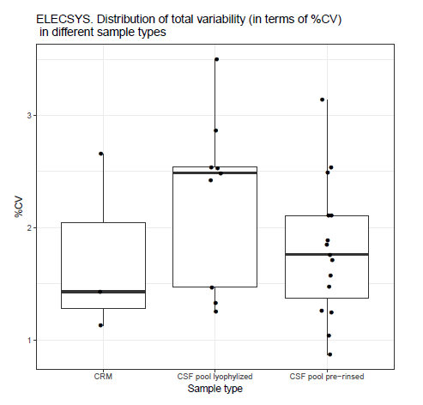
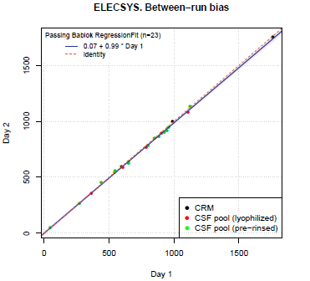
Precision: Roche
NON-Validated output
Suggest to delete
Original concentrations
No considerably differences in precision between sample types
No considerable run-effect
No differences between in CRM measurements at the begin and end of the runs

Slide 21
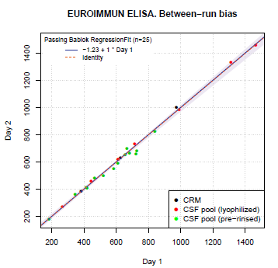
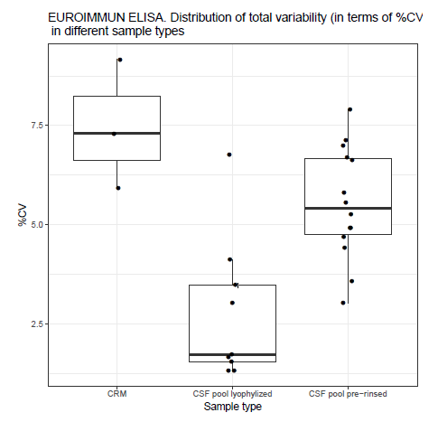
Precision: EUROIMMUN ELISA
NON-Validated output
Suggest to delete
Original concentration
Lowest variability in lyophilized samples
On day 2 considerable differences the between start- and end CRM measurements
No run effect

Slide 22
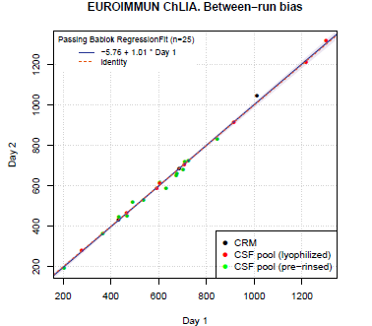
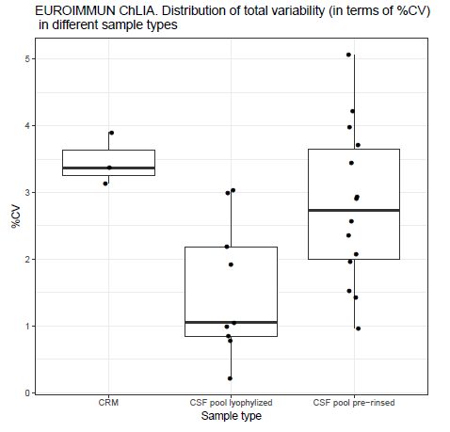
Precision: EURIMMUN ChLIA
NON-Validated output
Suggest to delete
Original concentration
Lowest variability in lyophilized samples
No differences between start- and end CRM measurements
No run effect

Slide 23
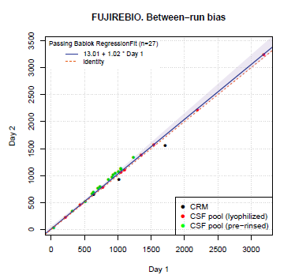
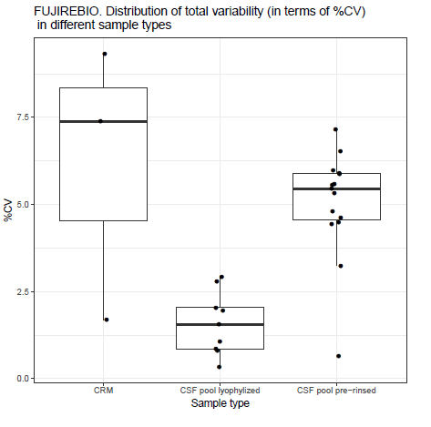
Precision: Fujirebio
NON-Validated output
Suggest to delete
Original concentration
Lowest variability in lyophilized samples
On day 2 considerable differences the between start- and end CRM measurements
Very small run effect (depends on the sample type)

