Slide 1
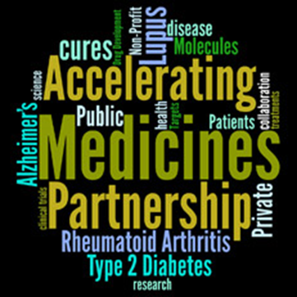

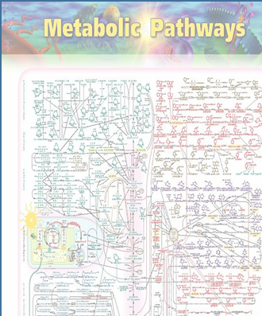
Alzheimer Disease Metabolomics Consortium
Partnerships to connect knowledge and enable a systems approach
Deeper understanding of metabolic failures across trajectory of disease
Rush Supplement
ROS/MAP
Mt Sinai
Modeling
ADNI I
baseline
Community Studies
Framingham
Rotterdam
MOVE AD
ADNI GO/2

Slide 2
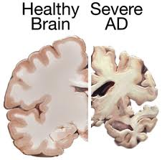
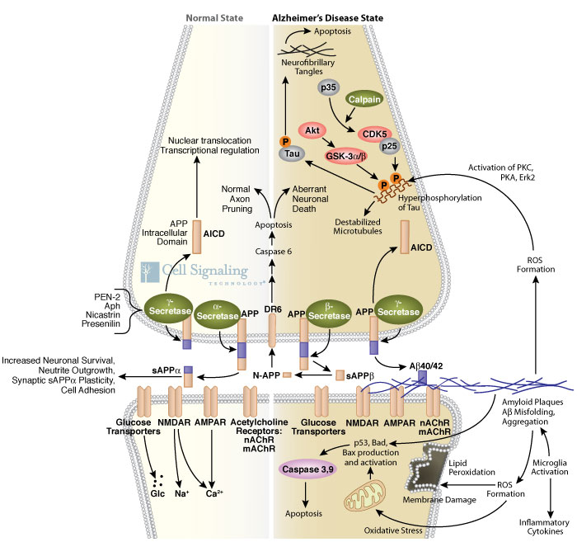
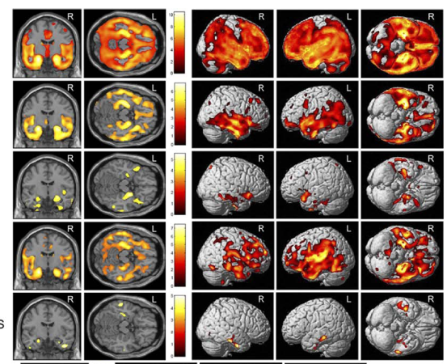
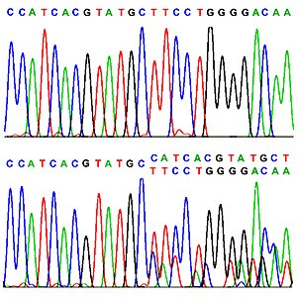
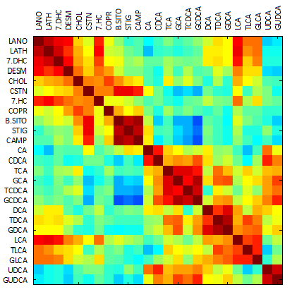
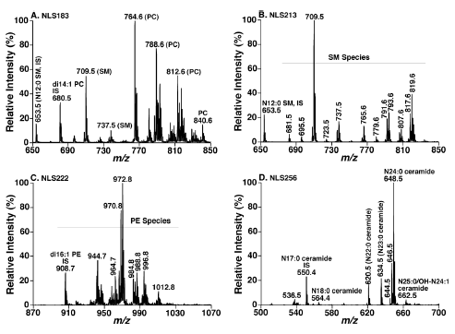

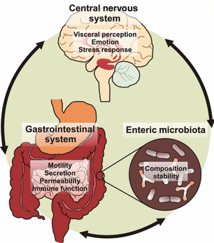
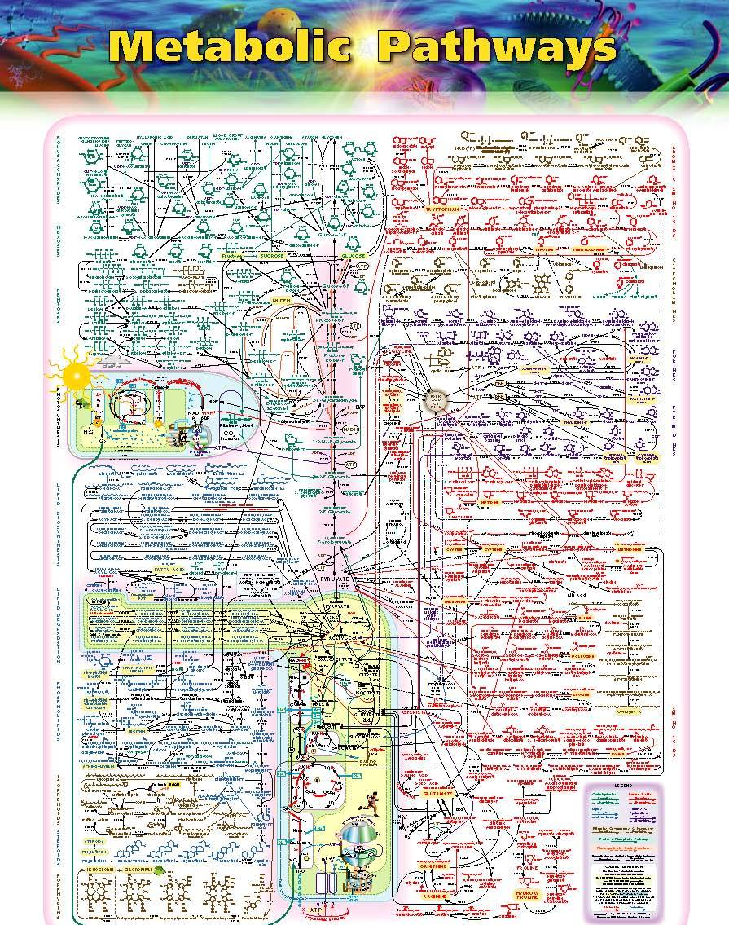
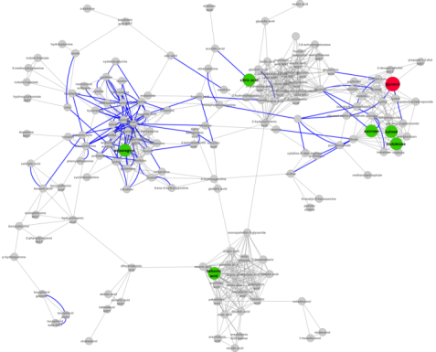
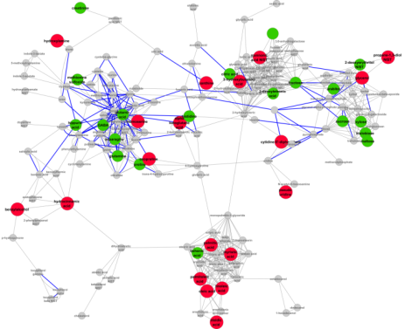
Looking for metabolic signatures in blood that are disease related and easy to measure
AD CSF Markers
Imaging
(Gut Brain Axis, Liver Brain
Axis, environment, diet)
Connect peripheral
and central biochemical
changes
Genomics and transcriptomics
Metabolomics
Metabolome-Genome links
Enzymes/genes implicated
Changes in biochemical pathways and network as disease progresses - New targets for drug design and biomarkers
AD Progression

Slide 3


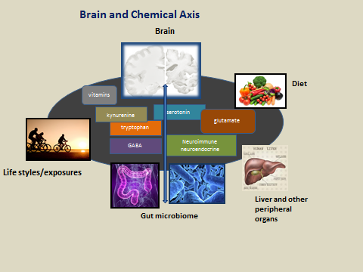

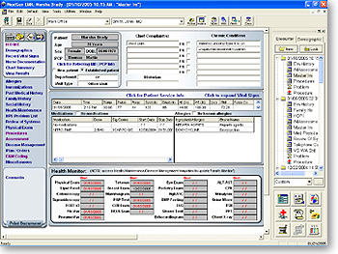
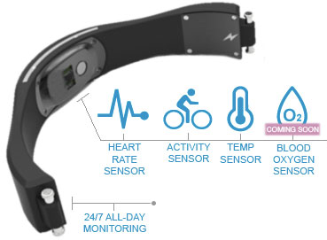
A Paradigm Shift – Time for change!
Electronic Medical Records
Health monitors

Slide 4
Alzheimer's Disease Metabolomics Consortium
Team Members
Indiana University Andrew Saykin (PI) Sungeun Kim (ADNI Genomics Core leader) NC State Bioinformatics: Alison Motsinger-Reif (PI) Daniel Rotroff Sanford Burnham Lipidomics Xianlin Han (PI) West Coast Metabolomics Center NIH Roadmap RCMRC Oliver Fiehn (PI) PO Metabolomics: Suzana Petanceska (NIH/NIA) 3U01AG024904-09S4 1R01AG046171-01 PO: ADNI John Hsiao (NIH/NIA/ERP) Dr. Michael Weiner and leadership of ADNI | University of Pennsylvania Mitchel Kling (PI) John Toledo Leslie Shaw (ADNI Biomarker Core) John Trojanowski (ADNI Biomarker Core) Phenomenome Discoveries Inc., (PDI) lipidomics Dayan Goodenowe (PI) The Metabolomics Innovation Centre Canada (TMIC) David Wishart (PI) Leiden University Metabolomics Center Thomas Hankemeier (PI) University of Barcelona Isidro Ferrer (PI) Helmholtz Zentrum Muenchen Gabi Kastenmüller Karsten Suhre | RTI Eastern Regional Comprehensive Metabolomics Resource Core NIH Roadmap RCMRC Susan Sumner (PI) Biocrates Inc. metabolomics Research Team Systems Biology Sage Networks ADNI Systems Biology Working Group (Under Construction) Duke University Medical Center Psychiatry, Metabolomics Core and Statistics (Coordinating Center) Rima Kaddurah-Daouk (Overall PI) P. Murali Doraiswamy (AD) Jessica Tenenbuam (Data science PI) Arthur Moseley (Duke Proteomics and Metabolomics Core PI) Will Thompson, (Duke Proteomics and Metabolomics Core, Metabolomics Leader) Joseph Lucas (Statistics PI) Rebecca Baillie (Lipid metabolism)

Slide 5
Metabolomics Centers Of Excellence Building a Comprehensive Biochemical Database for ADNI - Broad Biochemical Coverage
The Metabolomics Innovation Centre Canada (TMIC)
(David Wishart)
One carbon metabolism, catecholamine's, neurotransmitters, 40 informative compounds human disease
West Coast Metabolomics Center NIH Roadmap
(Oliver Fiehn)
Open metabolomics and lipidomics platforms over 500 compounds central and lipid metabolism
Complimentary metabolomics &
lipidomics targeted and
open platforms
Duke Proteomics and Metabolomics Center (Arthur Moseley, Will Thompson )
180 Amines, acylcarnitines, phospholipids
20 bile acids
Leiden Metabolomics Center Netherlands
(Thomas Hankemeier)
Oxidative stress markers, oxylipins and eicosanoids over 200 compounds
Cholesterol efflux capacity
Dan Rader
Sanford Burnham Institute Florida (Xianlin Han) 40 lipid classes, over thousand lipid species
Biocrates Inc.
Austria
Research Team
Duke collaboration
Phenomenome Discoveries Inc. Canada
(Dayan Goodenowe)
Targeted Phospholipids panel 30, PE plasmalogens 20
Spain consortium for AD
(Isidro Ferrer)
Purine metabolites
10
Comprehensive Metabolomics Resource Core RTI International
NIH Roadmap (Susan Sumner)
Gut microbiome 200 and methylation pathway
Large effort standardization
and integration!!

Slide 6
Standardization Approaches in
Implementation of Aims
Assessment of reproducibility and potential batch effects is an essential component of a rigorous analytical study. To maintain consistency across the labs participating in the ADNI metabolomics study, it is proposed to use the following steps in each lab’s protocol:
1) As all samples were randomized prior to shipment to the individual labs, each lab will analyze the cohort in the numerical order as received and coded on the sample vials.
2) The sample cohort currently includes 20 replicated samples which are blinded to each lab, providing a blinded QC metric across the cohort.
3) Assessment of reproducibility and potential batch effects will be accomplished via use the established NIST standard reference plasma (SRM 1950):
  Triplicate analysis of aliquots of NIST SRM 1950 plasma (http://srm1950.nist.gov/) on each plate or in each batch.
4) Additionally, each laboratory may include lab-specific QC samples as defined by laboratory standard operating procedure.
5) It is noted that the use of these QC samples will provide reference standards which would preclude the need for a ring trial.

Slide 7
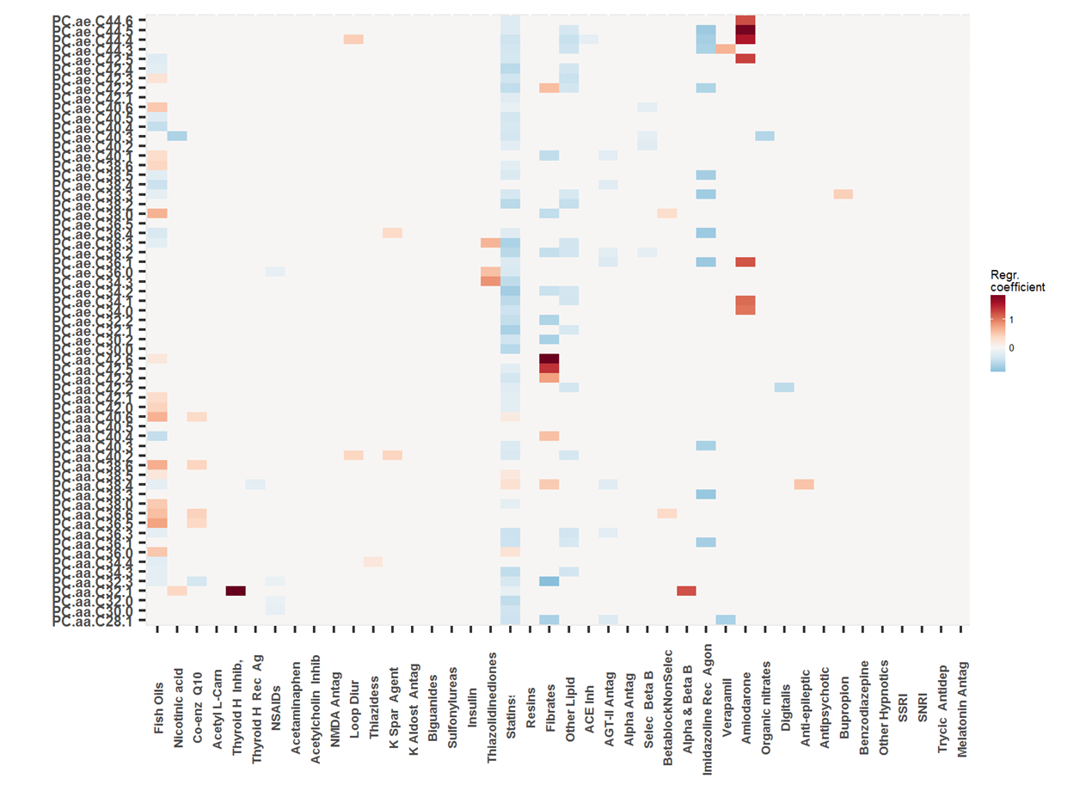
Accounting For Medication Effects in ADNI

Slide 8
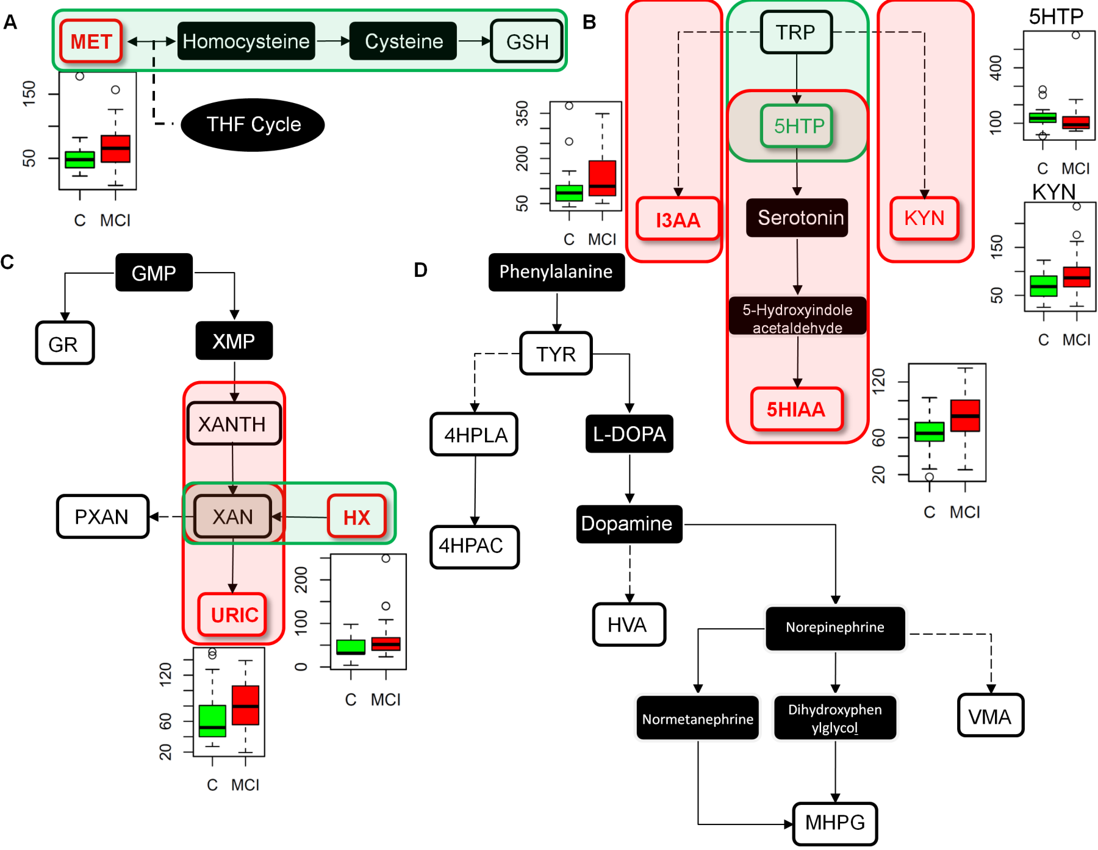
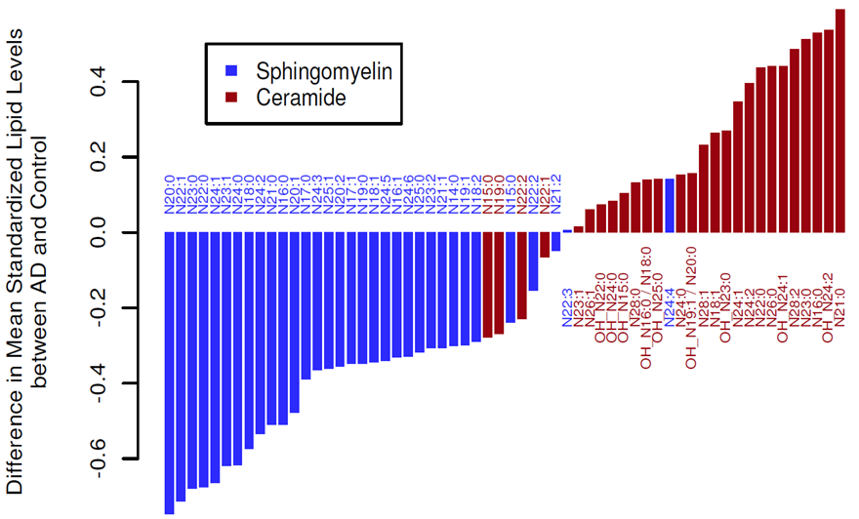
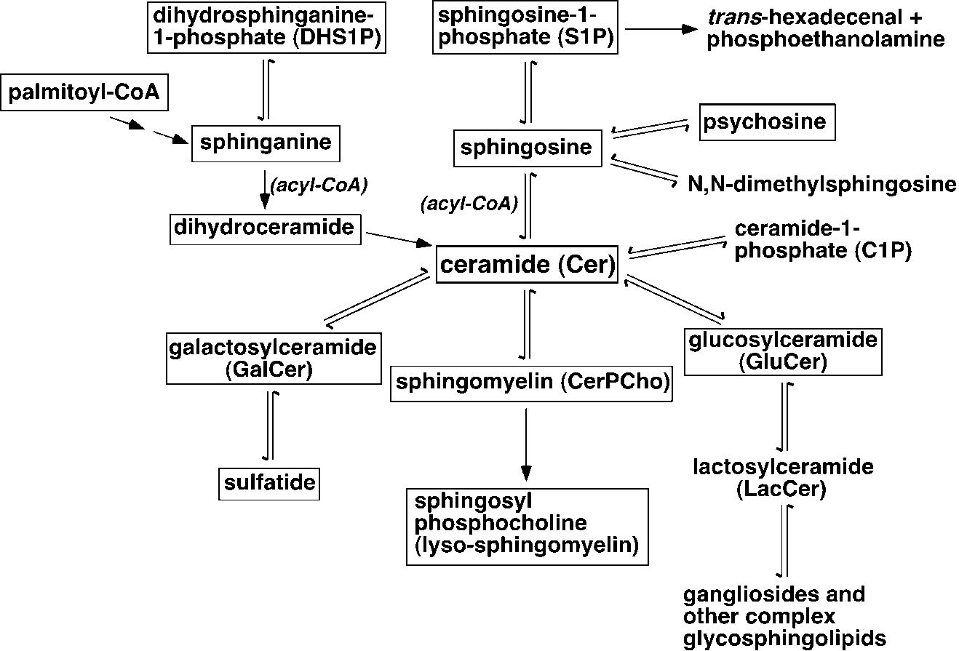
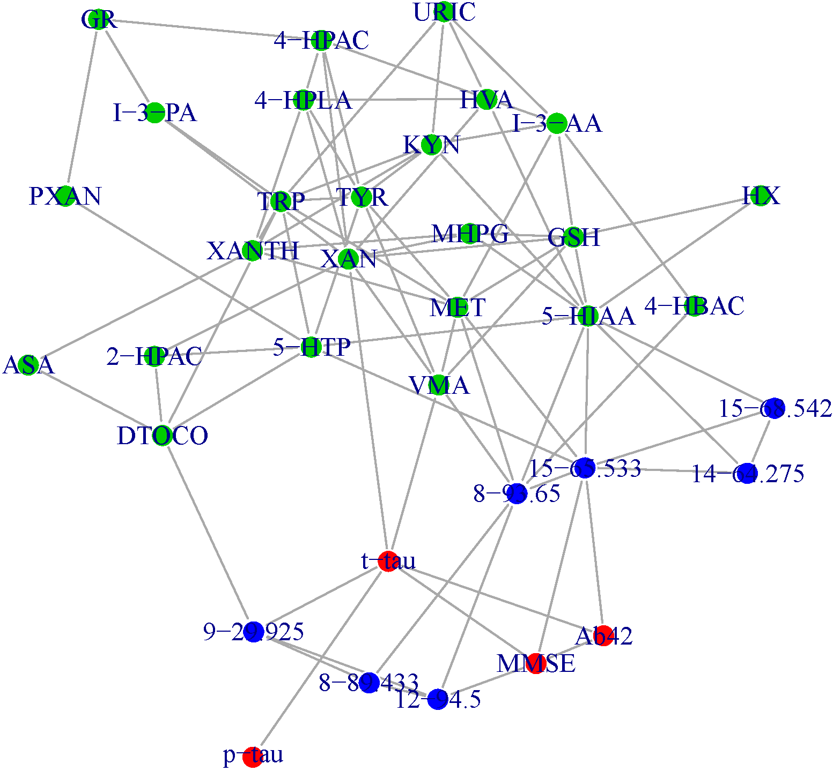
Hypothesis Being Tested - Replication of Earlier Findings
New hypothesis generated
PC metabolic defect early in AD
Ceramide sphingomyelin defect
Failure in interconnected neurotransmission,
methylation and purine metabolism
Plasmalogen biosynthesis defect
Mitochondrial Energetics
Failure Gut Brain Liver Connections

Slide 9
ADNI I Baseline Datasets Deposited to LONI or Waiting Unblinding
P180
Amines, acylcarnitines, PC, SM (180)
Bile Acid
Cholesterol and gut microbiome metabolism (20)
Purine
(10)
PE plasmalogen
(10)
PC, LPC
NESI (30)
PC, LPC
PESI (30)
Replication of findings
Rotterdam
Framingham
Indiana
Made public – LONI 2015/2016
Non Targeted Metabolomics (300)
Non Targeted lipidomics (400)
Highly informative compounds (40)
Vetted ready to unblind and make public first week August 2016
neurotransmitters
Methylation
Analysis ongoing

Slide 10
Biological functions of metabolites measured
(first round)
Sphingomylins
Amines
Acylcarnitines
Phosphatidylcholines
Beta-oxidation of lipids mitochondrial functions
Control lipid membrane transport
Integrate energy production from amines, lipid, sugars
Protein metabolism
Signaling molecules
Membrane structure
Receptor functionality
Neurotransmitter release
Electrical stimulation
Inflammation
Signaling molecules
Membrane structure
Receptor functionality
Neurotransmitter release
Electrical stimulation
Inflammation
Signal transduction
Receptors
neurotransmitters
Receptor functionality
Neurotransmitter release
Electrical stimulation
Inflammation
Energy metabolism

Slide 11
Summary of Initial Findings
First attempts to connect central / peripheral metabolic changes at a network level
Metabolomics Session
800-930am Sunday
Confirmed phosphatadyl choline (PC) metabolism defects early in disease, established links to imaging changes
  Metabolic defect in CN with CSF markers of pathology, early changes!
  Metabolites that correlate with CSF markers of disease and correlate with disease progression
  Federoff , Thambisetty, our team and others noted some defects before
  PC by them selves are not predictive markers of disease but inform about disease mechanism
  Meta analysis across studies ongoing , mapping pathways enzymes and genes
  Importance of correcting for medications and confounds!! Previous studies did not
Conformed important role for Sphingomylins (SM) in disease pathogenesis, established links to central changes
Discovered that Bile acids in particular secondary conjugated produced by gut microbiome are impacted in AD and correlate with cognitive changes and imaging changes.
Discovered a role for amines markers pre disposing to development of diabetes in Framingham study as implicated in cognitive decline in AD and as correlated with central changes.
Established that acylcarnitines drivers of mitochondrial energetics as implicated in AD pathogenesis
Replicated four key findings in Rotterdam and Framingham studies

Slide 12
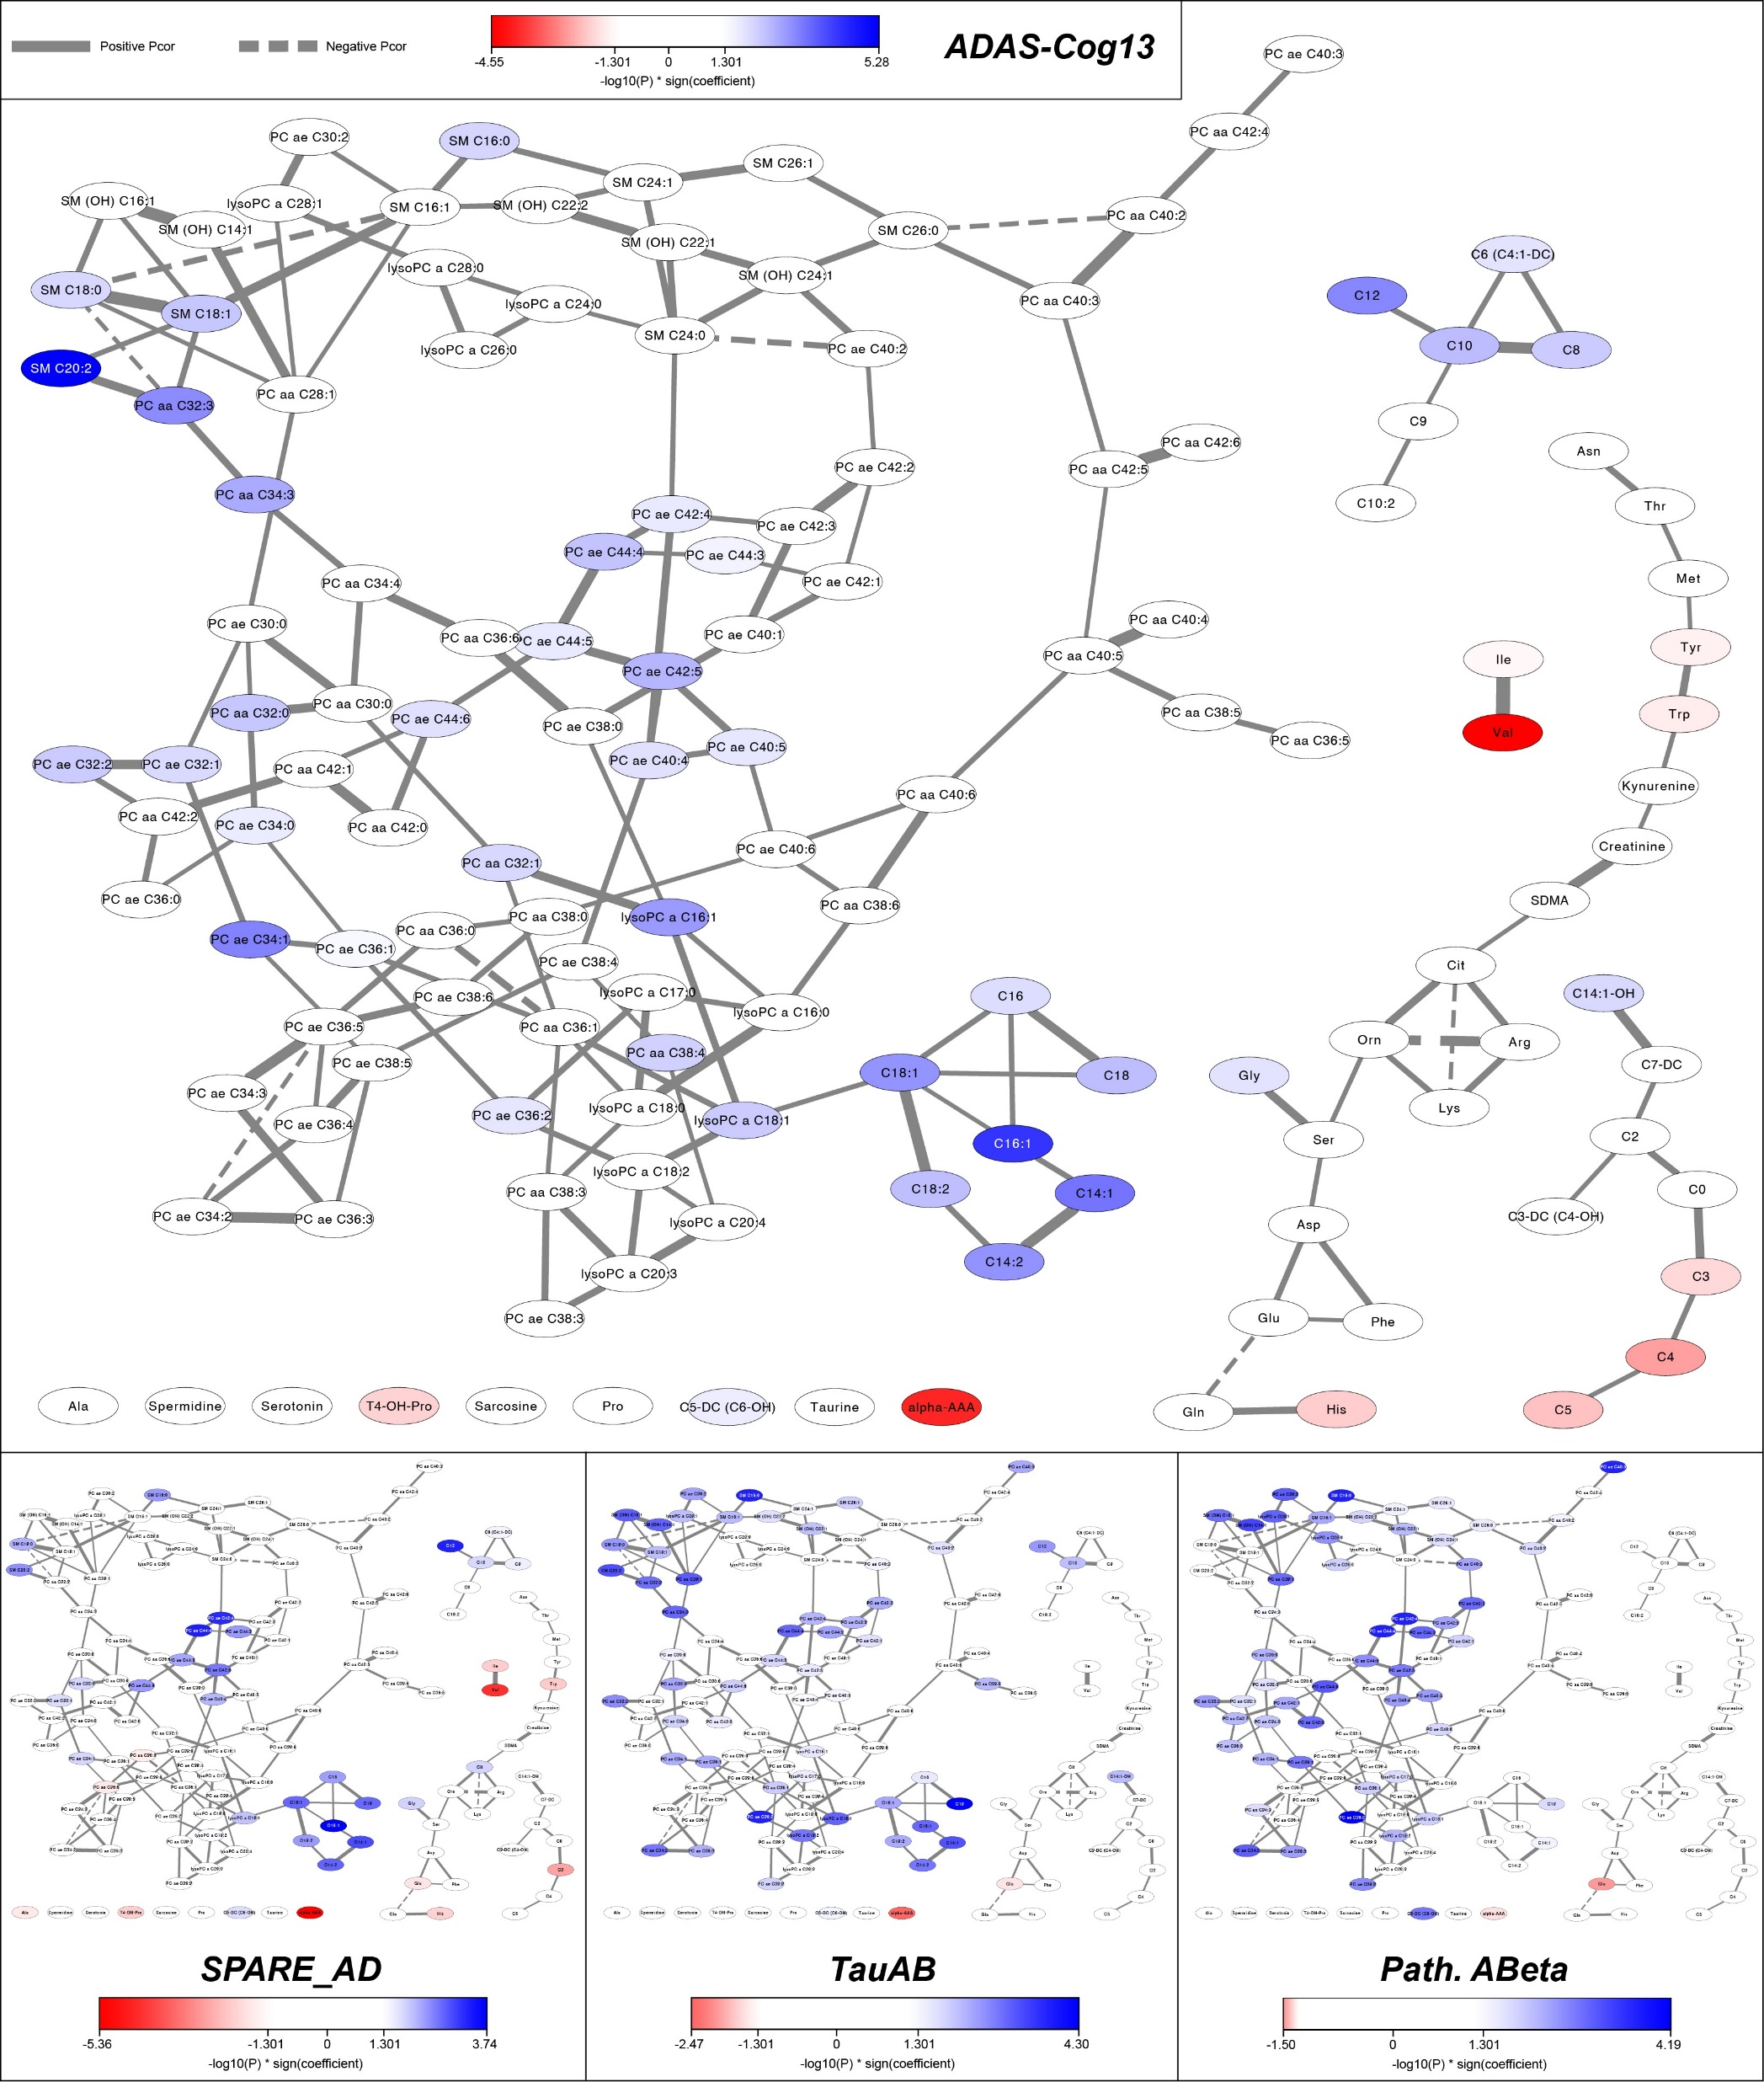
The Biochemistry Related to
CSF Markers and Imaging
Changes
Progressive changes within
metabolic network

Slide 13
Predictive Metabolic Network Modeling in Alzheimer’s Disease
Dept. of Genetics and Genomic Sciences
Icahn School of Medicine at Mount Sinai

Slide 14
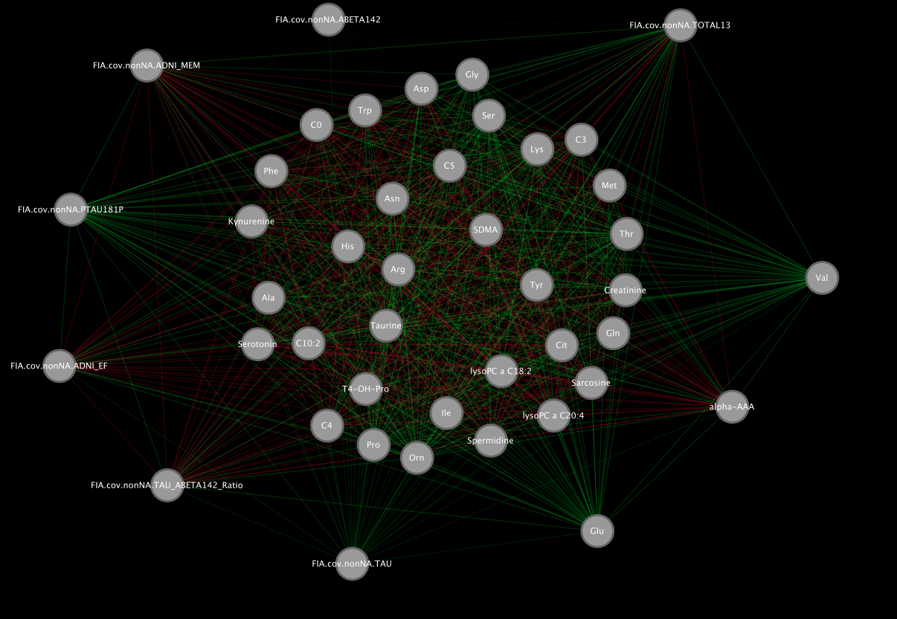
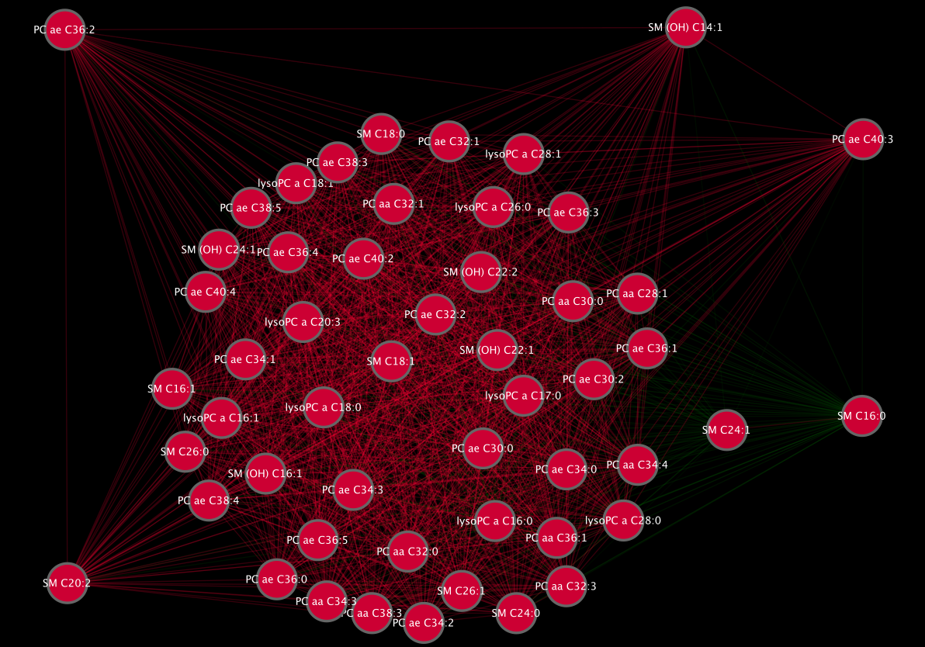
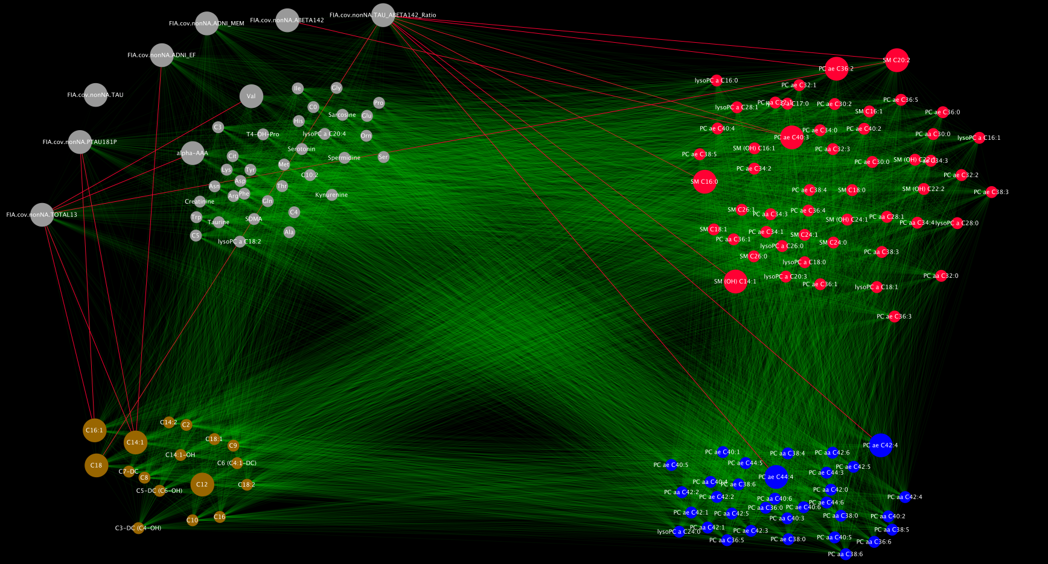

Slide 15
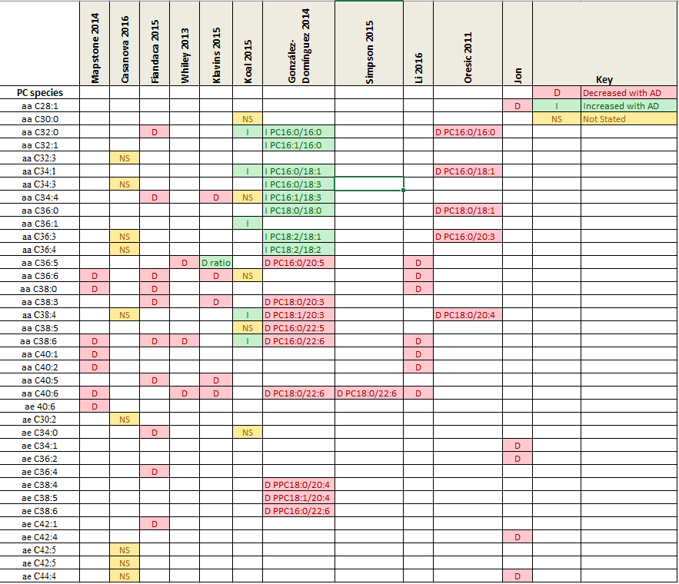
Cross studies comparisons Is metabolomics data yielding consistent findings?
PC hypothesis

Slide 16
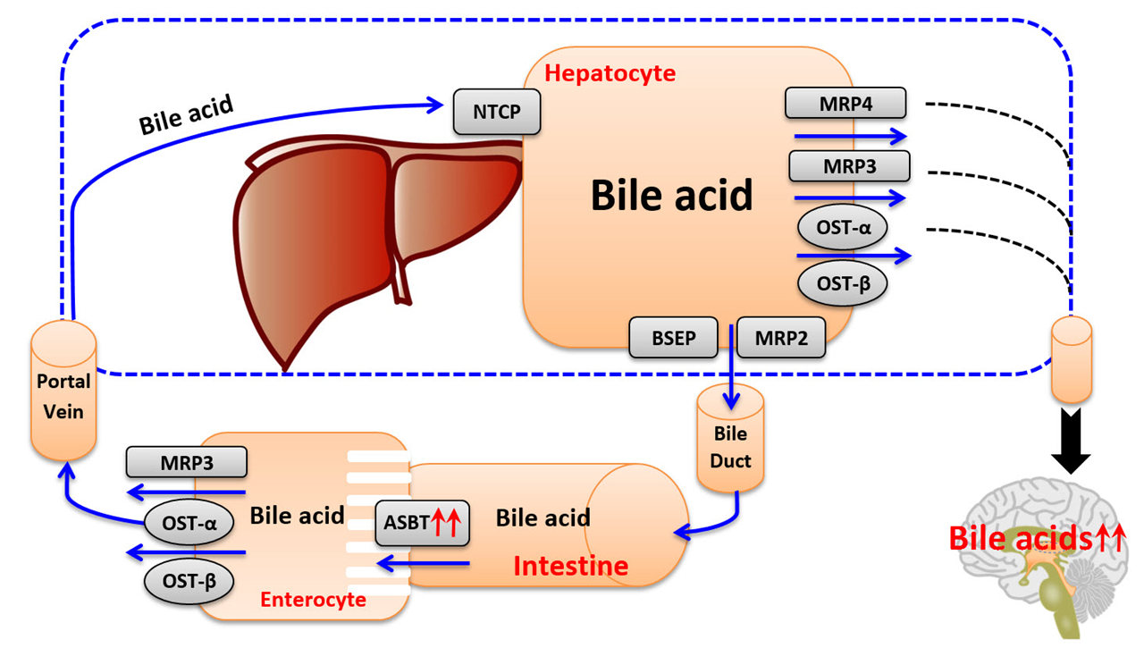
Gut Liver Brain Axis Defects in AD
A new direction for research
Neuroprotective BAs:
UDCA
GUDCA
TUDCA
Cytotoxic BAs:
DCA
LCA
T/GDCA
T/GLCA
T/GCDCA
Neuroactive BAs:
CDCA
UDCA

Slide 17
Linking Genome and Metabolome
Mapping SNPs and Genes implicated in regulating metabolic changes in AD
Several links established

Slide 18
A Special Issue in Alzheimer and Dementia Proposed
ADNI, Framingham and Rotterdam Findings and Cross Validation
6 papers being written, three will be submitted first week August

