Slide 1
Searching for better neuroimaging biomarkers for Alzheimer’s Disease
Yunglin Gazes, Ph.D.
Assistant Professor
Neurology Department

Slide 2
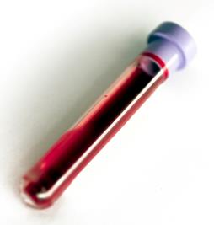
What’s a biomarker?
Definition (wikipedia):
a measurable indicator of the severity or presence of some disease state
Example:
AFP – liver tumor

Slide 3
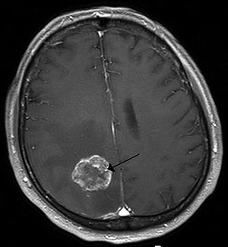
Neuroimaging biomarker
Neuroimaging:
CT (Computed tomography)
MRI (Magnetic resonance imaging)
PET (Positron emission tomography)
from wikipedia

Slide 4
What is the ideal biomarker?
clearly separates AD from non-AD
Indicates disease progression
hypothetical data for illustrative purposes

Slide 5

Hallmarks of Alzheimer’s Disease
Hyperphosphorylated Tau
dx.doi.org/10.3109/03602532.2014.882354
10.3233/JAD-190851
Amyloid Beta

Slide 6
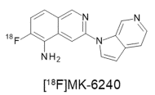
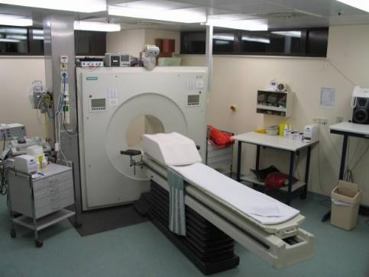


Current neuroimaging biomarkers for AD – PET
PET = Positron Emission Tomography
An example of a mildly radioactive tracer that tags a molecule of interest
wikipedia

Slide 7
Tau PET tracks disease severity
Franzmeier et al., 2020

Slide 8
Practical problems with PET imaging
PET
Requires injection of radioactive substance
PET imaging is too costly
Not early enough to predict disease onset
Magnetic Resonance Imaging (MRI)
No injections
MRI less $$ than PET
May be sensitive to early neural changes

Slide 9
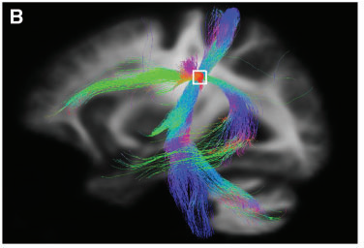
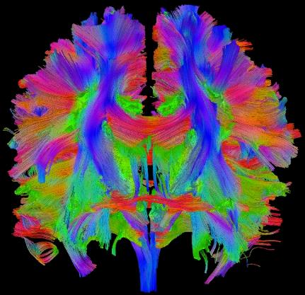
Diffusion Magnetic Resonance Imaging (dMRI)
Mito et al., 2018
https://www.cmrr.umn.edu/research/neuro-11.shtml

Slide 10
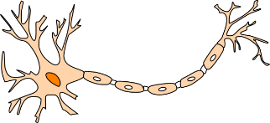
How dMRI works?
healthy axons
damaged axons
axon
a neuron

Slide 11
Fiber density and cross-sectional area (FDC) from dMRI
Mito et al., 2018

Slide 12
Can FDC from dMRI predict tau PET measures?
Axonal fiber density
(dMRI)
Study goal:
?
Tau severity
Can fiber density from dMRI detect tau pathology before it can be observed in tau PET imaging?
dMRI 6 months before Tau PET
lots of image processing

Slide 13
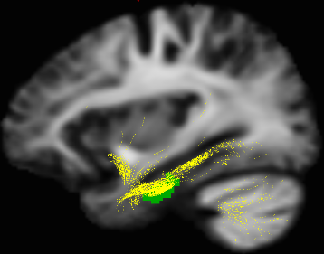
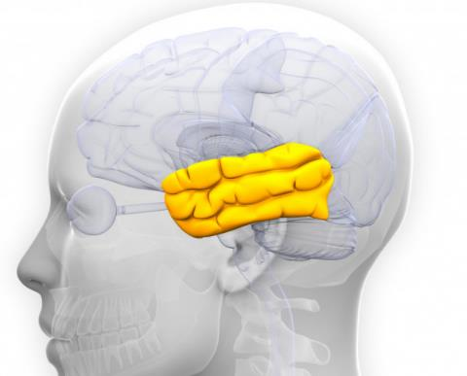
Measure tau pathology and FDC in medial temporal lobe, the area most vulnerable to Alzheimer’s disease
https://wellnessbeam.org/temporal-lobe-anatomy-functions-and-characteristics/

Slide 14
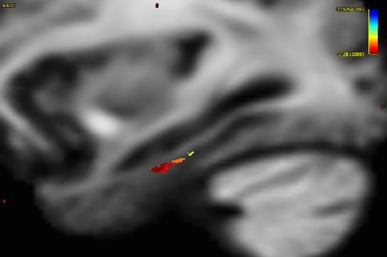
More tau pathology is associated with worse FDC.

Slide 15
More tau pathology is associated with worse FDC.
r = -.707, p=.007

Slide 16
Conclusion and future directions
FDC from dMRI has the potential to be a biomarker for tau pathology
Need more participants to confirm findings

Slide 17

Thank you!
William Kreisl, MD
Yaakov Stern, PhD
Christian Habeck, PhD
Ray Razlighi, PhD
Ashley Mensing
Linggang Luo
Christopher Langfield
Jayant Sakhardande

