Slide 1
Detecting and Diagnosing Alzheimer’s Disease

Slide 2
How is Alzheimer’s Disease Diagnosed?
Notes:
Now that we have a better understanding of how the brain changes due to Alzheimer’s disease, how would a doctor diagnose someone? There are many different tests a doctor might do to assess what the problem is.

Slide 3
How is Alzheimer’s Disease Diagnosed?
Medical history and physical exam
To understand the problem, the doctor may conduct a physical exam and ask about:
Past medical problems and current medical concerns
Medical conditions present in your family
Notes:
First, a doctor might talk to their patient about his/her medical history, any medical conditions in his/her family, and do a physical exam

Slide 4
How is Alzheimer’s Disease Diagnosed?
Mental health and cognitive status tests
Depression screening: to determine whether you have depression since depression can cause memory and thinking problems
Mental cognitive status tests: used to evaluate your memory, problem-solving skills, and other thinking skills. Some tests are very brief while others, such as a neuropsychological exam, may be a more comprehensive evaluation.
Notes:
A doctor would typically screen for other mental health issues and do cognitive testing to assess the patient’s ability to remember, think, and plan

Slide 5
How is Alzheimer’s Disease Diagnosed?
Lab Tests
Various lab tests may be conducted to assist in detecting potential causes of symptoms.
Bloodwork to rule out causes such as vitamin deficiencies or infections
Urinalysis to assess kidney function
Cerebrospinal fluid analysis via a spinal tap to analyze proteins in the CSF
Notes:
A doctor may also conduct various lab tests to rule out any other medical conditions that may have symptoms of cognitive impairment

Slide 6
How is Alzheimer’s Disease Diagnosed?
Brain Imaging
To evaluate the structure and function of the brain.
MRI to rule out other conditions that may cause similar symptoms but need a different treatment
PET scan to evaluate brain function and detect proteins in the brain
Notes:
Finally, a doctor may conduct brain imaging to get a better understanding of what the brain looks like and what changes may or may not be present. There are two common brain imaging techniques:
MRI (magnetic resonance imaging) which shows the structure of the brain. A doctor would be able to see brain shrinkage associated with Alzheimer’s disease through an MRI scan
Amyloid PET imaging, which we will talk about next

Slide 7
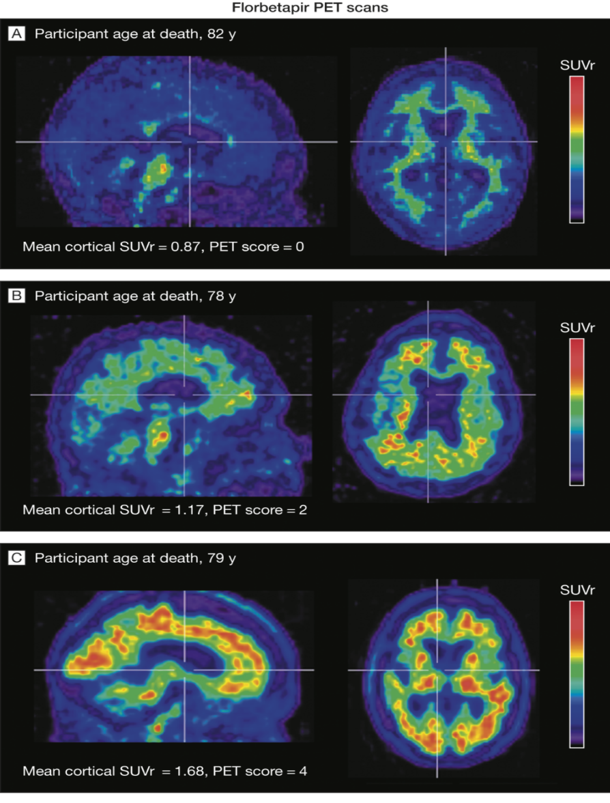
Amyloid PET Imaging
How can we image the brain?
Low Amyloid
High
Low
Sagittal view
Axial view
Positron Emission Tomography (PET)
RED = lots of amyloid beta
VIOLET = little to no amyloid beta
Intermediate Amyloid
High
Low
Sagittal view
Axial view
High Amyloid
High
Low
Sagittal view
Axial view
Adapted from: JAMA. 2011;305(3):275-283. doi:10.1001/jama.2010.2008
Notes:
Amyloid BETA PET imaging is one of the most recently developed techniques. We can use PET imaging to detect the amount of amyloid beta in the brain by injecting a compound into the bloodstream that adheres to amyloid beta and can be visualized in the brain. If you look at the diagrams, the warm red colors indicate high levels of amyloid beta while the cool blues and violet colors indicated low amounts of amyloid beta. So the top image is a brain with low amounts of amyloid while the bottom image shows high amounts. Doctors are able to diagnose probable Alzheimer’s disease based on behavioral and neuropsychological testing, but amyloid PET imaging is especially useful when someone has unexplained memory problems.

Slide 8
Test you knowledge!
In the next activity, you will examine brain scans!
Notes:
Now it’s your turn! Test your knowledge of brain scans in this next activity (can use slides or handouts)

Slide 9
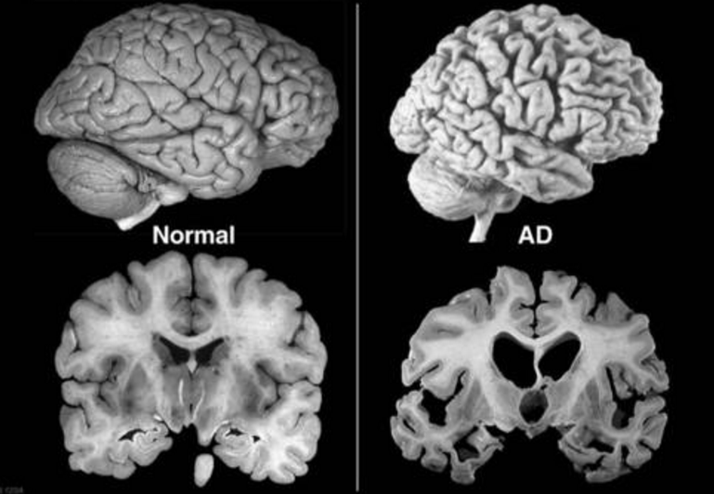
What differences can you find between the normal brain and the Alzheimer’s disease brain?
Post-mortem of human brain
Notes:
Let’s first start off by comparing an Alzheimer’s disease brain and a healthy brain. What differences do you notice? (answers on next slide)

Slide 10
Differences:
Brain atrophy/shrinkage
Ventricles (holes in center of brain which contains cerebral spinal fluid) are larger
Less white matter

Slide 11
Which image shows a positive scan for beta-amyloid? Which image shows a negative scan? How could you tell?
A
B
Beta-amyloid PET Imaging
Notes:
Now let’s look at an amyloid PET scan. Which images shows positive scan, which negative? How could you tell?

Slide 12
Answer:
A
Negative Scan
B
Positive Scan

Slide 13
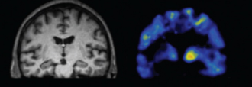
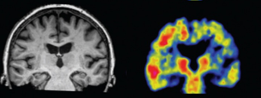
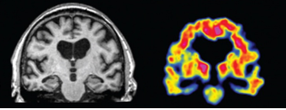
Which image shows a healthy brain?
Which images shows Alzheimer’s disease?
Which image shows Mild Cognitive Impairment? How could you tell?
A
B
C
Magnetic Resonance Imaging and Beta-amyloid PET Imaging
Notes:
Let’s look at both MRI and amyloid PET scans. Which image shows a healthy brain? Which shows an Alzheimer’s disease brain? What do you think is going on in the middle panel (choice B)?
Students will probably respond saying “something in the middle” or “early stages”. Say “Yes, this is what is called Mild Cognitive Impairment, which is when someone starts to have brain changes and some symptoms, but they are still very mild.”

Slide 14
Answer:
A
Healthy Brain
B
Mild Cognitive Impairment
C
Alzheimer’s disease

Slide 15
Which image shows Alzheimer’s disease? Which image shows Mild Cognitive Impairment? How could you tell?
A
B
Beta-amyloid PET Imaging
Notes:
This one is really tricky! Which shows Alzheimer’s and which shows mild cognitive impairment?

Slide 16
Answer:
A
Alzheimer’s disease
B
Mild Cognitive Impairment
Notes:
Although both had red indicating high amounts of amyloid beta, notice that in the top panel (AD) there is more amyloid everywhere, indicating later stages in the disease process

