Slide 1
How the Brain Works
Notes:
Today we are going to talk about the brain, which is the organ in our body that controls our thinking, feeling, decision making, movement - everything that makes us human. We will then highlight a brain disease called Alzheimer’s disease.
*slides adapted from resources from Dana Alliance: dana.org

Slide 2
Adapted from dana.org
Notes:
Frontal lobe: planning, reasoning, speech, movement, and problem-solving
Parietal lobe: processes sensory information like touch, pressure, temperature and pain; integrates with motor information
Temporal lobe: important for memory and learning, hearing, and language
Occipital lobe: visual processing center of the brain
Cerebellum: structure at the base of the brain that regulates balance and coordination. This area receives information from the eyes and muscles to detect where the body is relative to space (proprioception)
Brain Stem: regulates basic functions such as breathing, heart rate, and blood pressure

Slide 3
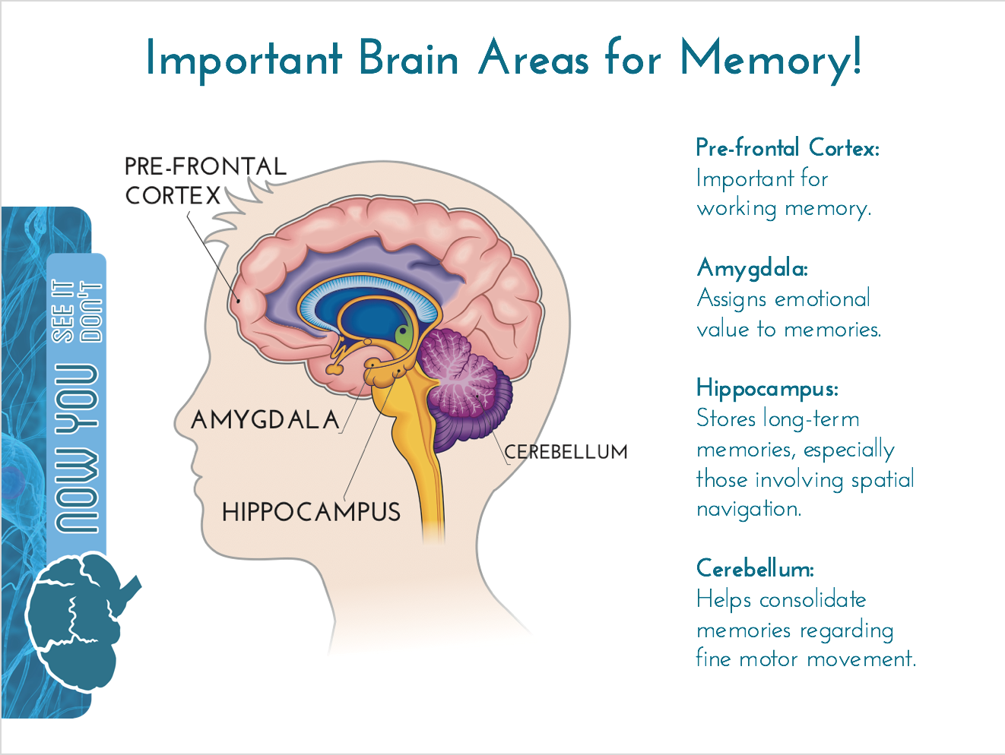
Adapted from dana.org
Notes:
Many brain regions are involved in memory, but several are more important than others. These include the pre-frontal cortex, a part of your frontal lobe that is important for working memory. This area also talks to other regions of the brain to keep specific memories in short-term memory while they wait to be discarded or consolidated into long-term memory.
The amygdala nuclei are almond-shaped regions in your temporal lobe that are important for assigning emotional value to otherwise non-threatening memories. An example is when you associate a doctor’s office with the pain and fear of getting a shot.
The hippocampus may be the most frequently discussed brain region involving memory. This sea-horse shaped area in your temporal lobe stores long-term memories and plays a very important role in spatial navigation. For instance, the hippocampus of taxi drivers who have to memorize roadmaps are more developed compared to those who do not drive taxis.
The cerebellum is at the back of your brain, and is normally associated with balance and coordination. Turns out this area is also important for remembering how to use your fine motor skills for certain activities, such as riding a bike or ice skating.

Slide 4
Adapted from dana.org
Notes:
Cell body- also known as the “soma,” the cell body contains the neuron’s nucleus and it is where a lot of proteins are synthesized. The cell body protrudes out into 2 processes- dendrites and axons.
Dendrites- small, branch-like projections on the soma that receive input signals from neighboring neurons. These signals can be excitatory, which means they make the neuron fire off an electric signal (action potential), or they can be inhibitory, which means they prevent the neuron from firing.
Axon- the long, tail-like feature of a neuron that conducts the electric signal down from the soma. The axon is usually covered in a white fatty substance called “myelin,” which helps insulate the axon to propagate the signal.
Nodes of Ranvier- gaps along the axon that are not covered in myelin. These allow the electric signal to jump from one node to another node, a process called, “saltatory conduction.”
Synaptic Terminal- the individual branches that mark the end of an axon and are where the electric signal travels to be converted to a chemical signal that gets released into the space between two neurons, called the “synapse”. This chemical signal will talk to the neighboring cell and convey an excitatory or inhibitory message.

Slide 5
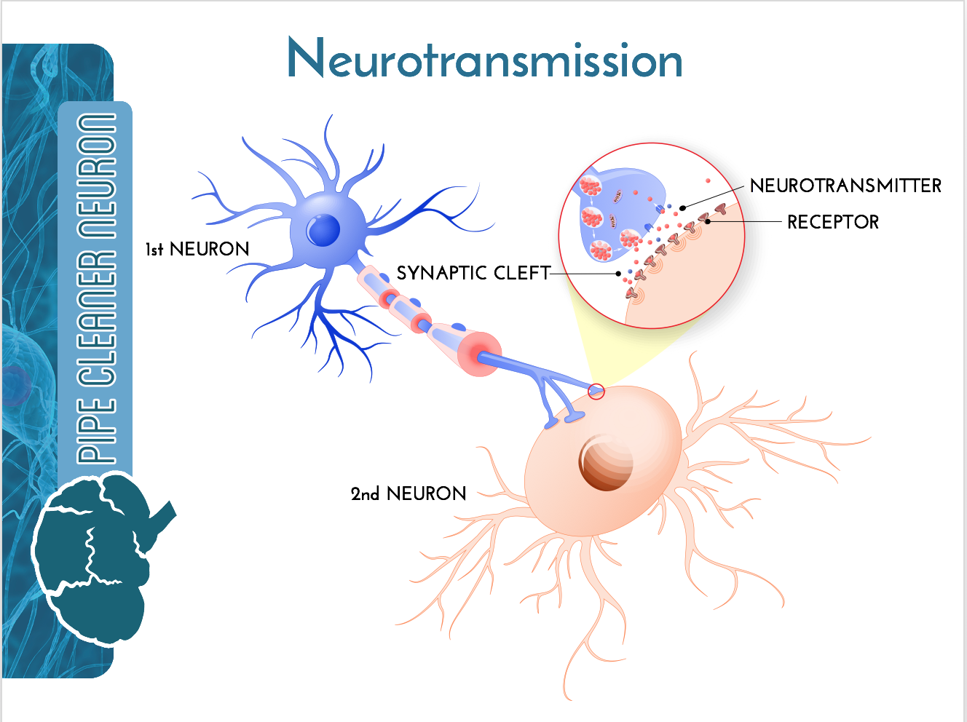
Adapted from dana.org
Notes:
Neurotransmission is the mechanism by which neurons communicate. This process requires a combination of electric and chemical signals in the cell. Communication between neurons enables us to think, read, write, speak, and dream. Pretty much everything we do relies on successful neurotransmission! The chemical signal that one neuron (pre-synaptic cell) releases into the synapse between itself and another neuron (post-synaptic cell) is called a “neurotransmitter.” Once released, the molecules of neurotransmitter will float across the synapse and bind to proteins called “post-synaptic receptors,” where they dock in a lock and key formation. This binding will lead to either excitation or inhibition of this second neuron. Excitation means an electric signal will cause the post-synaptic cell to “fire” off a signal known as an Action Potential. The signal is consequently sent down the axon to be converted into a chemical message. Inhibition means the post-synaptic cell will not fire at all. The type of neurotransmitter and the type of receptor it binds to will dictate what type of response a neuron will generate.

