Slide 1
Normal Aging or Alzheimer’s Disease?

Slide 2
What do YOU think the symptoms of Alzheimer’s disease are?
In the next activity, it will be up to you to figure out symptoms of normal aging versus the warning signs of Alzheimer’s disease
You will also have to figure out what our brain can do at different points across the human lifespan!
Notes:
Now that we have a better understanding of brain changes associated with Alzheimer’s disease, let’s figure out what the differences between normal age-related changes and Alzheimer’s disease symptoms are.

Slide 3
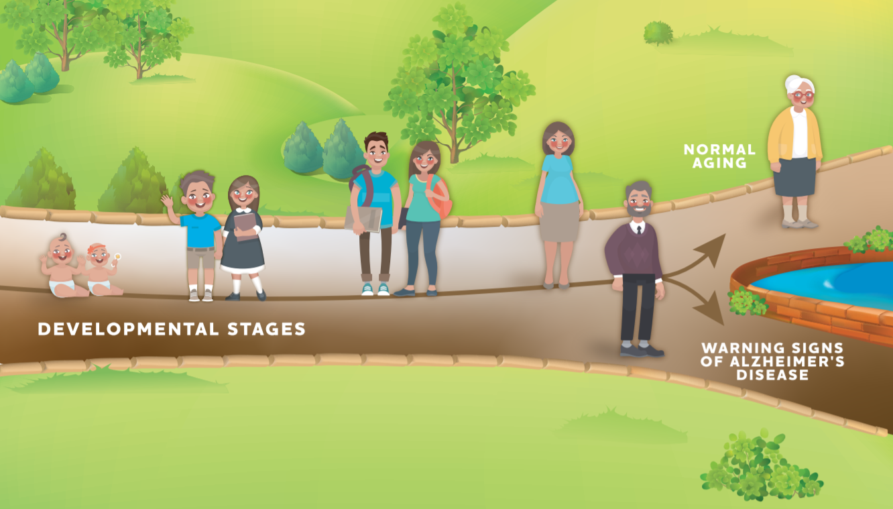
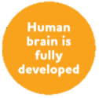
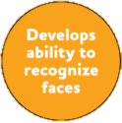
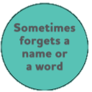
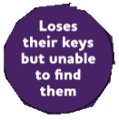
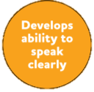
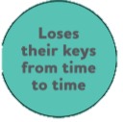
Notes:
Escape presentation and click on each text bubble to move it to the stage the students guess. Answers on next slide

Slide 4
Notes:
Correct answers. Note that students may put “poor judgement” under the teenager stage or similar guesses like “hard to have conversation” under infant. While this may not be incorrect, for the context of this activity they should be corrected. This is a great opportunity to discuss how we don’t expect teenagers to have the best judgement since their brain is still developing nor do we expect infants to be able to hold a conversation. We do expect an older adult to be able to have good judegement and hold a conversation, so that is a warning sign of something that Alzheimer’s

