Slide 1
What happens to the brain with Alzheimer’s disease?
Notes:
Alzheimer’s is a disease of the brain that causes problems with memory, thinking, and behavior. It is not a normal part of aging. Alzheimer’s gets worse over time. Although symptoms can vary widely, the first problem many people notice is forgetfulness severe enough to affect their ability to function at home or at work. The disease may cause a person to become confused, get lost in familiar places, misplace things, or have trouble with language. We are going to focus on the changes associated with Alzheimer’s disease.

Slide 2
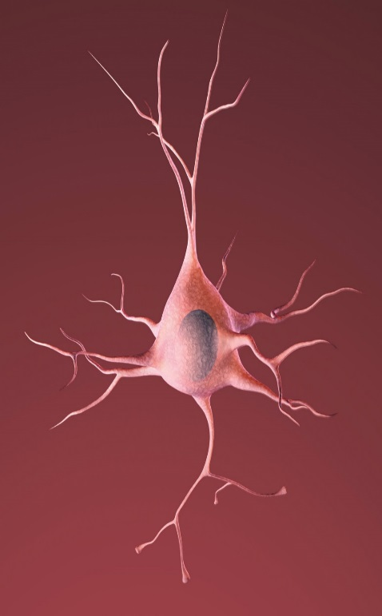
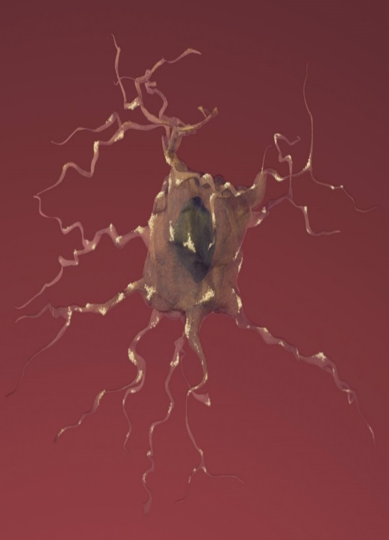
What is Alzheimer’s Disease?
What differences do you notice?
Healthy Neuron
Alzheimer’s Disease Neuron
Notes:
Here we have a depiction of a healthy neuron and a neuron from a brain with Alzheimer’s disease. What differences do you see?
Answers: different colors, AD neuron looks sick, AD neuron looks like it is dying, axons/dendrites look difference, neuron nucleus looks unhealthy in AD neuron, etc

Slide 3
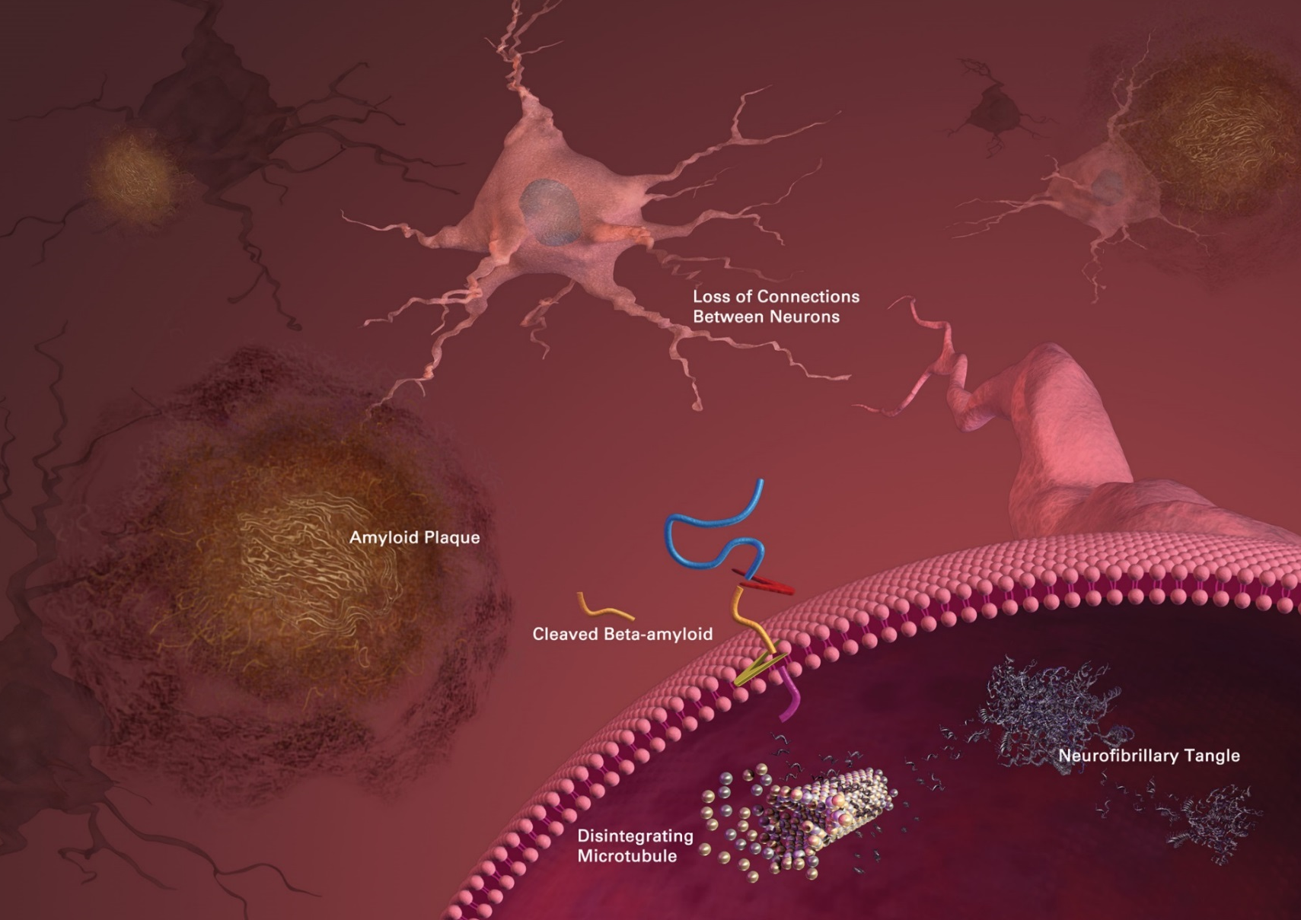
What is Alzheimer’s Disease?
Tau Tangles
Notes:
So what causes the neurons in Alzheimer’s disease to look so different and sickly? In this figure we can see neurons in the brain and the pathology, or brain changes, associated with Alzheimer's disease. There is a buildup of amyloid plaques (point to them) outside of the neurons that disrupt how the neurons communicate with each other. And then there is a buildup of another protein called tau that tangles up inside of the neuron (point to them) which disrupts normal neuron functions.

Slide 4
What is Alzheimer’s Disease?
Beta-Amyloid Plaque Formation
Formation of Tau Tangles
Loss of Connection Between Cells
Inflammation
Healthy Neuron
Alzheimer’s Disease Neuron
Notes:
When there is this buildup of beta amyloid plaques and tau tangles, we start to see a loss of connection between the neurons and inflammation in the brain that causes the neurons to go from healthy to sick. The neurons eventually start to die.

Slide 5
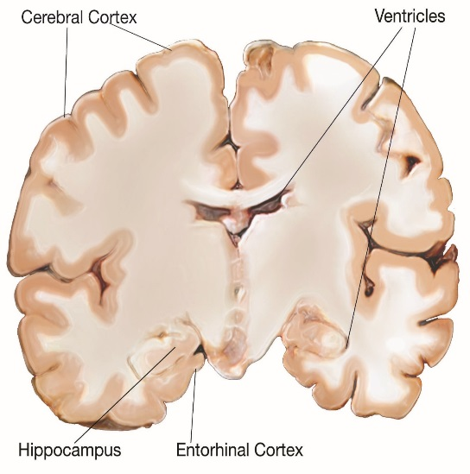
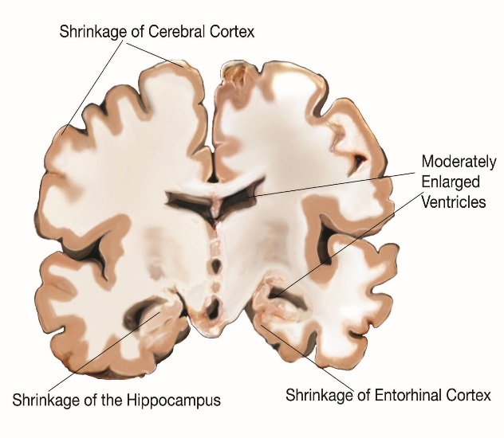
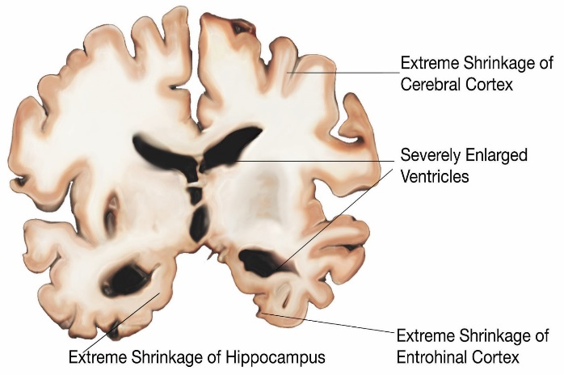
Stages of Disease Progression
What do you notice as the disease progresses?
Healthy
Mild to Moderate
Severe
Notes:
So how do these neuronal changes translate into the symptoms we associate with Alzheimer’s disease? We know there are billions of neurons that make up the brain, so let’s explore how the Alzheimer’s disease pathology causes widespread damage in the brain. This figure depicts a slice of the brain if you were looking at it from the front. What changes do you notice as the disease progresses?
Answers: more black areas (which represents loss of tissue), brain is getting smaller, more “holes”, spaces are getting bigger, etc
Correct! As more neurons start to die because of Alzheimer’s disease, the brain starts to shrink. As the areas in our brain important for memory and cognition start to get sick and shrink, we start to see impairment in memory and cognition.

